Slide 1
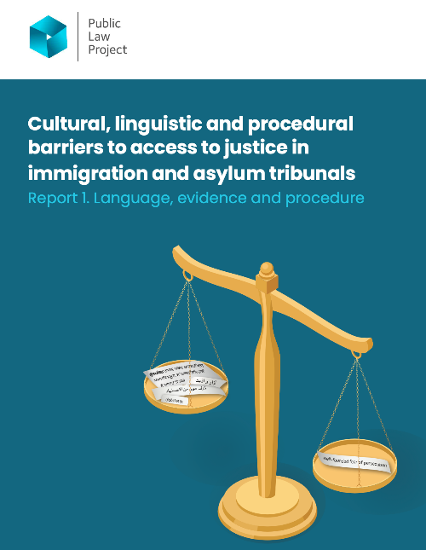
Report Findings
Selbi Durdiyeva
1 July 2026

Slide 2
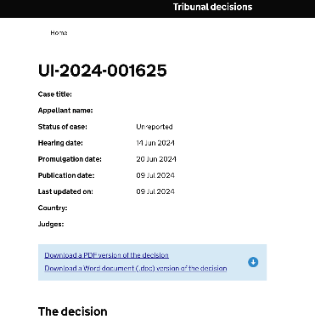
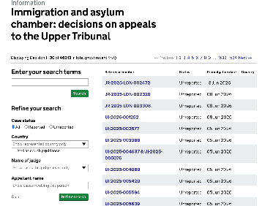
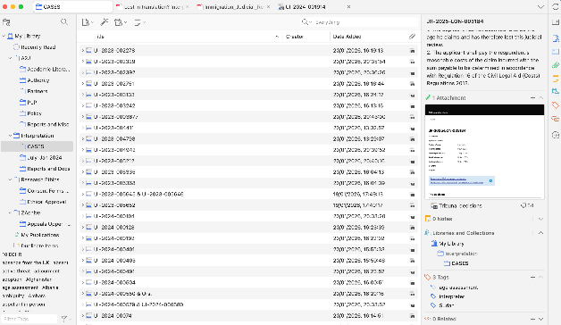
(The How?) Method:
271 Upper Tribunal (IAC) Decisions
7 semi-structured interviews
6 hearing observations

Slide 3
Why culturally sensitivity and awareness matter?
Materially alters the outcomes of the case;
Affects credibility findings;
Affects ability to understand and engage with country and other expert reports and guidance;
Expectations around:
  Evidence;
  Behaviour;
  Documents and their formats;
  Forms of relationships;
  Expression (e.g., the degree of openness);
  Medical evidence;
Affects applicant’s ability to participate and engage;
Assumptions, bias and discrimination;
Empathy;
Procedural fairness.

Slide 4
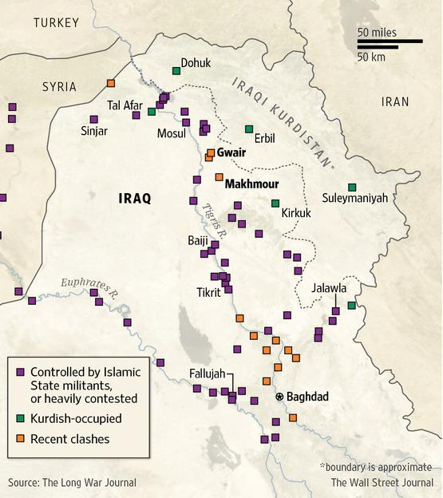
Example:
The UT judge:
  ‘The fact that the Appellant and his documents interchangeably used the words ‘Erbil’ and ‘Makhmour’ was, for him, possibly as meaningless as someone saying in one place that they were born in ‘Camden’ and another in ‘London’.’
  ‘the decision maker did not explore innocent explanations’
  ‘indeed indicative of a “closed mind”’
UI-2023-001986

Slide 5
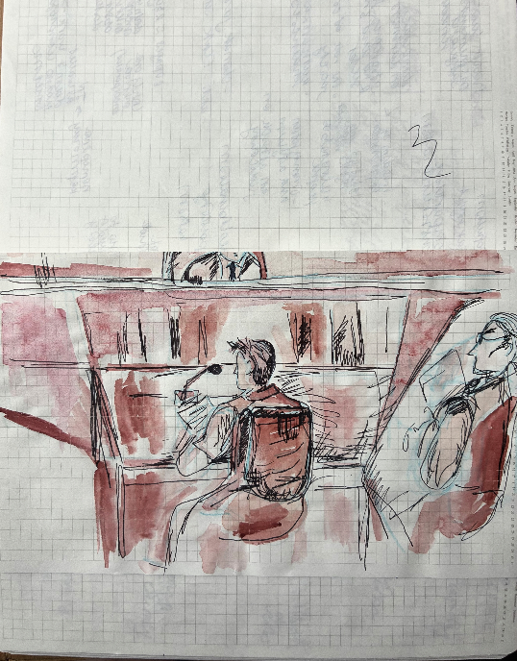
Observation Notes
Interpretation
Litigants-in-person
Tribunal ethos/culture: hearing management
Multiple references to cultural understanding

Slide 6

Recommendations
I. Language and Dialect Interpretation
  Case briefings before hearings for interpreters.
  Judicial check-ins on interpretation during proceedings (not only at the beginning).
  Recognise the risk of misunderstanding in interpreted evidence.
  Proactive identification and correction of interpretation errors (for legal representatives).
  Clarify interpreters' roles through guidance and training (not requesting to summarise).
  Monitor interpretation services and interpreter working conditions.
II. Understanding Context
  Improve engagement with country evidence submitted by parties.
  Strengthen guidance on documentary evidence and cultural bias.
  Provide clear reasons when accepting or rejecting evidence.
  Improve the quality of evidence provided by all parties.
  Recognise lived experience alongside professional expertise.
  Ensure age assessments are trauma-informed and centred on children's welfare.
III. Representation, Participation and Procedural Fairness
  Increase support for unrepresented applicants.
  Reinforce minimum standards for legal representation.
  Recognise care as central to procedural fairness.
  Improve access to legal aid and referral pathways.
  Recognise that lack of representation can create procedural and evidential disadvantages, particularly in culturally and linguistically sensitive cases.
HMCTS, Home Office, MoJ, Judicial College

Slide 7
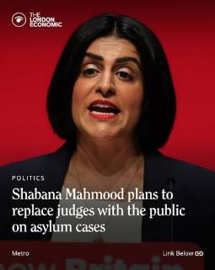
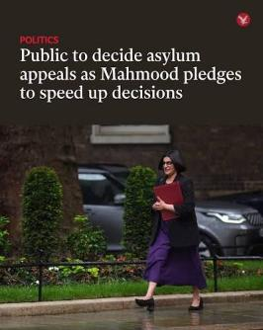
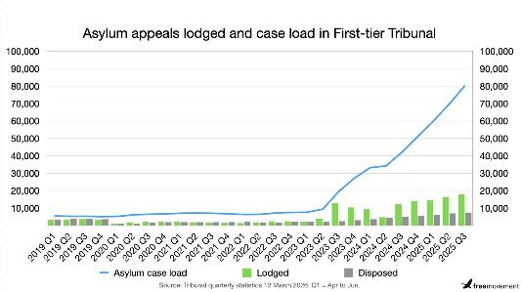
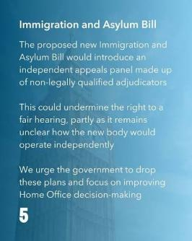
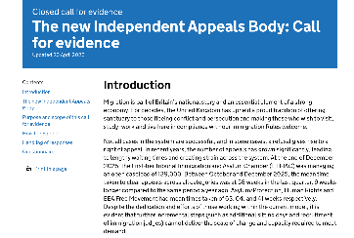
Policy Relevance

Slide 8
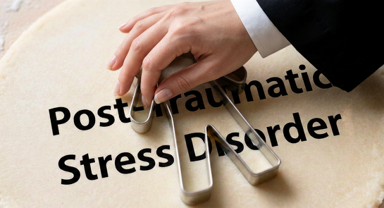
Report 2: Forthcoming
Report 2 – Identity, Relationships, and Vulnerability
Family and/or private life
LGBTQ+ identity
Mental health, trauma, and vulnerability
*Image generated in Canva

Slide 9

Thank you!!!
Research participants:
  Interpreters (3);
  Legal representatives (3);
  Intermediary (1);
Idea support:
  Arienne Griffith;
  Vic Pogge von Strandmann;
  Rebecca Hacker;
  Rakesh Singh;
Research Design:
  Arienne Griffith;
  Joe Tomlinson;
  Caroline Selman;
  Lauren Fox;
Recruitment:
  Rebecca Hacker;
  Ade Lukes;
  Rachel Francis;
Revision and feedback:
  Arienne Griffith;
  Rebecca Hacker;
  Lauren Fox;
Dissemination:
  Arienne Griffith;
  Sue Wixley;
  Ade Lukes;
  Nicole Chen;
  Rebecca Hacker;
  Sarah Haines;
  Ally Azua;
  Lee Marsons;
  Lauren Agnew;
  Rachel Knowles;
  Lauren Fox;
  Jenny Rayner;
  Jasmine Quiller-Doust;
  Joe Tomlinson;
  Natalie Byrom ;

