Slide 1

culture and language in asylum appeals:
The sea we are all swimming in
Rebecca Hacker
Solicitor - Public Law Project
7th July 2026

Slide 2

Culture as the key
Potential to ‘unlock’ a client’s case in different respects -
Client care
Tribunal hearings
Legal arguments

Slide 3
Client care
Culture is:
Broad
Not a monolith
Not static
Living, not an object
Often implicit
Client care requires:
Awareness
Cultural humility
Curiosity
Research
A proactive approach

Slide 4
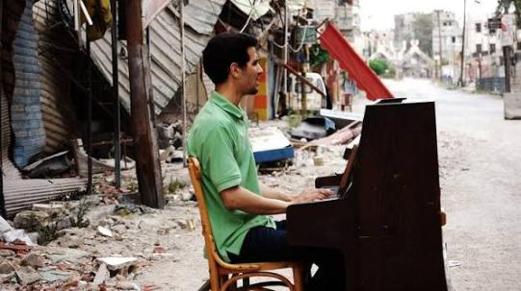
Example: Culture in exile
Notes:
The “Pianist of Yarmouk” – in Al Yarmouk, a refugee camp for Palestinian refugees established in Damascus in 1957.

Slide 5
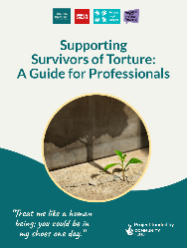
Client care (cont’d)
Being culturally attuned is part of trauma-informed practice
Trauma Treatment International’s 2026 guide to supporting survivors of torture makes key recommendations including:
Research relevant cultural, political, and social contexts
2) Remain open to learning new information from the person
3) Recognise collective trauma and systemic oppression (e.g. history of racial oppression) and remain sensitive about what institutions may represent to a survivor
Notes:
Trauma International guide: https://www.refugeewomen.co.uk/wp-content/uploads/2026/06/Supporting-Survivors-of-Torture-A-Guide-for-Professionals.pdf

Slide 6

At the Tribunal
Legal culture and language are not neutral
Acknowledge and discuss with clients
Take steps to ensure meaningful participation in hearing – not just attendance
  Own interpreter
  Intermediary
  Ground rules
  Friend / support worker
Notes:
Image from: http://ifsw.org/social-work-action/climate-justice-program/

Slide 7

Example: Client’s appeal
Intermediary appointed to attend client appointments and hearing
Ground Rules Hearing
Ground Rules ordered in advance
First names only
Judge seated on same level
Access to aromatherapy oils, fidget toys
Permission to stand, sway, tap
Permission to leave the room if needed
No oral cross-examination
Notes:
HMCTS Guidance, HMCTS Intermediary Services: https://www.gov.uk/guidance/hmcts-intermediary-services
Intermediaries are communication specialists who work on behalf of HMCTS to support people participating in a court or tribunal hearing. They provide impartial recommendations to HMCTS about a person’s specific communication needs and outline the steps needed to achieve them.

Slide 8
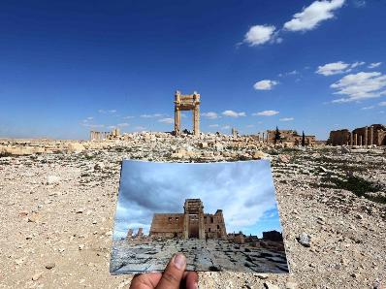
Legal arguments: 1951 Refugee Convention
Persecution: destruction of cultural heritage – criminalized under the Rome Statute
Continued risk: cultural norms relating to shame and attribution of moral responsibility
Climate impacts: for some communities, destruction of natural environment and culture go hand in hand
Notes:
Palmyra, Syria, after destruction by Daesh (2015 – 2017)
https://www.independent.co.uk/news/world/middle-east/palmyra-syria-photos-new-palmyra-photos-show-devastation-of-artefacts-ruined-by-isis-a6964766.html

Slide 9
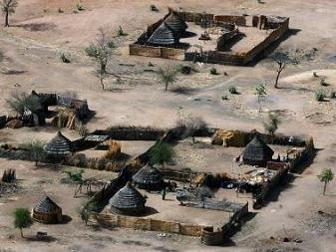
Example: Darfur
Looting of museums: loss of tangible cultural heritage
Burning of ancestral villages and farmlands: destruction of traditional mudbrick architecture, generational granaries, and communal spaces
Fracturing of intangible heritage: Forced displacement of non-Arab Darfuris has uprooted and threatened the continuity of oral histories, languages, traditional farming customs and way of life
Pattern of genocide
Notes:
Palmyra, Syria, after destruction by Daesh (2015 – 2017)
https://www.independent.co.uk/news/world/middle-east/palmyra-syria-photos-new-palmyra-photos-show-devastation-of-artefacts-ruined-by-isis-a6964766.html

Slide 10

Thank you!
Email: r.hacker@publiclawproject.org.uk

