Slide 1

Life jackets and hard hats
Appellant and representative experiences in the F-tier Tribunal

Slide 2

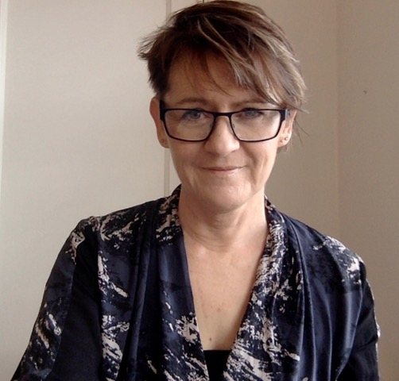


Presenter
Shirley Hayes
NDCS subject specialist
Disability Benefits and SEND Appeals

Slide 3




Presentation overview
1
The appellant – what’s at stake?
2
The Tribunal rules - why they matter
3
DWP and LA practices
4
The resilient representative
5
Summary
6
Sources and recommendations

Slide 4
You have been a life jacket when I've felt like I am drowning. You've answered every question (even though I questioned absolutely everything) and explained every step. You stood up for what was right ….. alone I would have gone insane!!
Parent - section B,F,I SEND appeal

Slide 5
Without your help and the help of others, I know she wouldn't be where she is now. It is hard work for all of us, and as this situation showed, sometimes it feels like I don't have the strength to keep fighting for what is right and what should be normal for her and all.
Parent of young person – Post 16 section I SEND appeal

Slide 6
Our appreciation for Alex and her team is beyond words. They didn’t just help us win a case – they helped us reclaim our voice.
Parent - DLA appeal represented pro bono by Cooley LLP

Slide 7
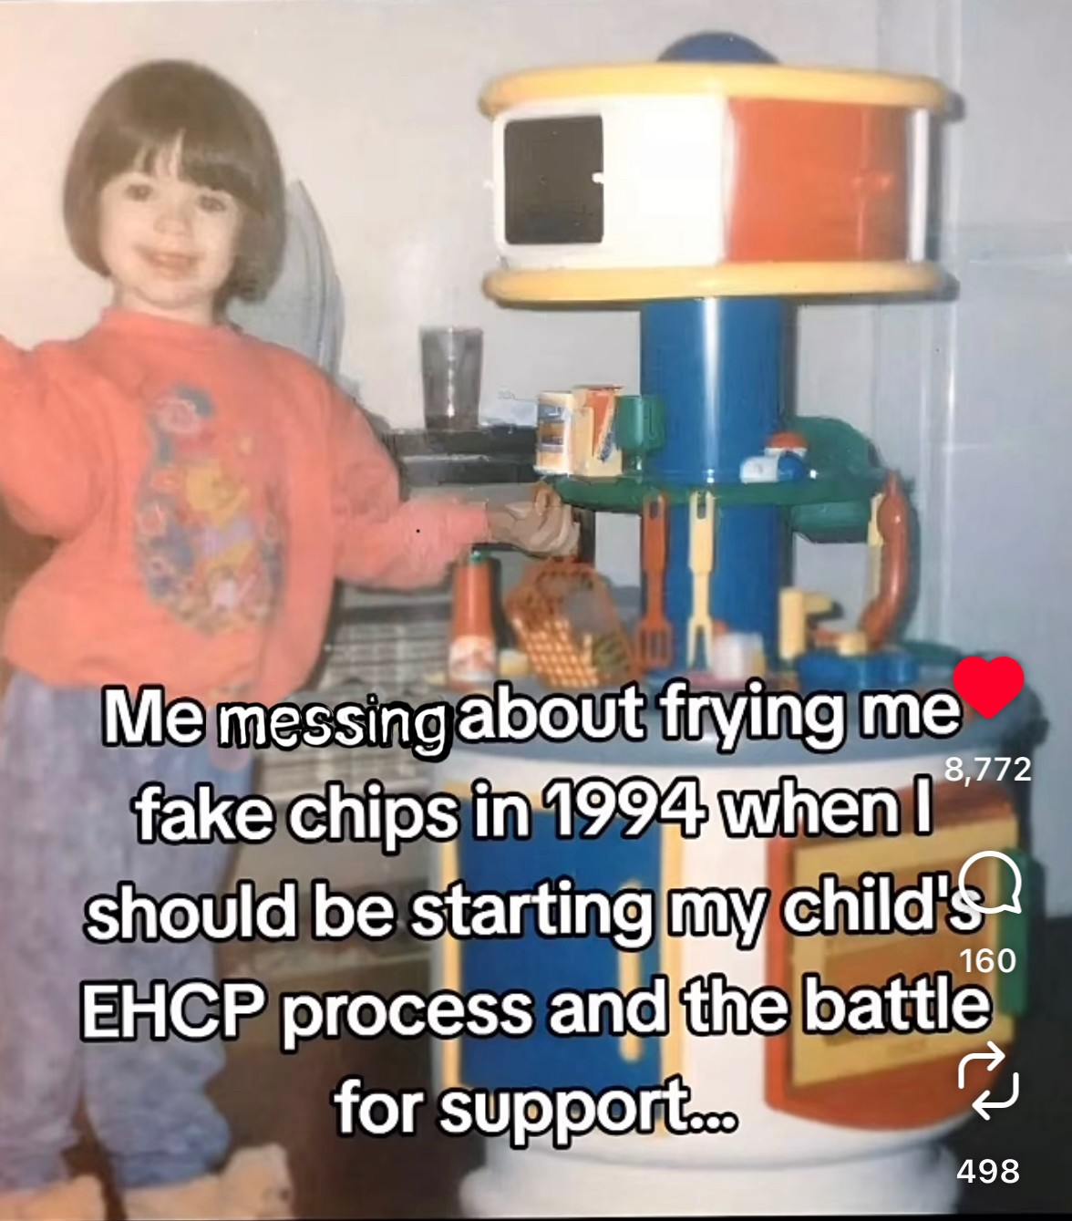
A parent uses social media to express their feelings about the SEND system

Slide 8
The Tribunal rules
2.—(1) The overriding objective of these Rules is to enable the Tribunal to deal with cases fairly and justly.
(2) Dealing with a case fairly and justly includes—
(b) avoiding unnecessary formality and seeking flexibility in the proceedings;
(e) avoiding delay, so far as compatible with proper consideration of the issues
(4) Parties must—
(a)help the Tribunal to further the overriding objective; and
(b)co-operate with the Tribunal generally.

Slide 9
DWP/LA practices
1) Systemic issues – long delays
2) DWP – mandatory reconsideration notices issued later than outcome
3) LA – variation in approaches to appeals casework

Slide 10

The resilient representative

Slide 11
The Tribunal rules
11.—(1) A party may appoint a representative (whether a legal representative or not) to represent that party in the proceedings.

Slide 12
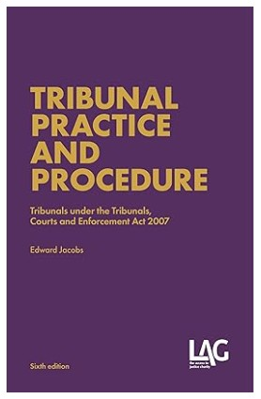
Tribunal practice

Slide 13
The increased case management and legalism among the judiciary and the demand for greater involvement by representatives have yet to be reconciled in theory and practice, with the traditional enabling and inquisitorial approaches of some tribunals.
TRIBUNAL PRACTICE AND PROCEDURE – Edward Jacobs [Introduction para 1.98]

Slide 14
Summary
5

Slide 15
Sources/recommendations
The Tribunal Procedure (First-tier Tribunal) (Social Entitlement Chamber) Rules 2008
https://www.legislation.gov.uk/uksi/2008/2685/contents
The Tribunal Procedure (First-tier Tribunal) (Health, Education and Social Care Chamber) Rules 2008
https://www.legislation.gov.uk/uksi/2008/2699/contents
TRIBUNAL PRACTICE AND PROCEDURE (6th Edition) - Edward Jacobs (LAG books)
https://www.lag.org.uk/
CHILD POVERTY ACTION GROUP https://cpag.org.uk/
IPSEA https://www.ipsea.org.uk/
Disability Rights UK https://www.disabilityrightsuk.org/
Benefits and Work https://www.benefitsandwork.co.uk/
The Benefits Training Co. https://www.benefitstraining.co.uk/

Slide 16
For every deaf child, with any level of hearing loss
Freephone Helpline 0808 800 8880
helpline@ndcs.org.uk
ndcs.org.uk
The National Deaf Children’s Society is a registered charity in England and Wales no. 1016532 and in Scotland no. SC040779.

