Slide 1
Introduction to Tribunal Representation
in the Social Security Tribunal
Public Law Project | Tribunal Advocacy | Procedure | Bundles | AI
Presented by Emma Baldwin and Brandi Amiss-Towler
Free Representation Unit

Slide 2
Overview
How cases come before the Tribunal
Case Management
Relevant Evidence
Procedure Rules and the Hearing
AI in the Tribunal

Slide 3
SOCIAL SECURITY LAW: FIVE DISTINCTIVE FEATURES
PURPOSE: to provide a basic standard of living for the inhabitants of the United Kingdom, to “guard against the eventualities which make it difficult for people to be self-sufficient” (Hinchy v Secretary of State for Work and Pensions [2005] WLR 967 (HL), Baroness Hale at [48]).
A CLAIM-BASED AND RULE-BASED SYSTEM: entitlement to benefit depends on making a claim (s.1 Social Security Administration Act 1992), and a claimant will only then qualify for benefit if they fulfil the relevant statutory criteria.
COMPLEXITY : “In the field of social security, primary and secondary legislation are notoriously labyrinthine.” – SSWP v Borrowdale & Morina [2007] EWCA Civ 749 at [1], per Kay LJ.
A DECISION-BASED SYSTEM: benefits are awarded or refused by a formal, identifiable decision.
INVESTIGATORY, NON-ADVERSARIAL AND ENABLING PROCEDURES: “A [claim for benefit] requires investigation to determine whether any, and if so, what amount of benefit is payable out of the fund. In such an investigation, the Minister or the insurance officer is not a party adverse to the claimant. If analogy be sought in the other branches of the law, it is to be found in an inquest rather than in an action.” – Kerr v Department for Social Development [2004] 4 All ER 385 (HL), Baroness Hale at [61].

Slide 4

Lifecycle of a claim

Slide 5
OVERVIEW: FROM THE INITIAL CLAIM TO THE TRIBUNAL
1. Making a claim
I(a). Collect evidence – e.g. Medical assessment (PIP & Work Capability Assessment)
II. Making a decision on a claim
III. “Mandatory reconsideration” *
IV. Appeal to the First-tier Tribunal
V. First-tier Tribunal hearing
* Except for income-related ESA – R(Connor) v SSWP [2020] EWHC 1999 (Admin)
Notes:
Broadly take this talk in seven parts: the six stages of the life cycle of a claim for benefits set out on screen (of course, not every claimant goes all the way to a first-tier tribunal hearing), before (very) briefly talking about social security law and where to find it.
I would recommend annotating or reading the copy of the FRU training pack – this talk starts at page 8.

Slide 6
Making a decision on a claim: core principles
WHO?
Decisions are made by the DWP on behalf of the Secretary of State under the Carltona principle. (Carltona v Commissioner for Works [1943] 2 All ER 560 (CA))
HOW?
Entitlement is determined by applying the correct legal test to the facts.
FORMALITY
Benefit decisions must be formal and identifiable decisions.
DATE
Entitlement is assessed by reference to the claimant’s circumstances at the relevant date. (Social Security Act,s.8(2)(b))
FINALITY
Once made, a decision is final unless revised, superseded or successfully appealed. (Social Security Act 1998, s17(1)).
Date
Later evidence may be considered if it sheds light on the claimant’s position at that time. (Social Security Act, s.12(8)(b))
ADVOCACY POINT​
Always ask:​
What is the decision under appeal? ​
What was happening at the relevant time? ​
Does the evidence relate back?​

Slide 7
APPEAL TO THE FIRST-TIER TRIBUNAL: THE ROLE OF THE TRIBUNAL
The Tribunal’s Focus​
Identifying the real issues in dispute
Testing the evidence ​
Applying the statutory test fairly and lawfully ​
The Representative’s Role​
Gather and present relevant evidence ​
Assist the Tribunal to identify the key issues ​
Clarify and contextualise the evidence ​
Ensure the claimant can participate fully
Advocacy Point
Good tribunal advocacy narrows and clarifies the dispute.

Slide 8






Case Management in the Tribunal

Slide 9
The Bundle
Brief Facts
SSWP/HMRC Submissions
Index
Application for Appeal
Claim form(s), medical assessment(s), further evidence

Slide 10
Evidence and the Bundle
What Evidence Matters?
The key issue is relevance and probative value.
Ask:
Does it relate to the legal test?
Does it relate to the relevant period?
Does it assist the Tribunal on a disputed issue?
Working with the Bundle
Use the chronology and index
Identify:
factual assertions,
medical evidence,
witness evidence,
and the Secretary of State’s reasoning
Spot missing or inconsistent evidence

Slide 11
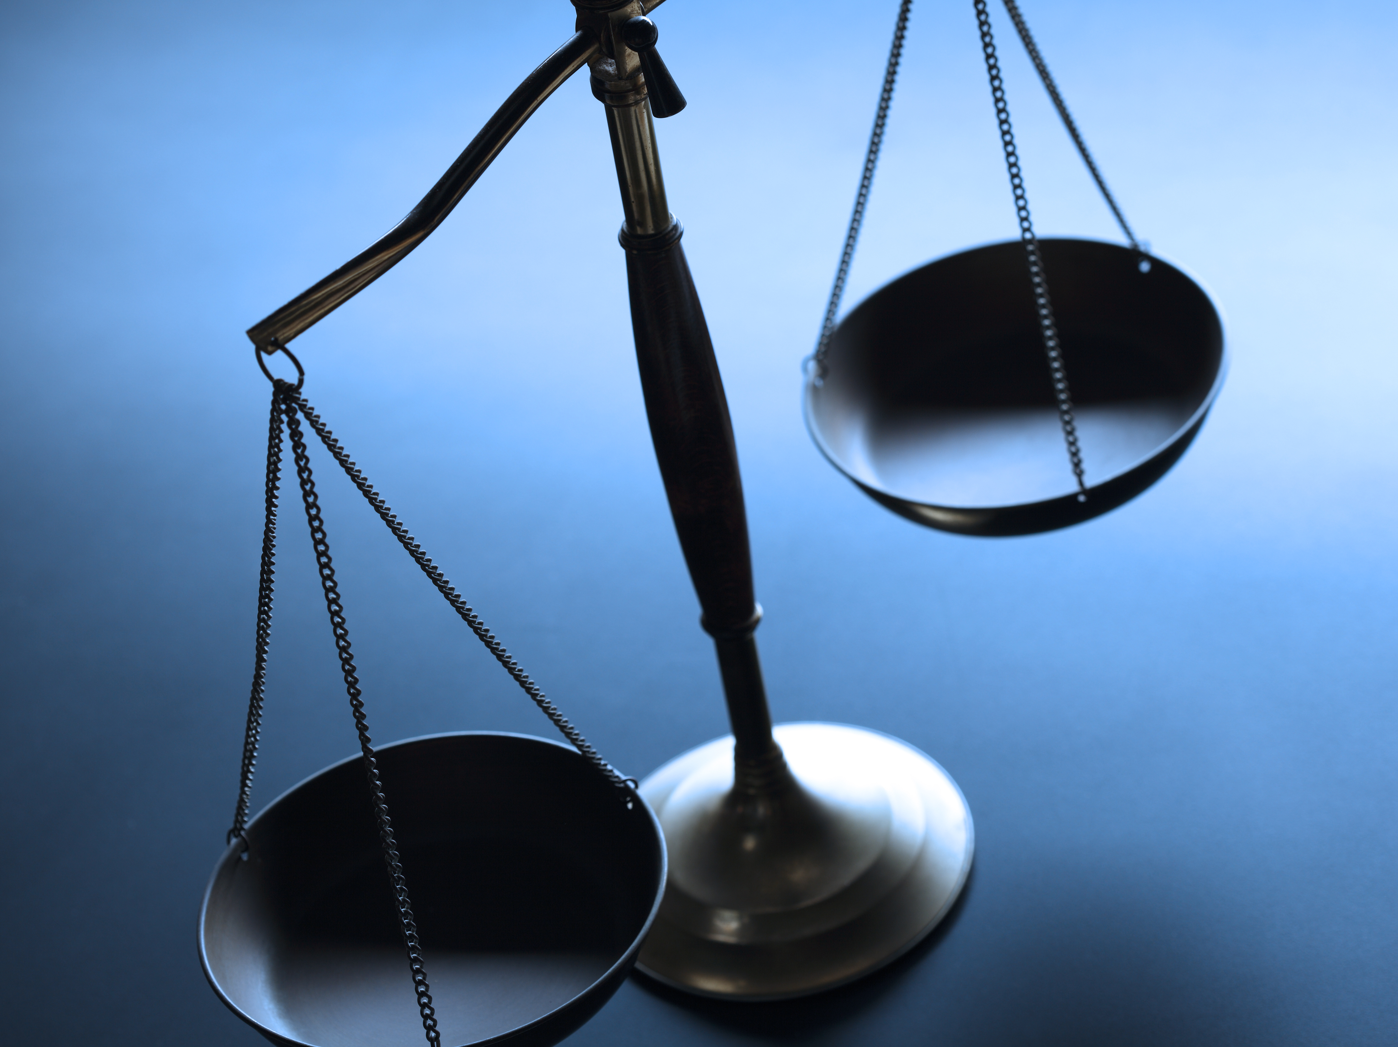
Advocacy in the Tribunal

Slide 12
Written submissions
Keep these brief as the tribunal already has a lot of written evidence in front of them
These are to clarify the issues for the tribunal – what is in dispute and what is agreed
Make important points
Potential to add any further evidence e.g. specialist hospital letters

Slide 13
Oral advocacy in the tribunal
The Tribunal Will Usually Lead
Tribunal advocacy is collaborative and inquisitorial rather than adversarial.
The Advocate’s Role
Assist the Tribunal to identify the real issues
Connect evidence directly to the legal tests
Clarify omissions, misunderstandings or inconsistencies
Ensure the claimant has had a fair opportunity to present their case
Practical Tips
Prepare a prompt sheet
Track oral evidence carefully
Avoid repetition
Be prepared to summarise the case succinctly
Advocacy Point ​
​Good tribunal advocacy narrows and clarifies the dispute.

Slide 14
Tribunal panels
PIP / DLA / AA
• Judge
• Doctor
• Disability Qualified Member
ESA / UC / IIDB
• Judge
• Medical Member
Other Benefits
Judge Alone or with another specialist member

Slide 15
Procedural Rules and Case Management
Key Rules
Rule 2 – overriding objective
Rule 5 – case management powers
Rule 6 – review
Rule 7 – procedural failures
Rule 15 – evidence and issues
Procedural Applications
When seeking:
adjournments,
extensions,
or late evidence,
Consider:
Added benefit,
Causes of delay,
and the Effects of delay (“ABCDE”).
Advocacy Point
The Tribunal has a wide range of case management powers to manage cases fairly and justly.

Slide 16

AI in the Tribunal

Slide 17

Ethical Considerations
Maintaining confidentiality
Responsibility for inaccuracies
ai generated evidence and claim forms

Slide 18
Risks
AI may generate plausible but inaccurate legal arguments​
Always trace arguments back to primary authority​
Advocacy depends on accurate legal analysis​
Damage to reputation and credibility

Slide 19
Using AI in Tribunal Practice
Be transparent about any use of AI, particularly AI generated submissions
Always verify authorities and quotations
Exercising professional judgment

Slide 20

Questions?

