Slide 1
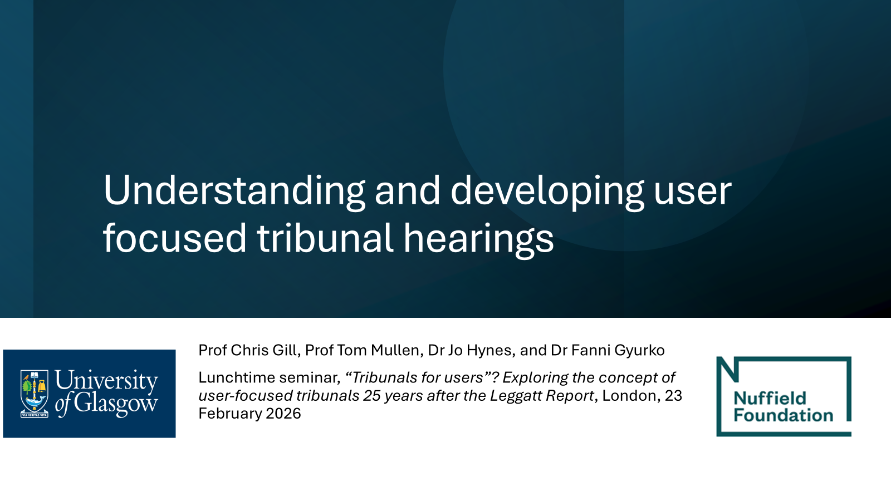
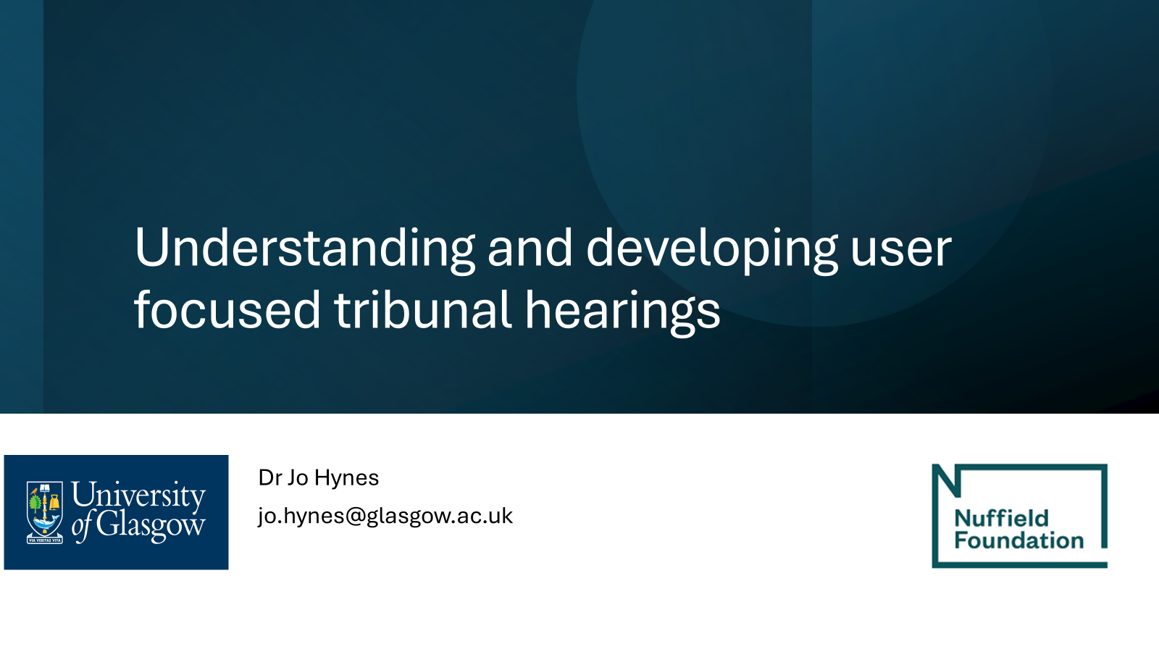

Slide 2
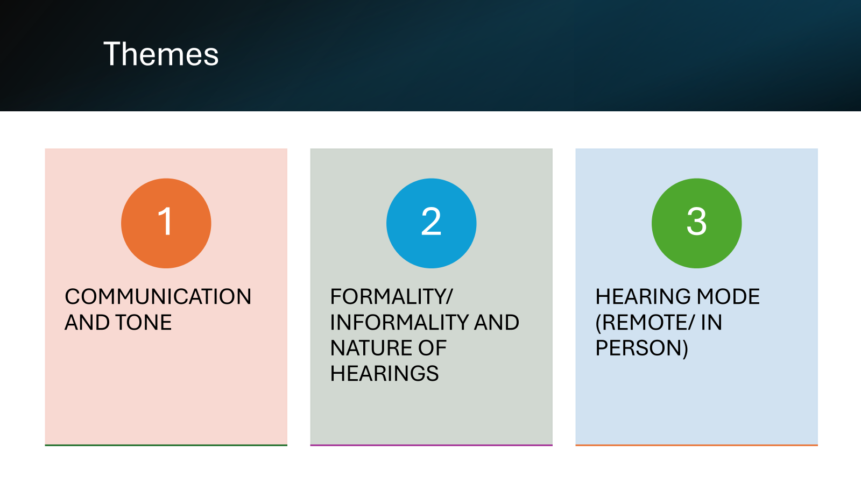

Slide 3
COMMUNICATION AND TONE
Enabling atmosphere.
Introductions and orientation/ signposting.
Dealing with heightened emotions sensitively.

Slide 4
Communication and tone
FORMALITY/ INFORMALITY AND NATURE OF HEARINGS
Inquisitorial versus adversarial approach.
Being mindful of technical language use (as well as legalistic).

Slide 5
Communication and tone
HEARING MODE (REMOTE/ IN-PERSON)
Telephone hearings present the most challenges.
User preference?
Tribunal hearings in court buildings.

