Slide 1


Making lawful decisions:
Complying with the Equality Act 2010
Helen Flynn
Head of Programmes and Partnerships
23 April 2026

Slide 2

Action Time
Just Fair
A UK civil society organisation that works to achieve lasting, positive change through the promotion and protection of economic, social and cultural rights (ESCR)
    ESCR are rights of everyday life, including the rights to housing, food and health
Our vision is for a fairer, more just society where everyone can live with dignity
Our mission is to lead and inspire action so that ESCR are respected, protected, and fulfilled across the UK
The hub for ESCR in the UK

Slide 3
Action Time
Equality Act 2010
Why compliance matters
Compliance as a floor not a ceiling
Equality Act as a tool for duty bearers to use for positive outcomes
Learning on effective implementation

Slide 4
Action Time
Why compliance matters
“…equal treatment can in effect lead to inequality, while unequal treatment might be necessary in order to achieve equality.”
Sandra Fredman

Slide 5
Action Time
Compliance as a floor not a ceiling
Report by Compassion in Politics Assessment of government Equality Impact Assessments 2010-2021 (April 2022)
34% of EIAs record that at least one protected characteristic will be negatively affected by a policy.
On average an EIA is published 197 days (approximately 7 months) after the policy was first announced.
More than a third of respondents (36%) who have been engaged in the work of creating EIAs stated that the EIA process is “not taken seriously at all” by government ministers and 26% said “not very seriously”.
More than half (58%) said the result of an EIA had never, to their knowledge, changed a proposed government policy.
The same proportion said they have on at least one occasion been asked to write an EIA for a policy that had already been signed-off.

Slide 6
Action Time
Equality Act as a tool
Improving outcomes for people with experience of inequality.
Supporting cross organisational and cross departmental working.
Raising awareness of inequalities within organisations and among partners.
Ensuring widespread organisational commitment to, and consideration of inequalities.
Supporting the participation of people with experience of inequality in decisions that affect them
Achieving greater consistency in practice - and an increased likelihood of maintaining such consistent practice across political administrations and between changes of individual leadership and turnover of staff.
Improving systematic approaches to equality impact assessments and assessment of policy and practice more broadly.
Strengthening systematic data gathering and analysis, especially in the conduct of equality impact assessments, thereby strengthening accountability.
Supporting the effective and efficient allocation of resources.

Slide 7
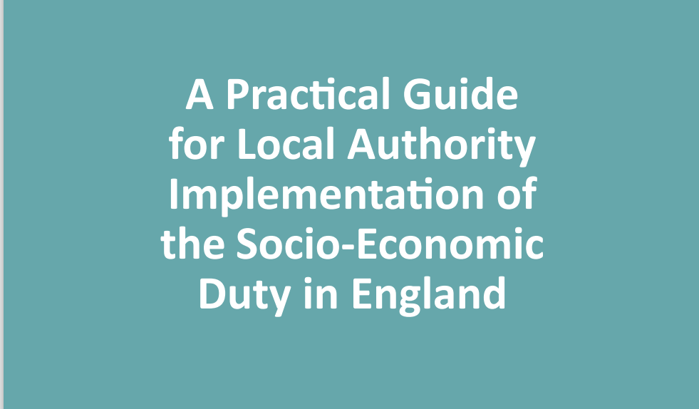
Action Time
Learning on effective implementation
https://justfair.org.uk/wp-content/uploads/2021/06/Socio-Economic-Duty-Guide-Final.pdf

Slide 8
Action Time
6 key steps for effective implementation
Meaningful impact assessments to understand the consequences of socio-economic disadvantage
Using data effectively as a tool for decision-making and accountability
Encouraging strong and visible leadership
Principles of working in partnership with people with lived experience of socio-economic disadvantage
Engaging with residents, civil society, and voluntary and community sector organisations
Ensuring access to justice and monitoring impact and compliance

