Slide 1
Collaborative Legal Approaches for Systemic Change: Learning Partnership Findings
Professor Lisa Vanhala &
Professor Jacqueline Kinghan
Public Law Project Webinar, 19th March 2026

Slide 2








Learning Partnership Overview 2018-2025
How best can public law advice and assistance be deployed to achieve or facilitate systemic change?

Slide 3
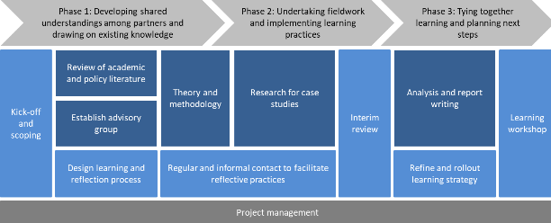
Learning Partnership - Approach

Slide 4
Changing Landscape
Post Brexit
Austerity Measures
Access to Justice & Changing Legal Needs
Changing Socio-Political Landscape
Public Law Landscape
Civil Society & Funding Landscape

Slide 5
Key Findings
Second-tier organisations like PLP can play a valuable role in activating social change
Effective collaborative working must be alive to wide ranging needs and capacity constraints
Long term collaborative partnerships require reflection and trauma-informed approaches

Slide 6
Key Findings
Relationship building takes time and highlights the importance of institutional memory
Organisational strategies need to be agile and responsive to changes in the socio-political landscape
There can be tensions and trade-offs for organisations using the law to pursue collaborative social change

