Slide 1

Judicial Review for environmental campaigners
Natasha Jackson

Slide 2
What is JR?
How does it work?
How can it work for you?

Slide 3
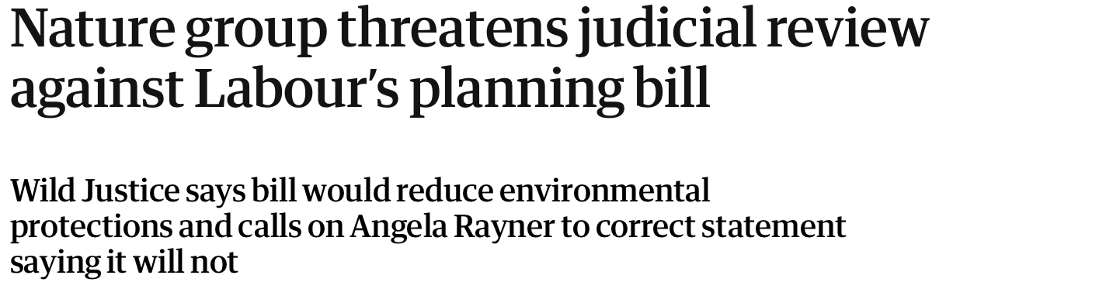
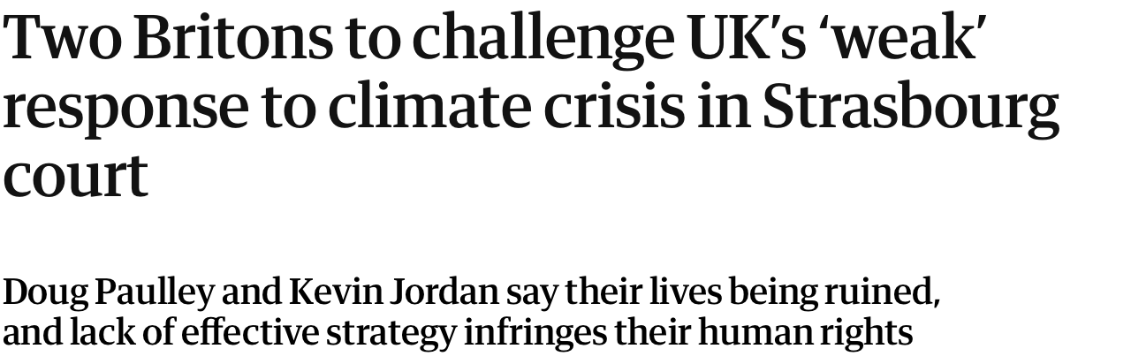

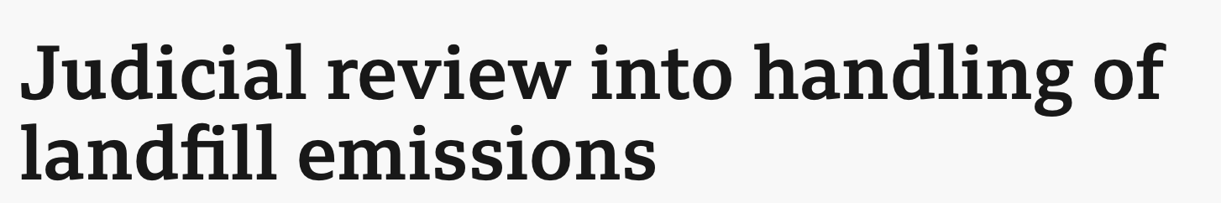
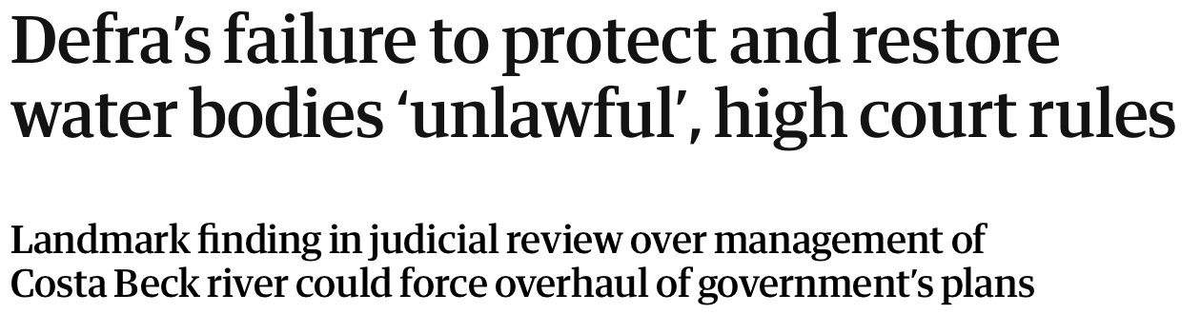
What is JR?
JR is a type of legal claim that challenges the legality of a public body’s decision.

Slide 4
Who can bring a JR?
Must have ‘standing’ i.e. “sufficient interest” in the outcome of the litigation
This is context-specific: AXA General Insurance Ltd v Lord Advocate [2011] UKSC 46.
Individuals will have standing if they are a “person aggrieved” (widely interpreted)
NGOs can have standing, and often do:
Associational standing i.e. a portion of the membership is affected, e.g. a local interest campaign group
Public interest standing: R v Inspectorate of Pollution, ex parte Greenpeace Ltd (No 2) [1994] 4 All ER 329; R v Secretary of State for Foreign and Commonwealth Affairs, ex parte World Development Movement Ltd [1995] 1 WLR 386 (QB)
BUT NB NGOs rarely have ‘victim status’ for the purposes of the Human Rights Act 1998 (c.f. Klimaseniorinnen)

Slide 5
What is a public body?
Any entity of body “exercising a public function”:
R v Panel on Take-overs and Mergers ex p Datafin plc [1987] QB 815

Slide 6
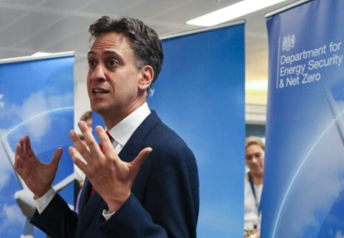

E.g. central govt
R (Pickering Fishery Association) v SSEFRA [2023] EWHC 2918 (Admin)
R (Friends of the Earth & Ors) v SSESNZ [2024] EWHC 995 (Admin)

Slide 7

E.g. local councils
R (Finch) v Surrey County Council [2024] UKSC 20

Slide 8



E.g. regulators

Slide 9
What is an “unlawful” decision? – Ground for JR
Illegality: decision-maker did not have the legal power to make the decision
Irrationality: Wednesbury standard of unreasonableness (high threshold); the decision was outside the range of reasonable responses
Procedural impropriety: e.g. failure to properly consult, non-compliance with environmental impact requirements, failure to give proper reasons
Human rights?: Art 8 right to private life; Art 2 right to life; A1P1 right to the peaceful enjoyment of property

Slide 10
Remedies
Quashing order: i.e. the decision no longer stands
Mandatory order: the public authority is required to do something
Declaratory relief: the court declares on the legality of a decision
Damages: very rare, but can be appropriate in some human rights claims
Interim relief: temporary relief pending final determination of the claim
NOT replacing the public body’s decision with a better decision!!

Slide 11
How it works: the life-cycle of a JR
Pre-action: start with a letter setting out the factual and legal basis your claim; the Defendant should reply within 14d, or sooner if there is urgency.
Issue proceedings: file a claim with the Administrative Court, with evidence. You may seek interim relief pending the determination of your claim. NB 3 month (or less) time-limit!
Acknowledgment of Service: the Defendant sets out whether they resist permission and, if so, why.
Permission: permission decisions will usually be made on the papers, but a refusal can be ‘renewed’ to an oral hearing before a judge.
Detailed Grounds: if permission is granted, the Defendant files a full ‘detailed’ response to the claim.
Substantive hearing: a full hearing of the JR claim will take place before a High Court Judge
Decision → (possibly) appeal

Slide 12
Intervening in JRs
In Re Northern Ireland Human Rights Commission [2002] 6 WLUK 366, per Lord Woolf:
"32. The practice of allowing third persons to intervene in proceedings brought by and against other persons which do not directly involve the person seeking to intervene has become more common in recent years but it is still a relatively a rare event. The intervention is always subject to the control of the court and whether the third person is allowed by the court to intervene is usually dependent upon the court's judgment as to whether the interests of justice will be promoted by allowing the intervention. Frequently the answer will depend upon whether the intervention will assist the court itself to perform the role upon which it is engaged. The court has always to balance the benefits which are to be derived from the intervention as against the inconvenience, delay and expense which an intervention by a third person can cause to the existing parties."
The Court will have regard to the overriding objective of dealing with cases justly and at proportionate cost, with specific reference to the factors listed at CPR r.1.1(2): CPR r.1.3; R (British American Tobacco) v Secretary of State for Health [2015] 1 CMLR 35 at §18.

Slide 13
Intervening in JRs
E v Chief Constable of the Royal Ulster Constabulary (Northern Ireland Human Rights Commission intervening) [2009] 1 AC 536:
“2. It may however be of some assistance in future cases if I comment on the intervention by the Northern Ireland Human Rights Commission (“NIHRC”). In recent years the House has frequently been assisted by the submissions of statutory bodies and non-governmental organisations on questions of general public importance. Leave is given to such bodies to intervene and make submissions, usually in writing but sometimes orally from the bar, in the expectation that their fund of knowledge or particular point of view will enable them to provide the House with a more rounded picture than it would otherwise obtain. The House is grateful to such bodies for their help.
3. An intervention is however of no assistance if it merely repeats points which the appellant or respondent has already made. An intervener will have had sight of their printed cases and, if it has nothing to add, should not add anything. It is not the role of an intervener to be an additional counsel for one of the parties. This is particularly important in the case of an oral intervention. I am bound to say that in this appeal the oral submissions on behalf of the NIHRC only repeated in rather more emphatic terms the points which had already been quite adequately argued by counsel for the appellant. In future, I hope that interveners will avoid unnecessarily taking up the time of the House in this way.”

Slide 14
Intervening in JRs: procedure
Apply under CPR r 54.17
Apply ‘promptly’; intervention is unlikely to be permitted if it would cause delay: CPR 54A para 13.2
Procedural requirements at PD 54A para 13
Can seek to intervene in writing and / or through oral submissions
Generally, intervenors bear their own costs: s.87 Criminal Justice and Courts Act 2015

Slide 15
Considering intervention?
What does your intervention offer to the proceedings? i.e. will the Court be assisted?
Timing: when do you want to intervene? In the High Court? On wait until an appeal?
Have you considered alternatives? E.g. provide a supportive ‘impact’ statement as evidence in the proceedings; providing campaign / comms support for the challenge

Slide 16
Costs
Environmental cases come under the Aarhus Convention, which cap the costs a losing claimant can be ordered to pay
£5k for individuals and £10k for organisations (although applications can be made to amend / lift the cap): CPR r 46.26 - 46.27
Procedure:
Register that Aarhus applies in pre-action correspondence
Request protection when issuing in Grounds and claim form
Must provide a statement of the claimant’s financial resources, verified by a statement of truth in support
Often sensible to also provide a full witness statement addressing why proceedings would be “prohibitively expensive”
Check CPR

Slide 17
Practical tips
Think hard about what you want to achieve
Be realistic about the remedies available through JR
Who is your ‘claimant’? NB considerations of NGO standing in JR / victim status for human rights claims
Be conscious of timing
Get ready to front-load a claim
Litigate smart: use JR as part of a toolkit involving e.g. Environmental Information Requests; OED Complaints; letters to regulators etc
Engage costs protection early on

Slide 18
THANK YOU!

