Slide 1


Introduction to the OEP

Slide 2
Public Body decision making and the environment ​
Government and public bodies decision making plays a pivotal role in shaping environmental outcomes.
Correct application of duties and compliance with legal obligations, should result in cleaner ecosystems, more sustainable development, and tangible progress towards EIP and national climate targets.
Failure to do so results in equally significant consequences, such as increased pollution, habitat loss and a decline in public trust.
Recent reforms have aimed to improve accountability, oversight and compliance.

Slide 3
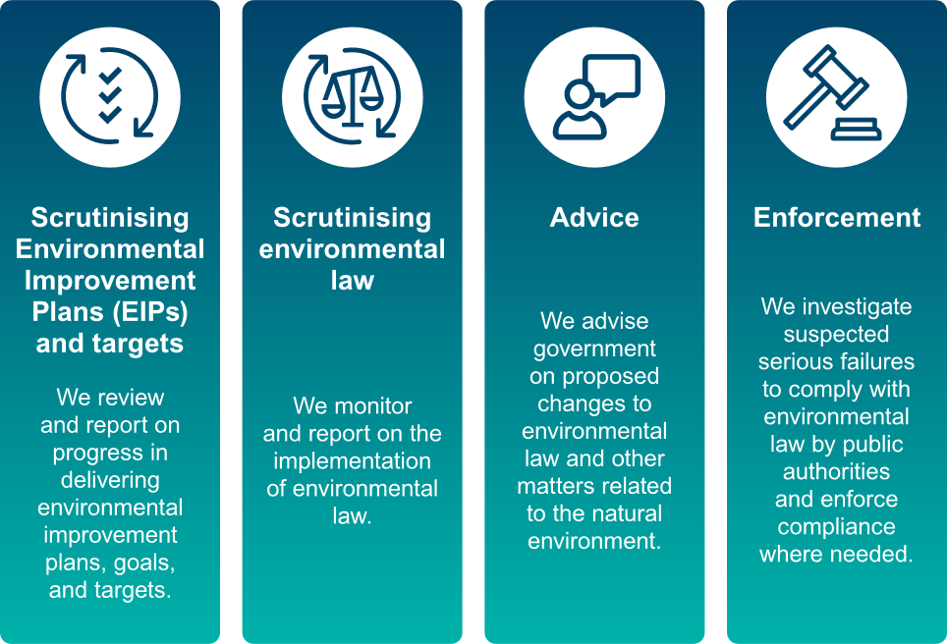
Functions of the OEP

Slide 4
OEP Complaints process
Someone
complains about
an alleged failure
OEP determines
eligibility
OEP determines if
the matter is serious
and a priority
Another OEP function
suggests a possible failure
OEP investigation
OEP produces (and normally publishes) an
Investigation
Report
Serious, urgent
cases can go direct to Judicial Review
OEP may serve
Information &
Decision notices
OEP refers case to
Environmental
Review

Slide 5
OEP complaint eligibility requirements: ​
You suspect that an “environmental law” has been broken.
The “environmental law” in question relates to England, Northern Ireland or a “reserved matter”.
The complaint is about a “public authority”.
You are not complaining on behalf of a “public authority” (a “public authority” cannot complain about another “public authority”).
If the public authority in question has an applicable internal complaints procedure, you have already complained to the public authority and finished that procedure.
You must normally complain within the specified time limit, whichever is the later of;
a year after the environmental law was last broken, OR:
if the public authority you are complaining about has an internal complaints procedure, three months since you finished that procedure.

Slide 6
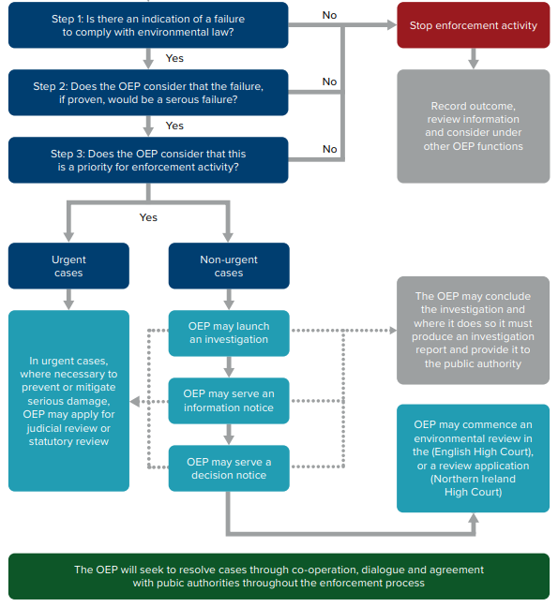
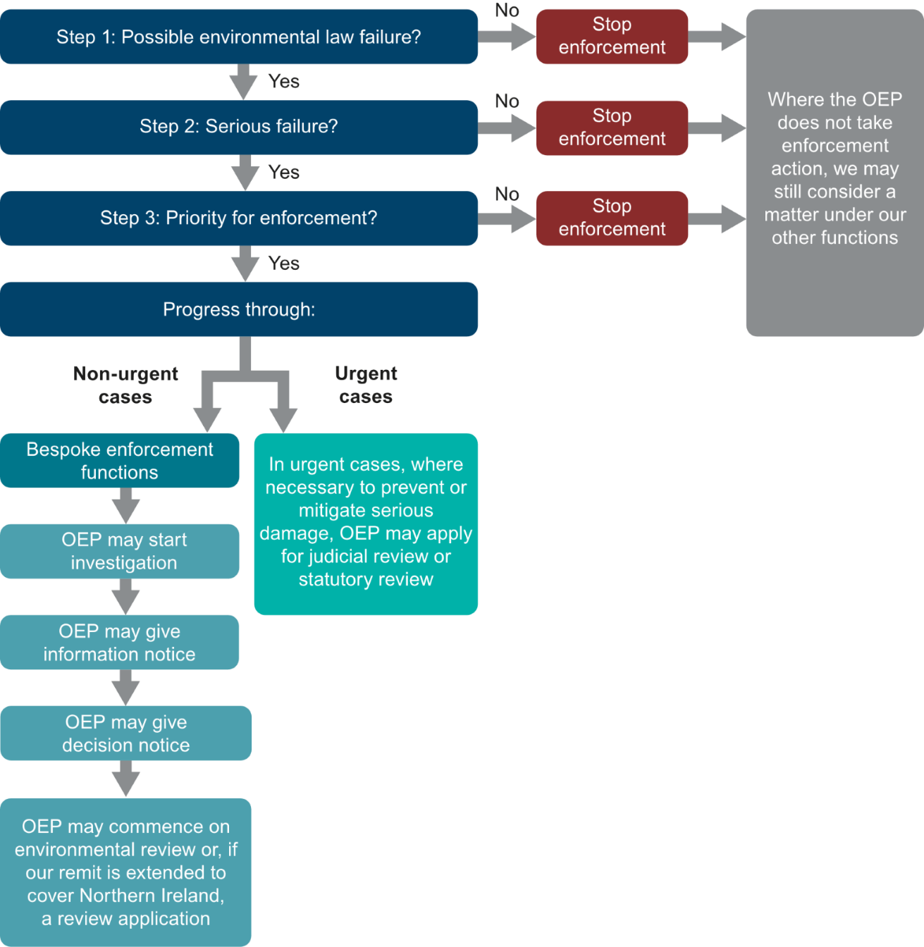

Assessment Process

Slide 7

Interventions and Resolutions:
Objectives of Intervention:
Flexible mechanism to resolve matters without formal investigation or enforcement.
Intervention approaches:
Engaging with public bodies to suggest how the public authority could improve compliance with a specific environmental law.​
Warning or advisory letters​
Agreement with public authorities where they accept they have failed to implement environmental law and commit to taking appropriate remedial matters​
Providing advice or observations to authorities who are proposing to adopt approaches which we consider are potentially unlawful.​
Any other actions considered necessary for the performance or furtherance of our enforcement functions.
Examples can be found on our website:
Our casework | Office for Environmental Protection (theoep.org.uk)

Slide 8
Investigations:
Objectives of Investigation:
We can commence investigations because of a complaint or on our own initiative.
The primary purpose of an investigation is to establish whether a public authority has failed to comply with environmental law.
Where they have not, we can use our enforcement functions to secure actions that can remedy, mitigate or prevent reoccurrence of the failure including through making recommendations .
Escalatory Options:
Where we are unable to achieve resolution either before or during the early stages of an investigation through engagement and agreement, we can serve an Information Notice (if the relevant legal threshold is met).
If following an Information Notice, further escalation is warranted, a Decision Notice may be served - formally setting out our conclusion on a PAs failure to comply with environmental law.; Why we think that is serious; The steps we consider the PA should take in relation to the failure.
PA must respond in writing and confirm the steps they will take and we can take further action if a PA does not comply.
Investigation outcomes:
Following investigation we will prepare a written report.
PAs are expected to comply with any recommendations
We will monitor PA’s implementation and may take further enforcement action if necessary.
We will publish our investigations reports.

Slide 9
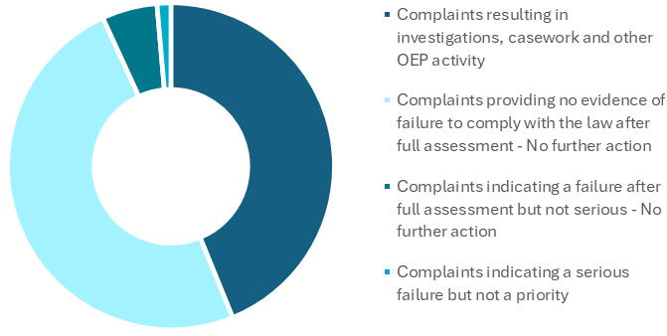
Outcomes:
4
47
Eligible complaint outcomes
32

