Slide 1

Friends of the Earth
Public Law Project Conference
Costs in Aarhus cases
Katie de Kauwe, Senior Lawyer
2 October 2025

Slide 2
​
Why does this matter? How did we get here?
Friends of the Earth’s experience of the Aarhus cost regime
Progress on cost rules
The ACCC’s findings post decision VII/8s

Slide 3

Why does this matter?
Justice is supposed to be blind
But financial resources matter
Without cost protection people are priced out of court
The default position – costs follow the event
Section 51 of the Senior Courts Act 1981
Protective Cost Orders are available in some circumstances: Corner House principles
Article 9(4) of the Aarhus Convention, in relation to access to justice, Parties “……shall provide adequate and effective remedies, including injunctive relief as appropriate, and be fair, equitable, timely and not prohibitively expensive. Decisions under this article shall be given or recorded in writing.”

Slide 4
How did we get here?
Cases like ACCC/C/2008/27 and ACCC/C/2008/33 – UK in breach of A9(4)
ACCC/C/2008/27 - Claimants in JR to challenge Belfast airport expansion ordered to pay costs of nearly £40,000
UK required to implement the ACCC’s findings – to date this work is incomplete
2013: cost caps were introduced - £5k for individuals; £10k for organisations
Civil Procedure Rules were subsequently amended
Default cost caps capable of variation
RSPB, FoE and ClientEarth v Secretary of State for Justice [2017] EWHC 2309
Application to vary must be done at the earliest opportunity i.e. at Acknowledgment of Service; later if there has been a “significant change in circumstances: CPR 46.27

Slide 5
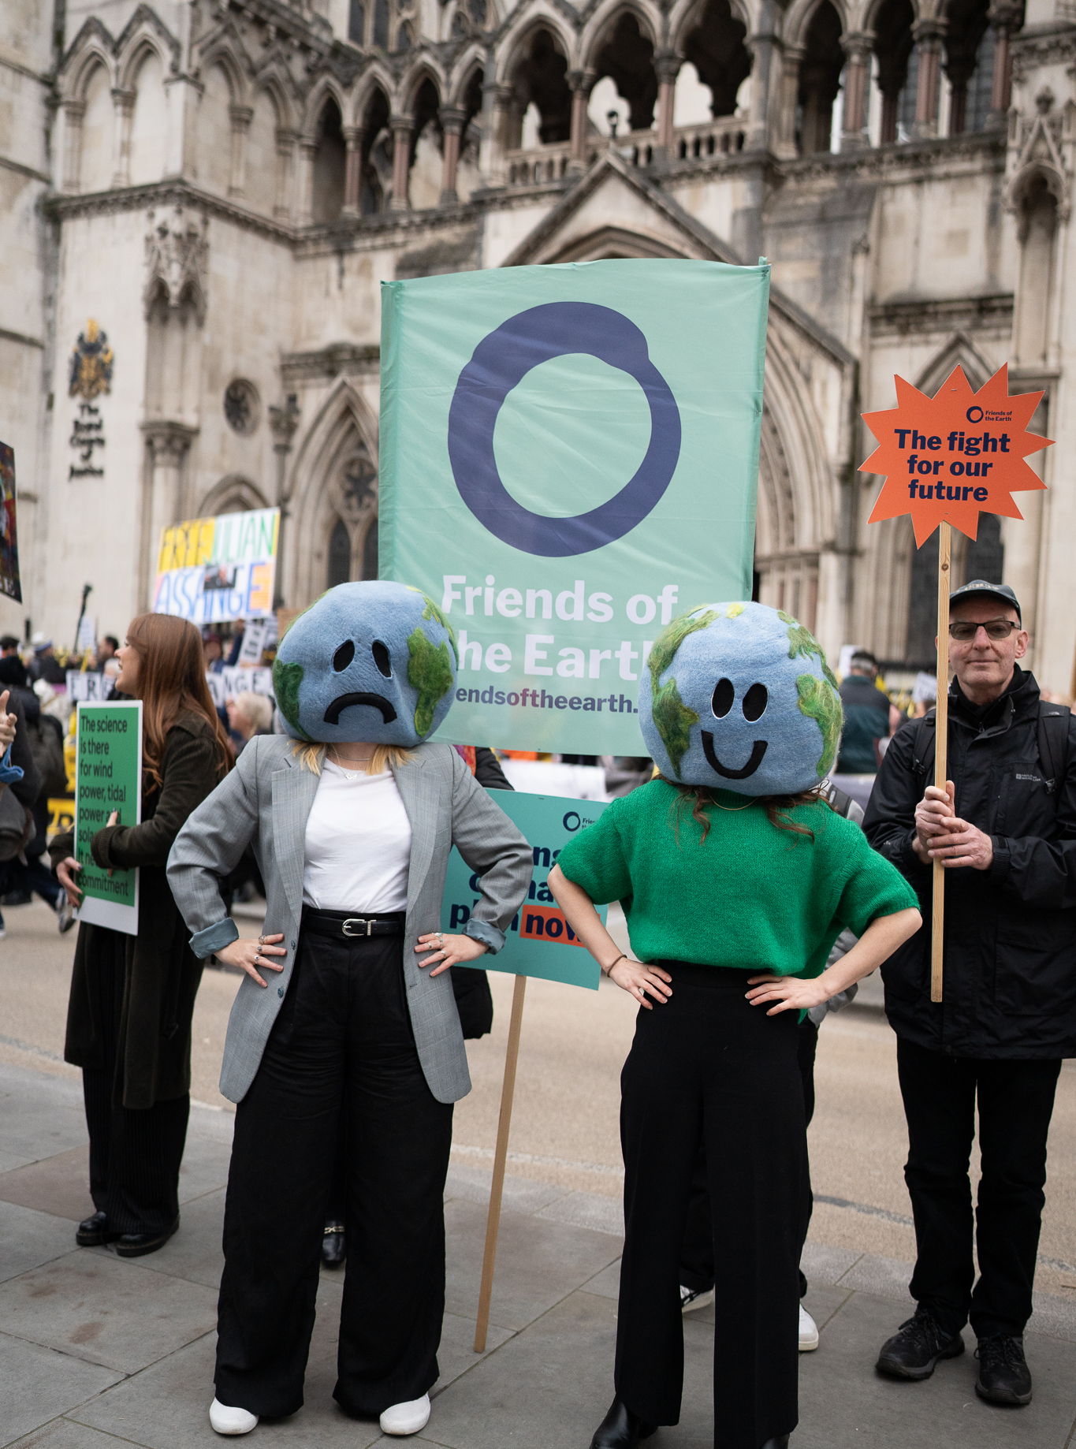
Friends of the Earth’s Experience
Mixed. FoE’s CCA challenges – no attempt to vary our cost cap or to dispute that these were environmental claims
But, NPPF challenge: two applications to vary by SoS HCLG
Mozambique challenge: R (FoE) v Secretary of State for International Trade/UK Export Finance (UKEF) & Anor (Rev1) [2023] EWCA Civ 14
Examples of cost caps being increased; not aware of a single case where costs for defendant varied upwards or where claimant’s costs reduced
R (oao Greenpeace) v SoS ESNZ [2023] and R(oao Uplift) v SoS ESNZ [2023] EWHC 2608 (Admin)
R (Biofuelwatch UK) v SoS ESNZ (AC-2024-LON-000713)

Slide 6

Progress?
2017 last time the UK updated its Environmental Cost Protection Regime
Government published Call for Evidence on 30 September 2024, closed 9 December 2024
“The government is committed to ensuring that the UK upholds its international law obligations under the Aarhus Convention.”
Some positive signs from the current Government - but very mixed signals
Report submitted to the Aarhus Secretariat May 2025 – some good points e.g. on appeals and cost consequences to challenging status of Aarhus claim

Slide 7
The ACCC
ACCC provided a draft report earlier this year – to be submitted to the Meeting of the Parties in November
Conclusion: UK has made progress, but is not yet meeting the requirements of Decision VII/8S
“In order to fulfil the requirements of paragraph 2 of decision VII/8s, the Party concerned will need to provide the Committee with evidence that, as a matter of urgency, it has taken the necessary legislative, regulatory, administrative and practical measures to: a) Ensure that the allocation of costs in all court procedures subject to article 9 of the Convention, including private nuisance claims, is fair and equitable and not prohibitively expensive;……….”
Issues remaining e.g. types of claims covered, variation of cost caps
In Northern Ireland – only downwards cost variation only for claimants
RSPB, Friends of the Earth & Environmental Rights Centre Scotland have commented on the draft report
Raised concerns given the views of the Special Rapporteur on Environmental Defenders

Slide 8
Thank you
Further Information
Pillar of Justice Report
Pillar of Justice II Report
Observers’ comments on ACCC draft report
katie.dekauwe@foe.co.uk

