Slide 1

Pillar of Justice II
Tom Brenan
Joint Executive Director, Head of Education & Policy
Environmental Law Foundation
elflaw.org

Slide 2
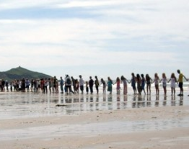
About ELF
Charity
Established in 1992
Access to environmental justice for all

Slide 3
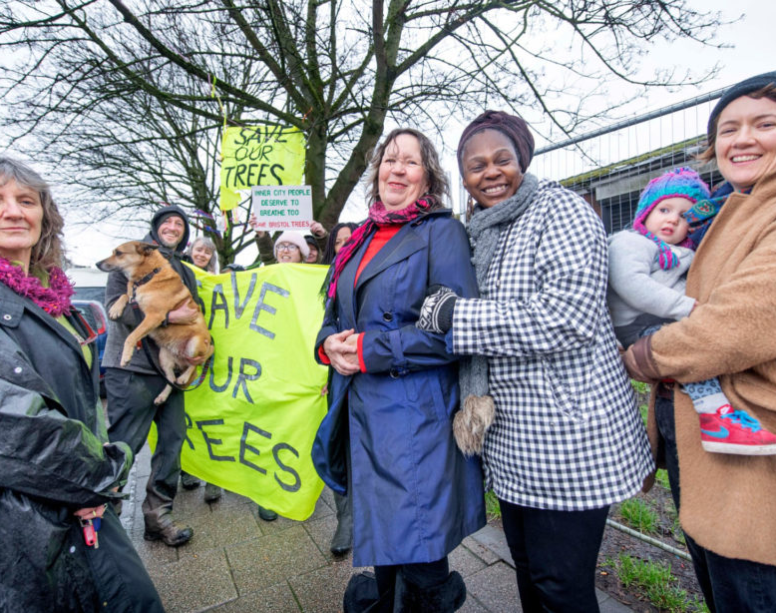
Advice & Referral
Pro bono network
Cross-disciplinary
In-house
University clinics
Range of enquiries

Slide 4
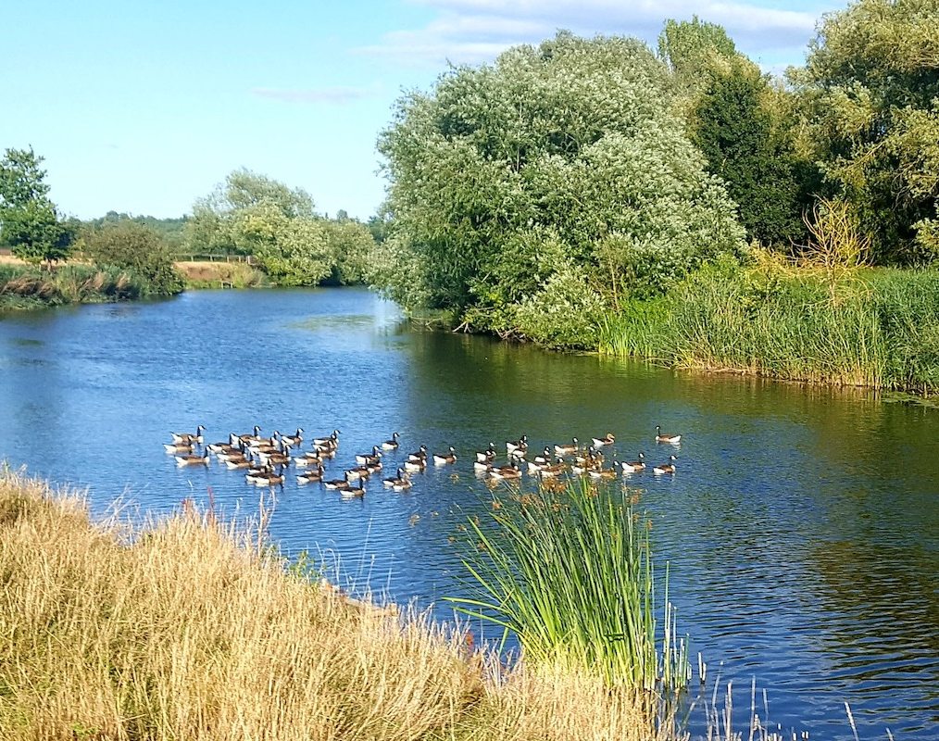
Outreach
Public legal education
Community events
Webinars
Podcasts
Resource library

Slide 5
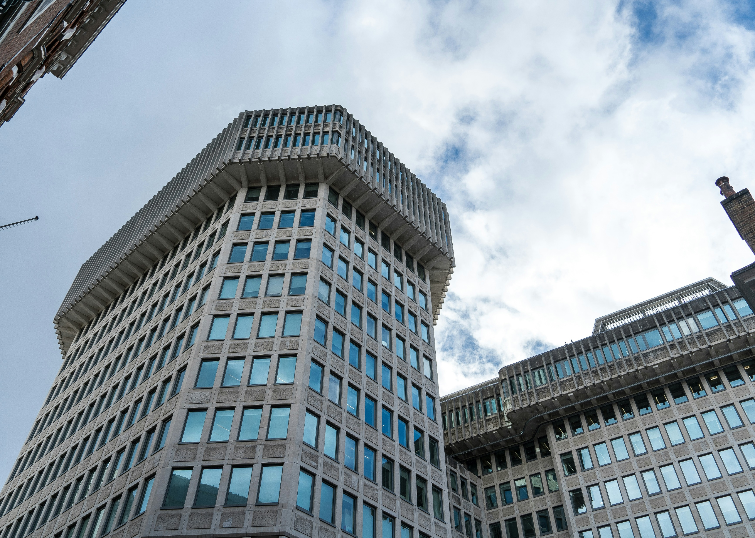
Policy
Aarhus Convention
MOJ – access to justice - costs rules
Consultation responses

Slide 6
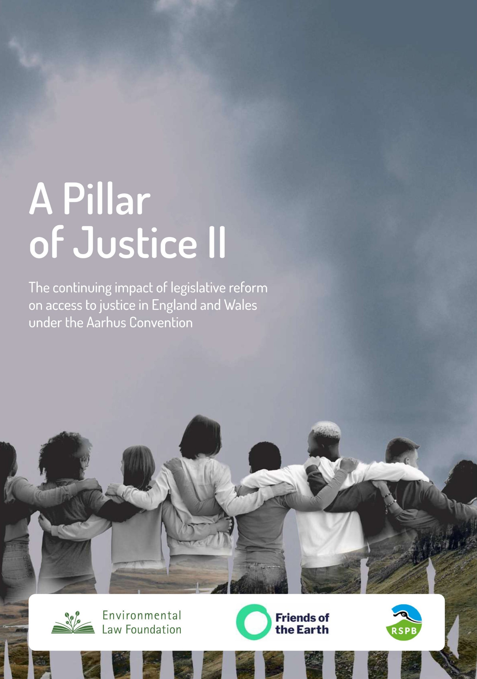
A Pillar of Justice II
Purpose
Ministry of Justice data
Pillar of Justice (2019)
ELF case studies

Slide 7
JR case numbers
Continuing decrease

Slide 8
Environmental applications
Continuing decrease
Less than half number of claims compared with POJ I period

Slide 9
Environmental applications
Monthly claims peaked Dec 2020 to Oct 2021 (10)
Dropped to 4 in 2022

Slide 10
Challenges to environmental claims
1 successful
27 unsuccessful

Slide 11
Permission
No significant change
Slight decrease since 2020

Slide 12
Successful cases
Modest overall increase since June 2018
AC claims around 10%
JR claims generally 3%

Slide 13
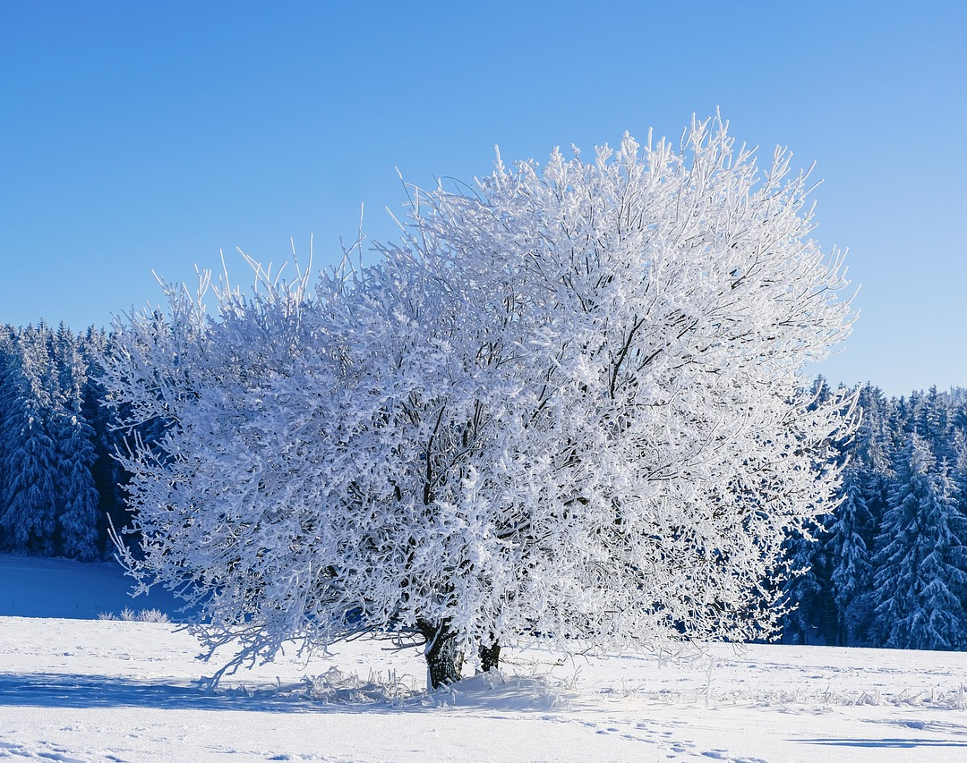
Chilling effect
ELF cases
Pre-issue
44% unwilling

Slide 14
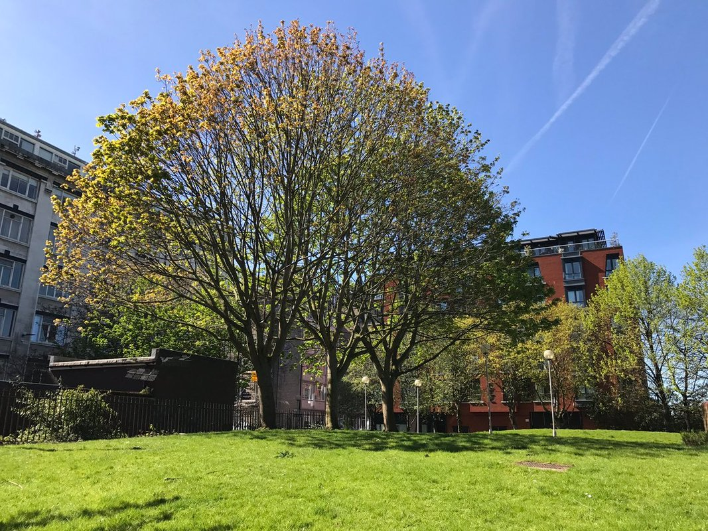
Bixteth Street Gardens
Liverpool City Council
Central Business District
Public green space
Redevelopment

Slide 15

Artificial hockey pitch
High intensity lighting
Permission given
AONB and Local Nature Reserve

