Slide 1

Access to justice: The future of legal aid and costs in public law
The Legal Aid Landscape
Chris Minnoch
CEO, Legal Aid Practitioners Group
PLP Seminar, 3 October 2025

Slide 2
The view from the top
In recent years the MOJ has carried out extensive reviews of the legal aid scheme in England and Wales:
Criminal Legal Aid Independent Review – Government Response Dec 2022
Means Test Review – consultation outcome May 2023
Review of Civil Legal Aid – various publications up to Mar 2025
(And let’s not forget the LASPO Post-Implementation Review, published in Feb 2019…)

Slide 3

The view from the top
“Legal aid is the cornerstone of our justice system. It underpins the rule of law in this country, helping to ensure that everyone, including the poorest and most vulnerable, can access justice and enforce their legal rights.
But when this Government took office, we inherited a legal aid system creaking under pressure after years of neglect.
….
We are determined to nurse this critical sector back to health, rebuilding a legal aid system that is sustainable, effective and efficient, and that helps people to address their legal problems as quickly and as early as possible. A system that enables our excellent legal aid profession to do what it does best - providing high quality support and advice for the people who need it most.
….
This is just the first step…”
Sarah Sackman KC MP
Minister for Courts and Legal Services
Jan 2025 – Housing and Immigration Fees Consultation
Fees? I’m sorry, the cupboards are bare. How about a cheese and pickle sandwich?
Can I have a fees transfusion please?

Slide 4
The review of civil legal aid - rocla
https://www.gov.uk/guidance/civil-legal-aid-review
Four workstreams:
1. Economic analysis of the functioning of the civil legal aid market
Provider Survey Report (Jan 24) – 228 responses, about 18% of providers
Market Research Report (Nov 24) – PA Consulting
2. Comparative analysis of domestic and international civil legal aid systems – report Mar 24
3. Social research on user experiences with civil legal aid
Perspectives of users and trusted intermediaries (Nov 24)
Perspectives of providers (Nov 24)
User Experience Literature Review (Jan 25)
4. Data publications – 11 publications
Advocacy Research Report (Nov 24)
Data Publications Overview Report (Nov 24)
‘Deep Dives’, with data tables (Jan-Mar 25)
Housing & Debt
Immigration & Asylum
Public Law
Clinical Negligence
Claims Against Public Authorities
Community Care
Discrimination, Education and Welfare Benefits
Family
Mental Health
And an ‘overarching summary report’.

Slide 5
Case volumes & Values
Legal Help and Controlled Legal Representation
Financial Year | Family | Immigration | Housing | Public | Total
2000-01 | 318,496 | 138,841 | 90,456 | 1,477 | 803,828
2000-01 | - | - | - | - | -
2012-13 | 204,247 | 52,371 | 85,191 | 1,352 | 573,770
2012-13 | £40.6m | £45.3m | £18.5m | £0.6m | £188.7m
2013-14 | 43,106 | 28,157 | 47,231 | 1,104 | 173,662
2013-14 | £26.2m | £39.1m | £11.4m | £0.5m | £134.3m
2024-25 | 27,343 | 32,870 | 30,848 | 3,714 | 155,523
2024-25 | £9.9m | £54.3m | £9.9m | £3.1m | £117m

Slide 6
Case volumes & Values
Civil Representation (Applications Granted)
(For Public Law – [LAA costs / Opponent Met Costs])
Financial Year | Family | Immigration | Housing | Public | Total
2008-09 | 125,879 | 2,255 | 13,381 | 1,570 | 151,779
2008-09 | £617m | £4.5m | £29.3m | £5.4m/£3.5m | £702m
2012-13 | 134,409 | 3,145 | 12,100 | 1,835 | 157,415
2012-13 | £699m | £4.6m | £25.5m | £5.7/£6.5m | £768m
2013-14 | 82,480 | 2,661 | 10,753 | 1,530 | 100,372
2013-14 | £738m | £3.2m | £24.3m | £5.4m/£5.4m | £798m m
2024-25 | 95,189 | 1,156 | 6,217 | 1,543 | 110,205
2024-25 | £838m | £4.9m | £16.9m | £5.9m/£16.4m | £930m

Slide 7
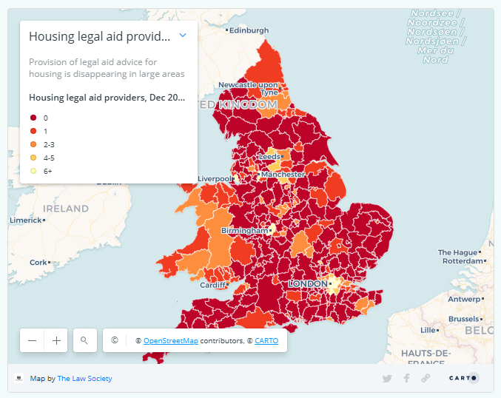
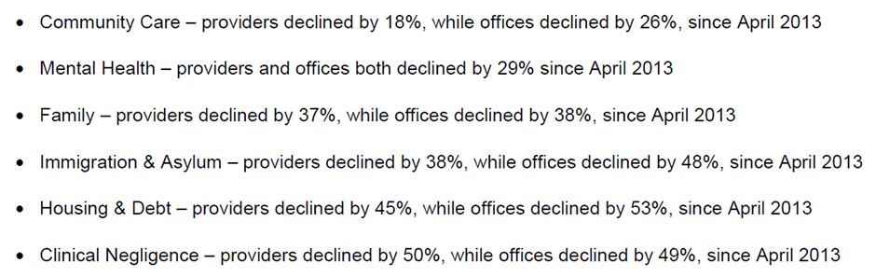
Client access
Law Society Legal Aid Deserts research:
Percentage of the population without access to a local legal aid provider:
Housing – 44% Welfare Benefits – 85%
Community Care – 70% Education – 90%
Immigration and asylum – 63%

Slide 8
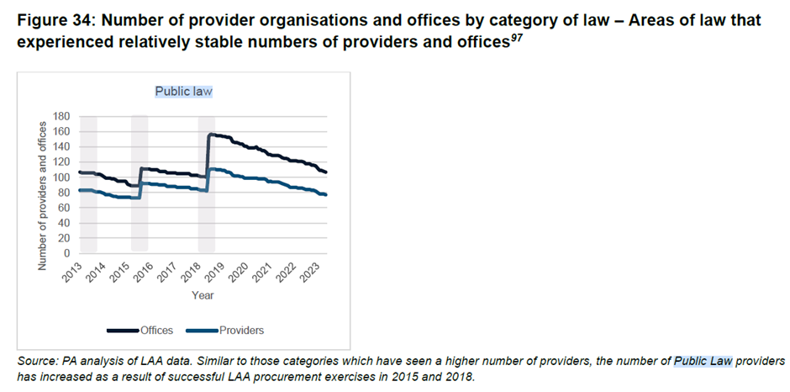
Client access

Slide 9


Client access
How does the MOJ or LAA assess ‘market capacity’ and ‘client demand’?
What steps the Legal Aid Agency is taking to engage with local legal aid providers to increase legal aid provision.
The Legal Aid Agency (LAA) monitors provider numbers in each procurement area and across all categories of law. It takes operational action where it can, to respond to market pressures that may arise.
At a local level, LAA hold market engagement events to understand challenges to service delivery for particular categories of law, considering how it can remove any barriers or manage concerns which could deter providers from bidding for a legal aid contract.
May I have a cheese and pickle sandwich?
No, you may not!
Written question from Henry Tufnell (Lab, Mid and South Pembrokeshire) 16 June 2025
Minister Sackman, Response, 23 June 2025
Note: I may be paraphrasing here.

Slide 10



The means test review
Commenced 2019
Consultation outcome 25 May 2023
Four phases of implementation:
Phase 1 - New non-means-tested areas of legal aid (August + Sept 2023)
Introduction of a range of mandatory and discretionary disregards (Nov 2024)
Phase 2 – new civil means test and contributory system…. Delayed to ‘2026’ due to ‘competing demands’
‘Whilst we are committed to raising thresholds, we will consider the threshold values prior to implementation. This is to obtain a better view of the impact of the recent inflationary period and the severity of the cost of living pressures.’
Phase 3 – new criminal means test
Phase 4 – removal of Crown Court capital passporting for benefits recipients who are homeowners
“This means that 3.5 million more people will be eligible for criminal legal aid in the magistrates’ court and 2.5 million more people will be eligible for civil legal aid”

Slide 11
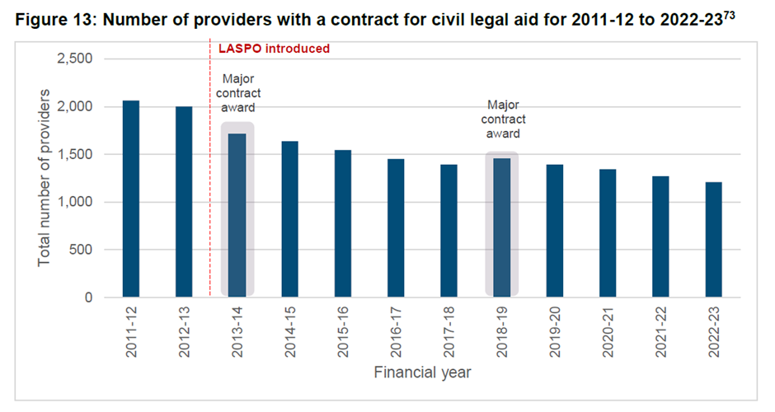
The workforce
RoCLA Market Research Report, PA Consulting, Nov 24

Slide 12
The workforce
LAA MI, provided to the CCCG, 2023 (not data verified by ONS)

Slide 13
Housing & Immigration Fees
“All forms of proceedings, if they are Housing or Immigration related, will receive an increase to fees. The proposals result in an effective overall uplift to total spend of 30% to Immigration fees, 21% for Housing fees, 16% for Debt fees, and 42% for HLPAS fees. This invests an additional £20m into the legal aid system once fully implemented. The exact increase individual providers receive will depend on the case mix undertaken.”
(Jan 2025)
“The uplifts to immigration and housing legal aid fees will commence on specified dates that will be aligned with the necessary digital and operational changes required. Immigration fee changes will come into force first, followed by housing. Fee increases will be applied to all new certificates or determinations made after the specified commencement dates.”
“The government acknowledges the views of respondents about the wider legal aid market, and in particular the issues raised around legal aid fees more generally. We will continue to consider measures to support sector sustainability across all categories of civil legal aid.”
(Jul 2025)

Slide 14
Housing & Immigration Fees

Slide 15

What else is New or on the horizon?
The fall-out of the LAA data breach – massive issues but also potential opportunities?
‘Always on’ commissioning and10-year crime and civil contracts
‘Hillsborough Law’ – legal aid for inquests and ‘proportionate’ legal costs for public bodies
The 2027 Standard Civil Contract
- Matter starts
- Remote working
- Office requirements
MOJ research to improve ECF take-up for immigration cases
MOJ ‘Legal Support Strategy’, ADR and digitalisation (i.e. family and housing possession)
LAPG research on Pro(vider) Bono – non-chargeable time generated by legal aid contracts and systems
Adopting a ‘High Trust’ model
Further fee increases, changes to payment mechanisms, working at risk…

