Slide 1
Strategic litigation from campaign point of view
Svetlana Kotova, Inclusion London

Slide 2
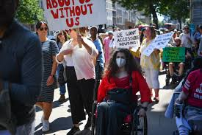
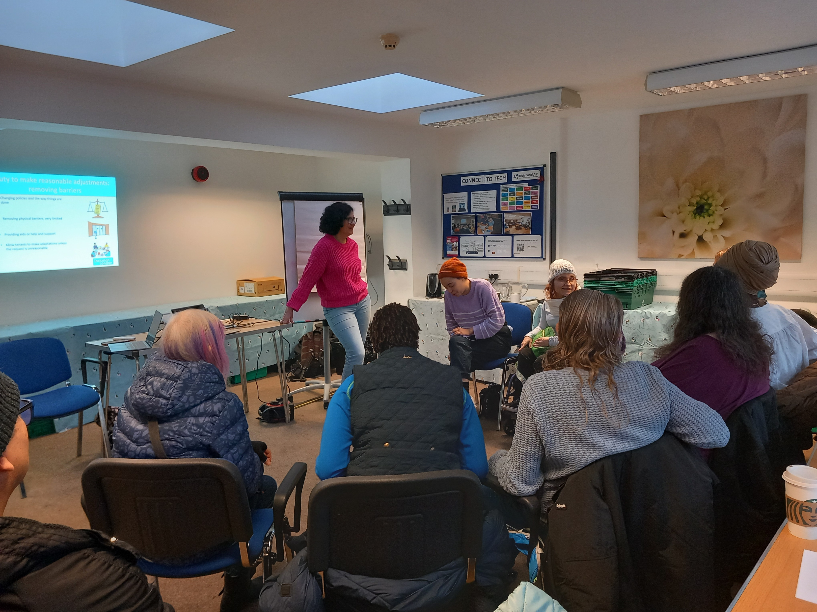
Inclusion London
Nothing about us without us
We are Deaf and Disabled people led organization campaigning for our rights

Slide 3
How we see strategic litigation
One among many tools to achieve campaign goals
Can be useful when our voices are ignored
Can help to expose the problem
Can help to mitigate or reduce harmful impact of policies
We are mindful of using the law in other ways: highlighting the issues with international human rights bodies and using human rights and international law to frame the arguments, disclosable advice notes, forcing compliance with PSED at consultation stage etc.

Slide 4
What we do on strategic litigation
Facilitating connections between lawyers and potential claimants
Highlighting the issues and persuading lawyers to take a cases
Develop tools to support people use the law and collect evidence
Providing witness statements
Funding initial advice
Interventions
Follow up after legal action

Slide 5
What we learnt
People don’t always know what happens to them is unlawful and could be challenged. Resources into raising awareness, building communities
It is important to think about potential legal action well in advance and build evidence base.
A case can change policy even if you don’t win, but the link to a wider campaign is important.
Claimants who bring cases need support.

Slide 6
What works for us when working with lawyers
Honesty and openness to explore possibilities
Learning from one another
Collaborative approach, but appreciating each party could say no
Being involved early on

Slide 7
Some of the issues where strategic litigation could help
Inaccessible application processes and constant failures to make reasonable adjustments, combined with settlement and NDA
Benefits rates
Conditionality and potentially extending “kinder” conditionality to everyone
Severe conditions criteria
Reducing Health element in UC for new claimants

