Slide 1
The basics of tribunal representation
- The SEND Tribunal
Ollie Persey, Garden Court Chambers

Slide 2
BUNDLES! New practice direction
Microsoft Word - HESC SPT BUNDLE PRACTICE DIRECTION 2025 for publication
Page limits
Format
What to include/not include
Late evidence

Slide 3
Tips for preparing an EHCP appeal
Read the working document- it should have footnote references to the evidence.
Most hearings are a battle of experts – who are yours and what do you need from them?
Establish where your evidence is weak(est). Can the weaknesses be addressed ahead of the hearing?
What does your client actually care about?
Placement costs (don’t forget transport and social care)?
What is your route to victory? Remember section B feeds into F which feeds into I
Are there relevant factors to section I that are not on the face of the plan? E.g. breakdown of relationship between parent and school, child’s stress etc.
Remember that the Tribunal is an inquisitorial jurisdiction and informal- do not prepare cross-examinations etc.
Promoting participation of client: pre-hearing conference and communication during the hearing
Don’t forget health and social care…

Slide 4
Delays in the Tribunal- EHCP appeals
1-year long delays
Expedition? Limited, largely for phase transfer cases and child out of school
Judicial review as alternative remedy? NB caution: LW, R (On the Application Of) v London Borough of Islington [2025] EWHC 703 (Admin) (24 March 2025)

Slide 5
DISABILITY DISCRIMINATION
HESC Practice Direction paras 7 to 8
“7. In a disability discrimination in schools case:
a. Every claim is considered by the Tribunal on receipt to determine whether the application meets with the requirements of Rule 20 and this Practice Direction.”
b. Since the Tribunal’s form does not require the claimant to set out numbered grounds of claim nor require them to identify with precision how each act complained of amounts to discrimination, the Tribunal will identify from the information provided by the claimant the general grounds of claim to which the Respondent must respond.

Slide 6
Disability discrimination
c. If the Tribunal forms the provisional view, based on the information provided with the claim form that there is no reasonable prospect of the claimant’s case, or part of it, succeeding, then the Tribunal may, in its discretion under Rule 8(4)(c), warn that the claim, or part of it, may be struck out and require the claimant to provide additional information before deciding whether to strike out the claim, or part of it.
d. If the claimant avers that the grounds admitted by the Tribunal do not adequately reflect their complaint, they may apply to the Tribunal for a variation of the Registration Directions Order in accordance with the timetable set out in the Order, setting out reasons why the allegations should be admitted.”

Slide 7
8. If the Tribunal forms the provisional view that a claim (or part of it) does not form part of a course of conduct extending over a period which ends within the time limit, or is otherwise made out of time, they may either:
a. Exercise discretion to admit the parts of the claim that are made out of time. In such cases, questions of timeliness will be a matter for the Tribunal determining the claim, having heard all the evidence; or

Slide 8
b. Refuse to admit those parts of the claim which are, in their provisional view, out of time, and direct the parties to participate in a preliminary hearing to determine whether those parts of the claim should be admitted.
In a disability discrimination in schools case, the Tribunal’s provisional views about timeliness when considering the claim on receipt shall not be a ‘decision’ of the Tribunal within the meaning of Paragraph 4(4) of Schedule 17 of the Equality Act 2010.

Slide 9
Processes in disability discrimination claims
All claims now triaged by salaried judge on receipt (ideally within one week)
Straightforward cases (in time exclusions/suspensions and obvious reasonable adjustments) sent out with standard directions
Fast track claims dealt with immediately (but stayed if pending IRP application)
Other claims considered by salaried judge (ideally within a month)
Updated template order and directions but form and content a decision for individual judge
Telephone or video case management where needed

Slide 10
Track allocation: Standard track
RB’s response, documents and attendance form to be received by | 6 weeks from receipt of claim
Latest date for applying to vary the timetable or registration directions | 6 weeks from receipt of claim
Claimants’ attendance form and additional documents to be received by | 9 weeks from receipt of claim
Final evidence deadline | 2 weeks prior to bundle deadline
Hearing bundles to be received by | 3 weeks prior to hearing date
Hearing date (10 am start) | Currently listing about a year from receipt of claim

Slide 11
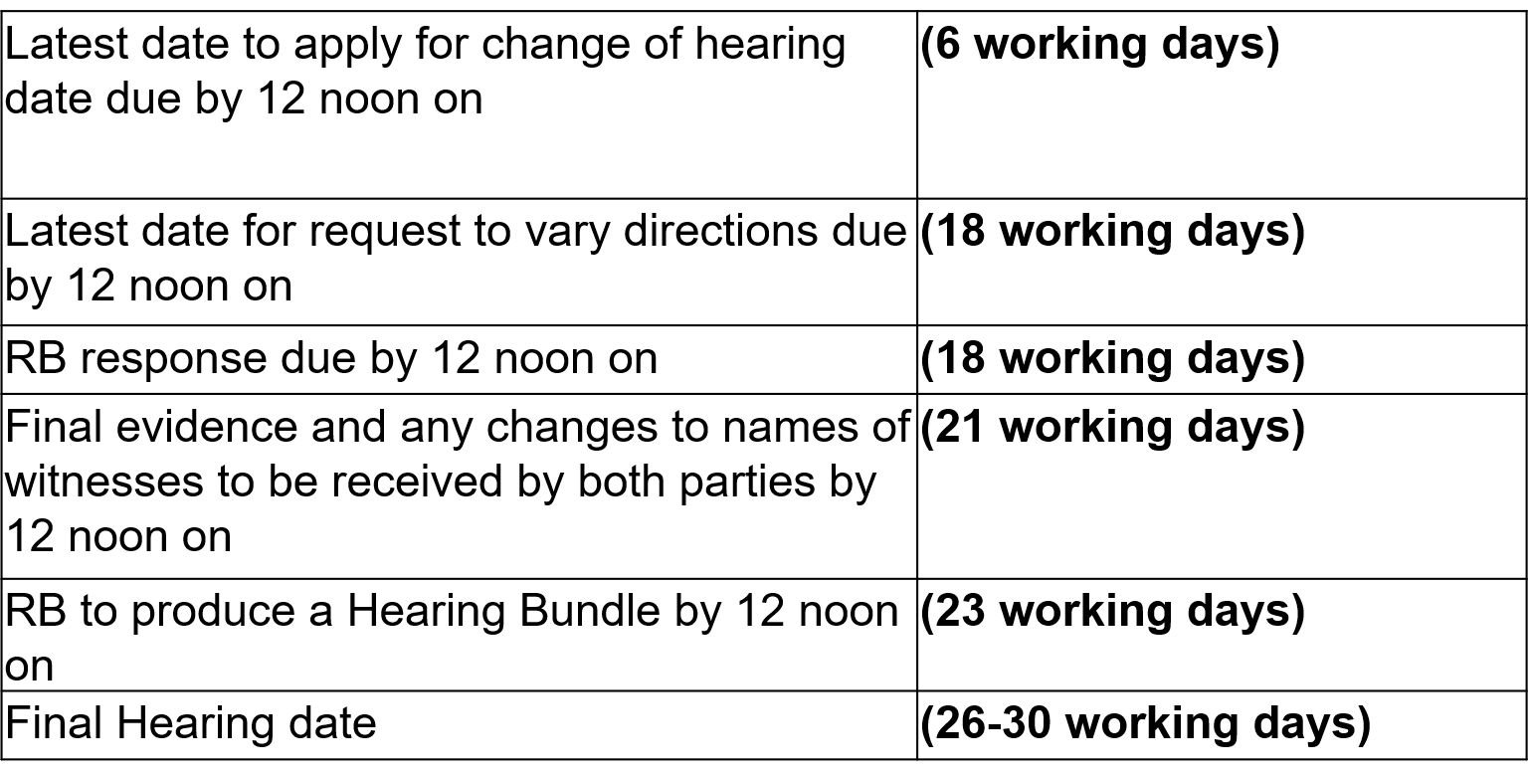
Fast track

Slide 12
Thank you
020 7993 7600 info@gclaw.co.uk @gardencourtlaw

