Slide 1
Litigating for positive change in the social security system
Claire Hall
Head of Strategic Litigation, Child Poverty Action Group
July 2025

Slide 2
CPAG strategy
CPAG litigation model
Representing individuals
Providing evidence
Interventions
‘Own
name’
Early Warning System
Judicial Review Project
Upper Tribunal Project
Approaches from NGO’s

Slide 3
Current cases
Judicial review
Challenge to ordering requirement in NCC exemption in two child limit (R (LMN and EFG) v SSWP [2024] EWHC 2577 (Admin)) – heard June 2025
+ pre-action cases
Statutory Appeals (UT(AAC))
- Official error appeal rights (GD v SSWP) – UT hearing 21 July 2025
Disabled carers erosion of transitional protection in UC (SSWP v MJ [2025] UKUT 035 (AAC))
Requirements for notice of appeal rights (TR v SSWP)
Recently concluded:
Awaiting decisions:
Advance closed period supersessions – (MJ v SSWP) heard April 2025
PIP activity 9 – (TL v SSWP) heard May 2025
ECtHR
Two child limit post-SC (x 3)
Bereavement Support for unmarried parents post Remedial Order (x 2)
CPAG “own name” legal work
Covid-19 Inquiry: CPAG is Core Participant in Modules 8 (Children and Young People) and Module 9 (Economic Response), hearings in October – December 2025
CPAG is a party in 3 DWP appeals in the First-tier Tribunal (GRC) against Information Commissioner decision notices

Slide 4
Live issues
Managed migration to UC
→ Unfair regs - Families with children in residential care not transitionally protected
→ UC administration – Requests for breakdowns of transitional element calculations ignored; incorrect TEs (under/overpayments); MR gatekeeping
Council Tax Reduction Schemes
Problems after migration to UC – council tax doubling overnight in some cases
Treatment of income (double-counting, UC TE)

Slide 5
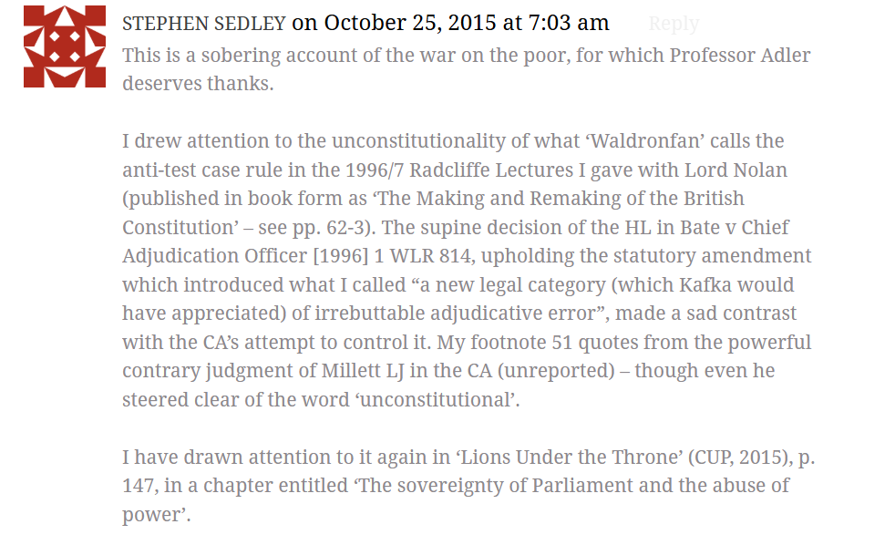
Human rights test cases in the tribunal
Recent example: SSWP v MJ (UC) [2025] UKUT 35 (AAC)
The UC Regs 2013 and UC (TR) Regs 2014 mean a carer newly assessed as having LCWRA loses both i) carers allowance and ii) transitional element, when the LCWRA element is added to their UC award.
This leaves them worse off at a time when their needs have increased.
Amounts to unlawful discrimination.
Remedy for individual: regulations could be interpretated (s.3 HRA) or disapplied (see RR v SSWP [2019] UKSC 52)
Source: comment section, UK Constitutional Law Association blog published 23 October 2015

Slide 6
After judgment…
Wider implementation:
advocating for updated DWP guidance for consistent (non-discretionary) application at 1st instance decision-making
SSWP option to amend regs
Decision-makers must apply Upper Tribunal decision in the meantime
Claimants can resolve at MR stage or on statutory appeal
Remaining questions…
S.27 SSA 1998 ‘anti-test case rule’
If the DWP award(ed) LCWRA for a period before the ‘test case’ date (29/01/25) the anti-test case rule would normally require DWP and the tribunal not to apply the UT MJ decision for the period prior to that date
If a claimant appeals such a decision, the tribunal appears to be required to apply the regs and maintain the discriminatory outcome
...even though it’s required by HRA 1998 (absent s.27 SSA 1998) to interpret the regulations in a Convention- compliant way?
Is the anti-test case rule incompatible with the HRA?

Slide 7



GATHERING EVIDENCE ABOUT THE IMPACTS OF CHANGES IN THE BENEFIT SYSTEM ON CHILDREN AND THEIR FAMILIES AND INFLUENCING CHANGE
Child Poverty Action Group (CPAG) set up the Early Warning System (EWS) to help us to get a better understanding of how changes to the benefit system like the introduction of universal credit, the benefit cap and changes to tax credit entitlement will affect the lives of children and their families.
To date over 8,000 case studies have been gathered from frontline workers, including welfare rights advisers, housing officers and support workers.
HOW CAN YOU GET INVOLVED?
If you or any of your colleagues work with families who have been directly affected by changes to the benefit system, and you think that someone needs to know about their experience, then you might want to get involved. If you’re interested in submitting case studies or have any queries about the EWS, please get in touch:
Early Warning System
Email: ews@cpag.org.uk
Tel:0203 955 4493
Early Warning System Scotland
Email: kmckechnie@cpagscotland.org.uk
Tel: 0141 611 7091
FIND OUT MORE
For further information and to view our EWS resources, reports and policy briefings, please visit our website.
Website: cpag.org.uk/early-warning-system

