Slide 1
Working with communities through judicial review and public law
Advanced Judicial Review 2025
Oliver Carter

Slide 2

What prevents individuals and communities from bringing public law challenges?

Slide 3

Barriers to bringing public law challenges
Funding legal advice, representation and court fees
Finding a lawyer to take on the case
Adverse costs if the case is unsuccessful
Who has standing to bring the case?
Timing: too soon or too late to litigate?
When to intervene with evidence or representations
Procedural complexity of judicial review
‘Mysticism’ of judicial review and public law?
Fear of failure or negative consequences
Judicial deference to public authority decisions
Discretionary remedies and hollow victories

Slide 4

“In England, justice is open to all…”
Public Law’s Disgrace, Tom Hickman KC:
“Most people could not bring a judicial review. That is not because there is any legal prohibition on them bringing a claim. They could theoretically do so.
But as all public lawyers know, a mere theoretical entitlement does not count as a right. To register as a right an entitlement must be capable of actually being exercised and enjoyed.
The vast majority of the population have no access to judicial review in any meaningful sense.”
(UK Constitutional Law Association, 2017)

Slide 5

Funding judicial review cases: the claimant’s costs
Legal aid (subject to means and merits tests)
Conditional Fee Agreements (inc. Discounted CFAs)
Private funding
Pro bono (note pro bono costs orders)
Crowdfunding (e.g. via CrowdJustice)
Grant funding (e.g. EHRC Legal Support Scheme)
Third party litigation funding (e.g. Law For Change)

Slide 6

Funding judicial review cases: adverse costs
The court has discretion, but the general rule is that the losing party pays (CPR 44.2(2)(a))
Legal aid costs protection (s26 LASPO 2012)
Costs-capping orders (ss88-90 CJCA 2015):
    Claimant may apply for a CCO in cases which are “public interest proceedings”, where C would discontinue the case if a CCO is not granted, and it would be reasonable to do so
Aarhus Convention environmental claims:
    Claimant may apply for costs cap to limit costs liability to £5,000 (individuals) or £10,000 (legal persons)
Costs orders involving interveners:
    Claimant or defendant cannot be ordered to pay intervener’s costs unless there are exceptional circumstances
    Interveners must be ordered to pay costs in certain circumstances (s87(6) CJCA 2015)
  Costs orders against courts, tribunals and coroners

Slide 7
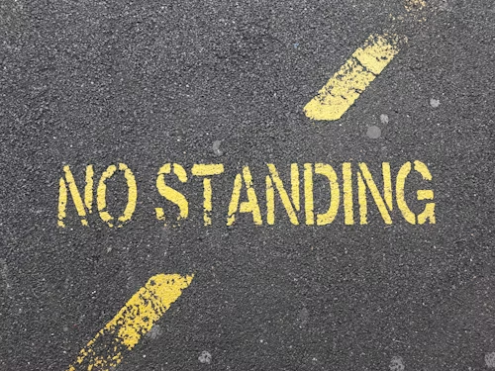
Standing: sufficient interest
‘The resurgence of standing’ – second seminar in Advanced Judicial Review 2025 covered standing
A person may not bring an application for JR unless he or she has a “sufficient interest” in the matter to which the claim relates (s31(3) SCA 1981)
Standing for individuals: in general, a person whose legal rights and obligations are directly and adversely affected by a public body’s conduct will have standing
Standing for organisations: associational, surrogate or public interest (for the latter, will normally have to demonstrate genuine involvement in specific subject area)
Narrower ‘victim status’ test in cases alleging a breach of human rights under the ECHR, via s6(1) HRA 1998 (this test usually excludes organisations, but see KlimaSeniorinnen)

Slide 8

Timing: what time is just right to bring a challenge?
CPR 54.5(1): the claim form must be filed promptly and in any event not later than three months after the grounds to make the claim first arose
This time limit may not be extended by the parties
When did the grounds of claim first arise? Prematurity vs lack of promptness
Consultation cases: challenge when consultation opens, when it ends, or when final decision is made? R (CU) v Secretary of State for Education [2024] EWHC 638 (Admin): depends on which of Gunning criteria is argued to have been breached
When considering any judicial review challenge, take precautionary approach and seek advice ASAP

Slide 9
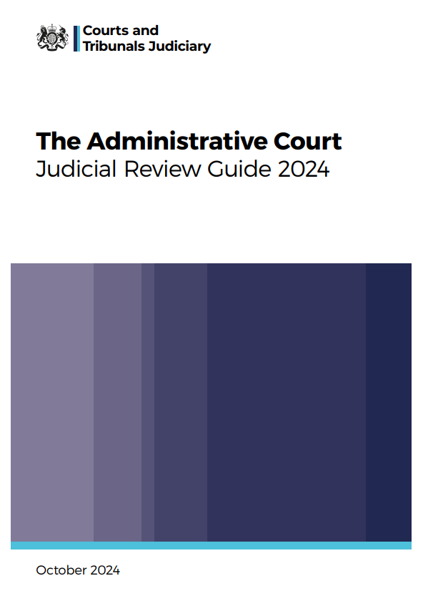
Procedural complexity and demystifying judicial review
The Administrative Court Judicial Review Guide:
    “required reading for all those who conduct judicial review cases (whether or not they are lawyers)” – foreword by Dame Victoria Sharp, President of the King’s Bench Division
Procedural rigour:
    “The appellate courts have emphasised the need for procedural rigour in judicial review…
    It applies to claims with a public interest element with as much force as to other claims and as much to defendant public authorities as to claimants” (2.12-13)
  Urgent cases: when does a case require urgent consideration by the court?
    When there is a genuine need for the application to be considered within seven days, use form N463. If quick but not urgent consideration is needed, use form N244
    A genuine need may arise when seeking an order to prevent the defendant doing something with irreparable consequences which may be done imminently, or requiring the defendant to do something immediately (i.e. a prohibitory or mandatory injunction)
    Note that the fifth seminar in Advanced Judicial Review 2025 covered urgent cases in detail
  Hamid jurisdiction: abuse of the court’s procedures
    The court may summon lawyers to explain their actions if it considers there has been an abuse of procedure; if the court concludes its procedures have been abused, it may refer the lawyer to their regulator and/or consider making a wasted costs order

Slide 10
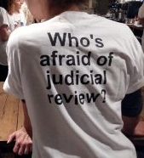
Fear of failure or negative consequences
What if the judicial review is unsuccessful?
When does a judicial review case have good prospects of success? (“if it smells bad”)
What if the court declines to grant the remedy we seek?
What if the public authority re-makes the same decision?
‘Making bad law’: negative consequences for future cases?
…but
Nothing ventured, nothing gained (what if the JR is successful?) – recognise the limits of law, but also that it can be a powerful tool
Many JRs succeed at the pre-action or permission stages
The constitutional importance of judicial review and holding public authorities to account
Wider benefits of public interest litigation and/or winning the argument outside court (e.g. abortion rights in Northern Ireland)

Slide 11
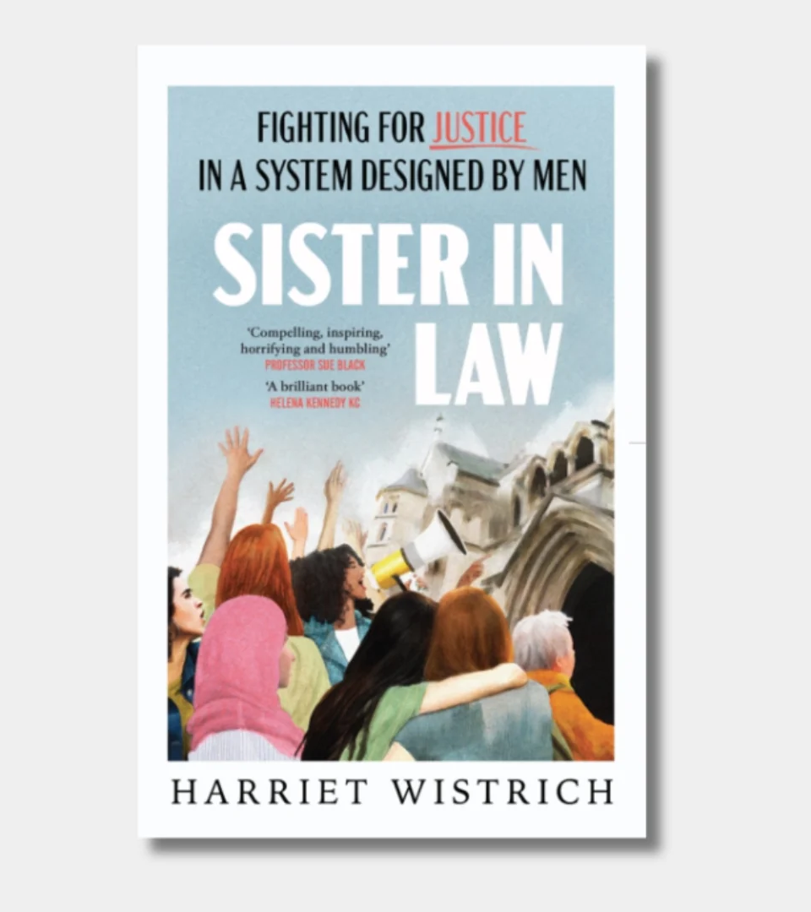
“The journey through the maze of our legal system is a bumpy and unpredictable ride, sometimes gruelling, sometimes mired in slow and convoluted processes.
Not every battle ends in victory – but we always make a mark.”

