Slide 1

The Metropolitan Police Gangs Matrix
Working with communities
through judicial review and public law
Katrina Ffrench
Founding Director - UNJUST UK

Slide 2

Who are we?
NGO established in 2021 by me! Directors of African and African Caribbean heritage.
Why do we exist?
To address discriminatory culture, policies, & practices within the Policing & the Criminal Legal System
What do we do?
Research & Policy, Advocacy, Litigation, Community Empowerment, Public Education, Media
Who do we work with?
People & Communities impacted by the Criminal Legal System, Academics, Lawyers, Students, Activists, Charities,
Grassroots Groups, Elected Officials, Public Institutions
Want to follow us?
Twitter: @UNJUST-UK
LinkedIn: UNJUST UK
IG: UNJUST UK

Slide 3

A Bit About Me ☺
Jamaican Heritage, Londoner
Eldest of three girls
1st in family to go to university
Studied Social and Political Sciences
Worked in local government
Volunteered to Hold Police to Account
CEO StopWatch
Founder UNJUST
Former Trustee of Transform Drugs
Member of Independent Scrutiny and Oversight Board
Elected local Councillor

Slide 4
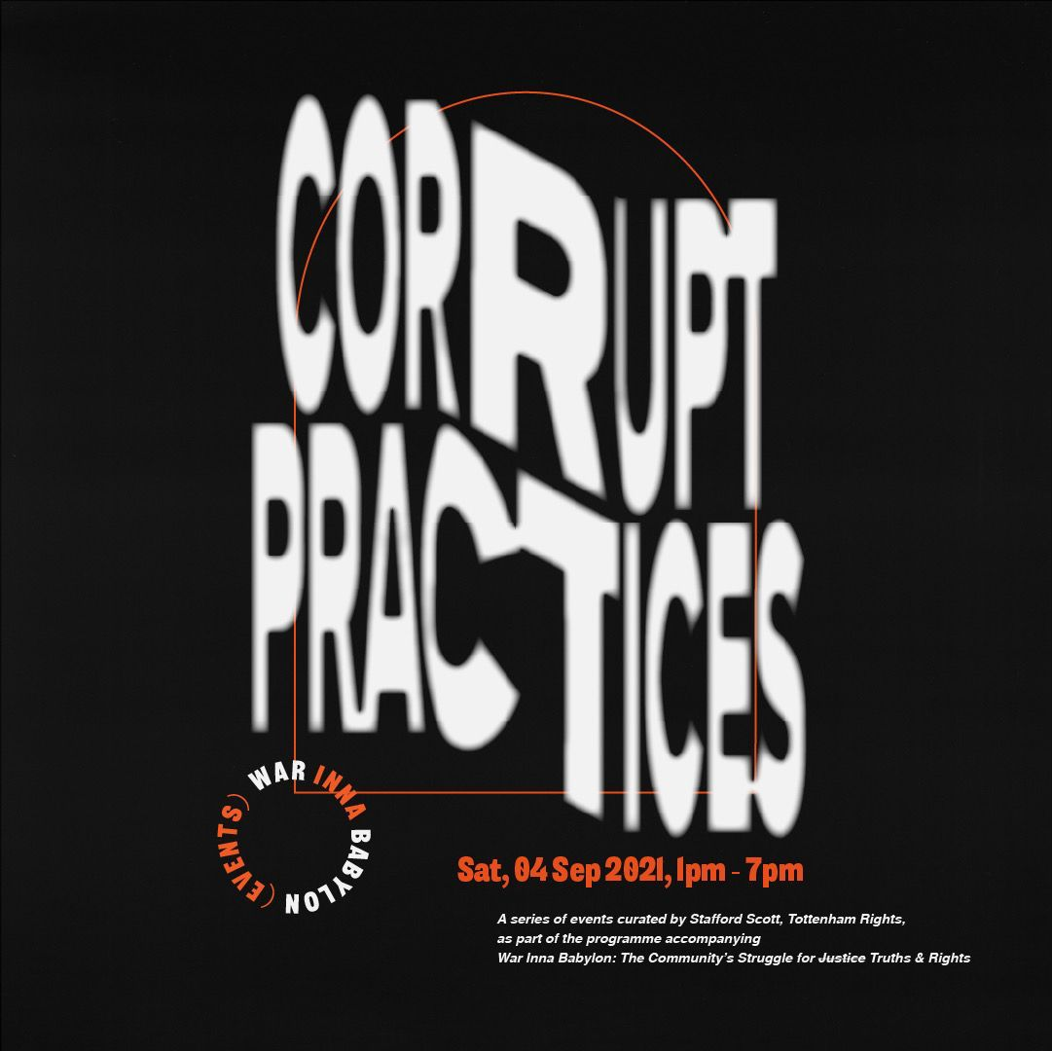
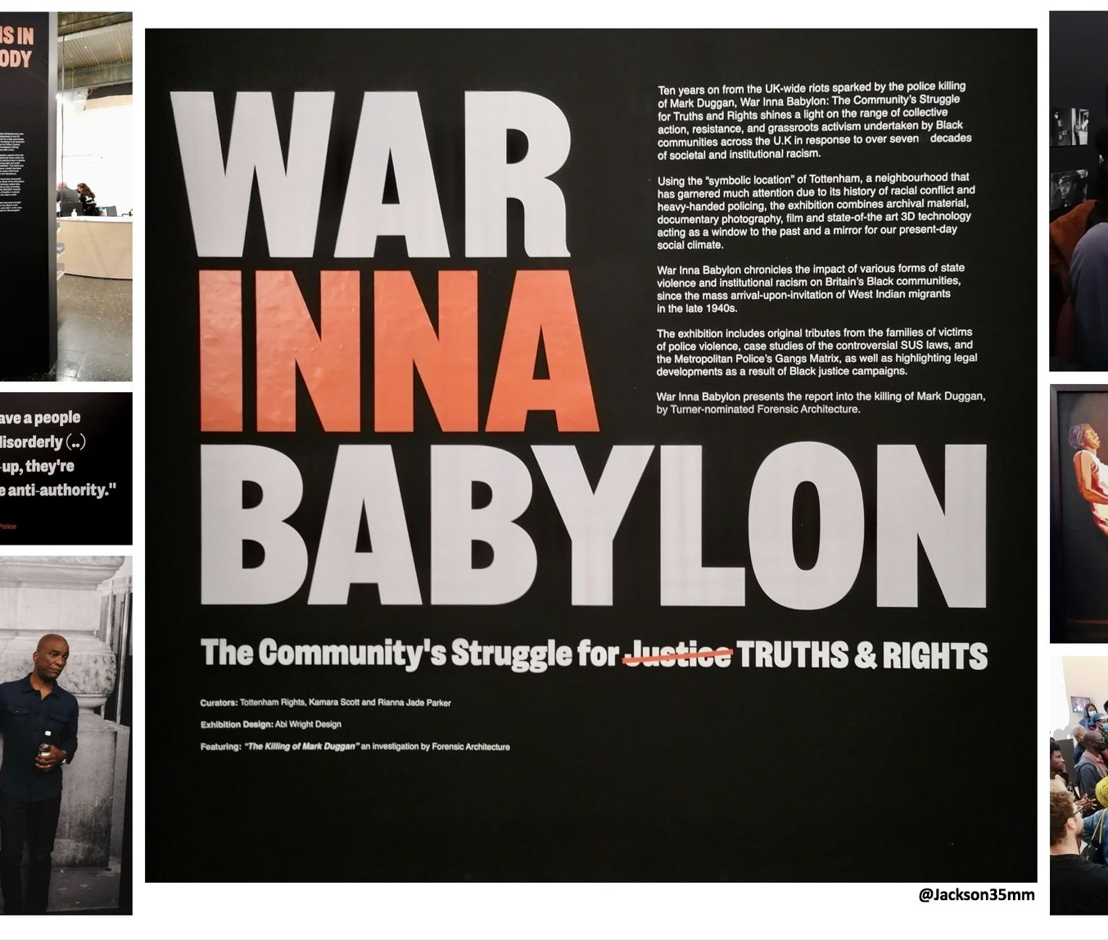
The Gangs Matrix
The Gangs Matrix - a police database developed in 2012 as a response to the 2011 London Riots. The database contained the personal information of thousands children and young people living in London who are perceived by the Metropolitan Police as ‘gang nominals’ and likely to be involved in serious violence.
Definition of Gang – Problematic
The lack of clarity regarding the criteria for adding/removing individuals to this database, and algorithms are used to rank those on the list with Green, Yellow or Red rankings based on danger levels and propensity to violence.
Lack of accountability and transparency enabled racial bias to be embedded into policy and practice for a decade.
The consequences of being on the Gangs Matrix are extremely punitive and detrimental to the quality of life and impact people’s entitlement to benefits, housing, and employment but also is likely to result in increased Stop & Search, Immigration problems, license conditions and school exclusions. Sharing of information was harmful.
Notes:
The term “Gang” does not have a precise definition. Section 34(5) of the Policing and Crime Act 2009, as amended by the Serious Crime Act 2015, provides that something is ‘gang related’ if it occurs in the course of, or is otherwise related to, the activities of a group that:​
Consists of at least three people; and
Has one or more characteristics that enable its members to be identified by others as a group.​​
Whilst this provides an indication of the characteristics of a gang, this definition was provided only for the purposes of the power to obtain an injunction. The wording is intentionally broad and wide-ranging to ensure that gang injunctions are used as an effective response to any gang activity encountered in a local area. Many groups of people may share a community, friendship or common characteristics such as age, but an additional feature of a gang is that it carries out criminal activity.
The following definitions are for information only, and are provided to explain the different structure, purpose, operation and context in which gangs operate. The definitions have no bearing on charging decisions made by the CPS.

Slide 5

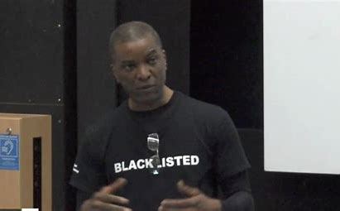



Dismantling The Gangs Matrix
May 2018 – Katrina becomes CEO, StopWatch ☺
Sep 2018 – StopWatch published ‘Being Matrixed’ a qualitative report that gave a voice to those impacted by the Gangs Matrix
Sep 2018 – StopWatch hosted a Parliamentary event in collaboration with Stafford Scott, Dr Patrick Williams, The 4Front Project, lawyers and Amnesty International, Young poets
Oct 2018 – StopWatch hosted a civil society
Nov 2018 – ICO issued Metropolitan Police Enforcement Notice
Dec 2018 – MOPAC published review into Matrix and set up a Gangs Matrix ‘Community’ Reference Group
Jan 2019 – 2020 Katrina, StopWatch CEO, sat on MOPAC GM Reference Group
Dec 2020 – After a phenomenal tenure as CEO Katrina leaves StopWatch ☺
Jan 2021 – Katrina establishes UNJUST C.I.C ☺ ☺ ☺ ☺
Notes:
Greens 2017 3881 to 1933 2022

Slide 6

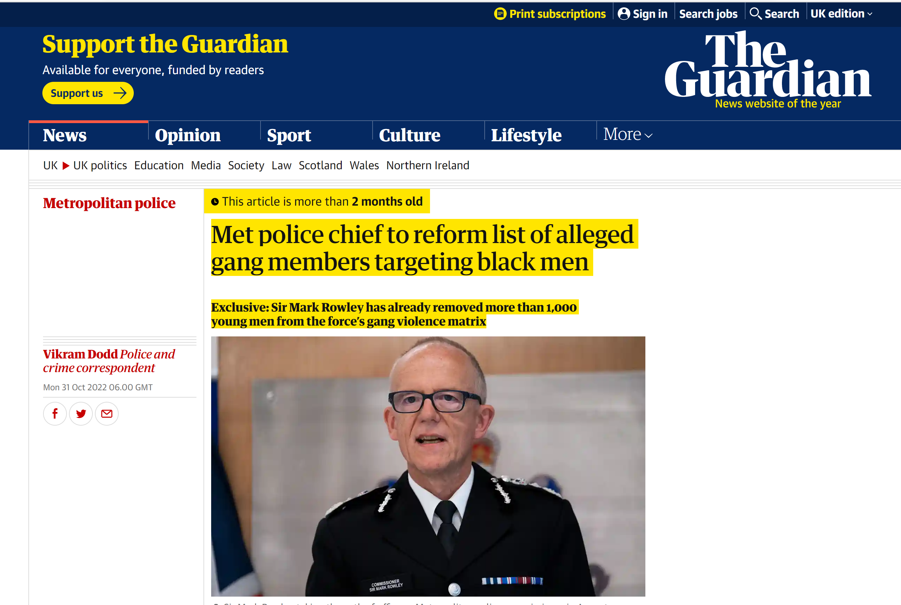
Dismantling The Gangs Matrix
Jan 2022 - Awate Suliman and UNJUST instructed LIBERTY and Doughty Street Chambers to issue judicial review proceedings against the Metropolitan Police.
Feb 2022 - We launched a crowdfunder. Raised nearly £10k and received donations from BLM, LUSH, Law for Change, and Koshka Duff to cover the remaining £8k needed to cover legal costs. WE DID IT!
May 2022 - The case was given permission to proceed with a court date set for Nov 2022.
Oct 2022 - Settlement discussions. Hand and Glove Maneuver
Nov 2022 - Court looming…… The Metropolitan Police admit Article 8 Human Rights Act breach and concede the database is in dire need of “wholesale change” BUT refuse to admit racial discrimination.
What Next? Removal of Greens. Confirm Matrix Status. Bring Claims for Article 8 Breach. Continue #ScrapTheMatrixCampaign
Notes:
Greens 2017 3881 to 1933 2022

Slide 7



The Erase The Database Collective
The collective is partnering with community activists, campaigners, academics and lawyers to create the #EraseTheDatabase campaign.
Our aim is to ensure that this legal win is translated into meaningful change for all whose rights were breached and lives damaged.
We also resist new and emerging forms of oppressive police technology

Slide 8
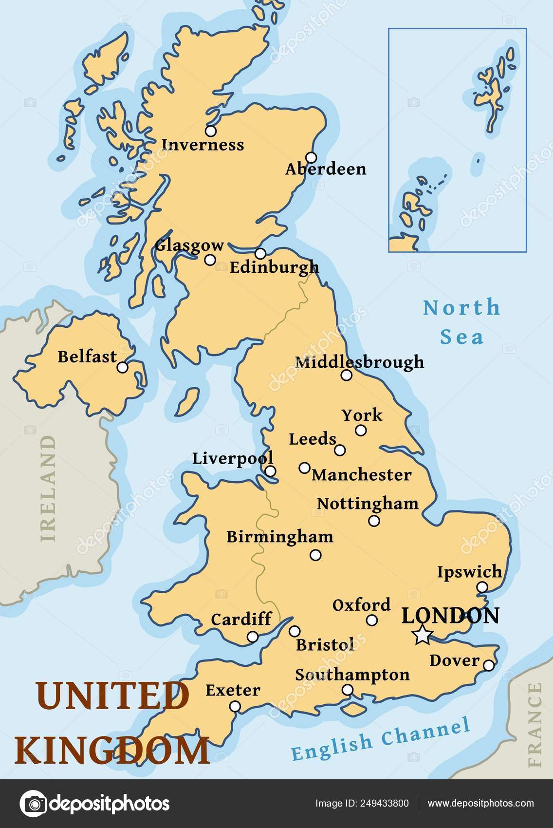
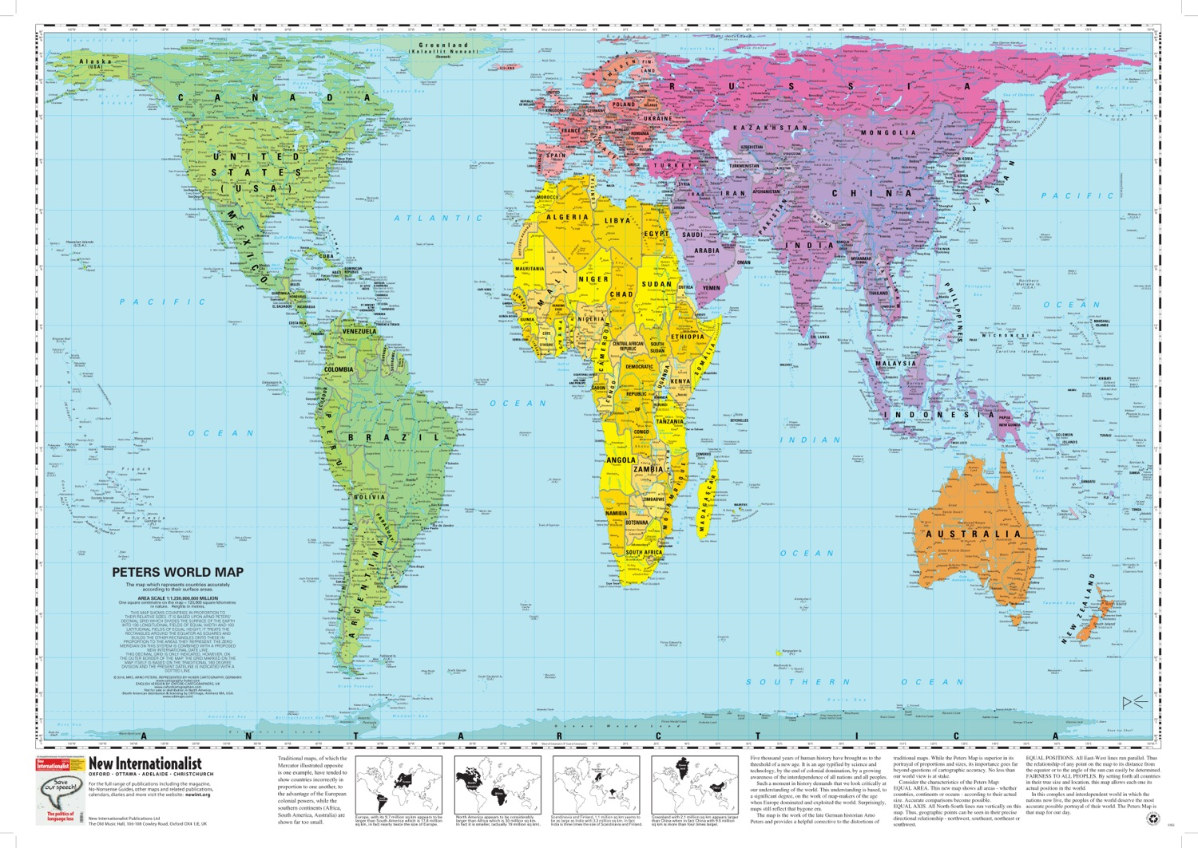
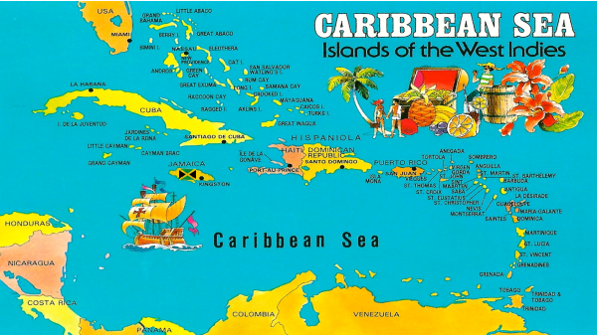

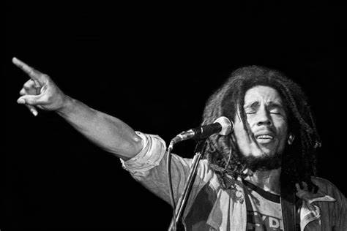
CommUNITY
“When the rain fall,
it don't fall on
one man’s
housetop”
Bob Marley
www.unjust.org.uk
info@unjust.org.uk
0300 323 0292

