Slide 1
Working with communities to bring judicial review
Emily Soothill, DPG
30 April 2025

Slide 2
Bibby Stockholm JR:
A case study

Slide 3
Background
Home Office has a duty to provide ‘adequate’ accommodation to asylum seekers. This is provided on a ‘no choice’ basis.
Pre-COVID, almost all asylum seekers were accommodated in shared houses in the community. During COVID, huge increase in use of hotels.
Government decided to start using military barracks and barges as asylum accommodation.
Conservative former immigration minister Caroline Nokes said this was to make the UK seem “as difficult and inhospitable as possible” – a place where asylum seekers were “segregated into a ghetto”.
Australian travel management company Corporate Travel Management given a £1.6 billion contract to provide asylum ships, including the Bibby Stockholm.

Slide 4
Bibby Stockholm
Bibby Stockholm is an engineless barge, which was previously used as a prison vessel.
The barge has 222 rooms and consists of 3 storeys.
The vessel can only be moved by deploying tugboats.

Slide 6

Judgment
On 23 May 2024 the High Court unfortunately dismissed our client’s judicial review in Parkes v Dorset Council, [2024] EWHC 1253.
The judgment found that neither the marine licensing regime nor the terrestrial planning regime applies to the barge, and the Court was unwilling to interpret legislation to close this loophole and give effect to the purpose of planning law, which was to allow local communities to have a say over the development in their area.
However, the judgment did confirm that it was within the hands of Dorset council to take enforcement action over the onshore aspects of the Bibby Stockholm operation, including the quayside security, embarkment, smoking and transportation areas.
Despite this disappointing outcome, in July 2024 the government decided to discontinue the contract to house asylum seekers on the vessel so we may have lost the battle but we won the war!

Slide 7
Major complaints
Community concerns: Local residents were given no say in the decision to moor the barge in their harbour and feared they lacked the resources to support those placed onboard. Concerns were seized upon and amplified by far-right groups across the UK, fuelling hostility and fear.
Vulnerabilities: Victims of torture, trafficking and those with severe mental health problems were accommodated in breach of the Home Office’s suitability policy. We represented a number of these asylum seekers in legal challenges and barge was described as a ‘site of misery’.
Overcrowding and safety: The barge was originally designed to accommodate up to 220 people for short periods whilst working, yet the Government intended to accommodate 506 asylum-seekers for up to 9 months at a time and 40 staff.
Restrictions on movement: Residents were not allowed to walk off the barge. Had to go through airport style security gates and be searched by guards with security wands every time they wanted to enter or leave. Access to the site by lawyers and NGOs was restricted.
Excessive cost: Government’s claims that the Bibby Stockholm was a cost-effective solution rang hollow. Cost the taxpayer at least £34.8m, according to the National Audit Office.

Slide 8
Timeline
5 April 2023: Home Secretary announced plans to accommodate destitute asylum seekers on the Bibby Stockholm.
13 July 2023: Leader of Dorset Council announced that the barge was outside its planning jurisdiction.
18 July 2023: Barge towed into Portland Harbour.
August 2023: Barge used to accommodate a small number of asylum seekers for a short period before the discovery of Legionella, when the barge was evacuated.
12 October 2023: Carralyn Parkes issued a claim against Dorset Council.
19 October 2023: Asylum seekers were moved back onto the barge.
5 December 2023: Court ordered a rolled-up judicial review hearing.
18 December 2023: An asylum seeker tragically took his own life.

Slide 9
What was the case about?
Portland Harbour is naturally enclosed on three sides by Dorset and the Isle of Portland.
Port is controlled by Portland Port Limited, who were able to directly contract with the Home Office to site the barge there.
Position of Dorset Council (and the Home Office) was that because the barge was moored above a part of the sea which was never exposed by the tide, lying below the mean low water mark, it was not possible for Dorset Council to enforce planning control.
As a local resident and the Mayor of Portland, Carralyn was the ideal Claimant to challenge this as she had a personal interest and also represented the local community.

Slide 10
Legal arguments
Boundaries of Dorset include Portland Port. Under the common law, harbours and enclosed bays where the sea ‘lies within the jaws of the land’ have sometimes been dealt with in the same way as rivers, estuaries or inland lakes, where planning does apply.
Denying Dorset Council the power to enforce would defeat the purpose of planning law in these circumstances, which is to reduce and manage the impacts of development on the local community.
The barge is an ‘accretion’. It is more like a pier than a boat. It’s a permanently moored hotel on a barge with no engine, with multiple connections, gangways, etc. A pier would be subject to planning control.
Even if the above was wrong, Dorset Council could and should enforce planning over the finger pier.

Slide 11
Judgment
On 23 May 2024 the High Court dismissed the claim for judicial review in Parkes v Dorset Council, [2024] EWHC 1253.
Holgate J found that neither the marine licensing regime nor the terrestrial planning regime applied to the barge, and the Court was unwilling to interpret legislation to close this loophole and give effect to the purpose of planning law, which is to allow local communities to have a say over the development in their area.
Court confirmed that Dorset Council had the power to exercise planning authority over the onshore aspects of the Bibby Stockholm operation, including the quayside security, embarkment, smoking and transportation areas.

Slide 12

The power of community action
In July 2024, Labour government took power and announced that they would cease using the Bibby Stockholm as asylum accommodation.
It had been the previous Government’s stated plan to have a fleet of barges across the UK housing asylum seekers.
However, communities in other parts of the UK also successfully mobilised to take action and protest against the use of this form of asylum accommodation.
In Tyneside, the Wirral and Teeside the ports decided not to allow the Home Office to place barges in their ports in light of local opposition.

Slide 13
Funding of litigation by communities
Litigation brought by communities will typically be funded by:
Wealthy individuals from the community who can afford to pay their own lawyers and run the risk of paying the Defendant’s costs if the claim fails;
Impecunious members of the community who qualify for legal aid and thus can have their legal costs paid and be protected from adverse costs risk;
Communities use a combination of their own resources, CFAs, raising fighting-funds (Crowdfunding etc), insurance and, where appropriate, applying for Cost Capping Orders (NB. Aarhus Convention provides important costs cap for environmental claims)

Slide 14
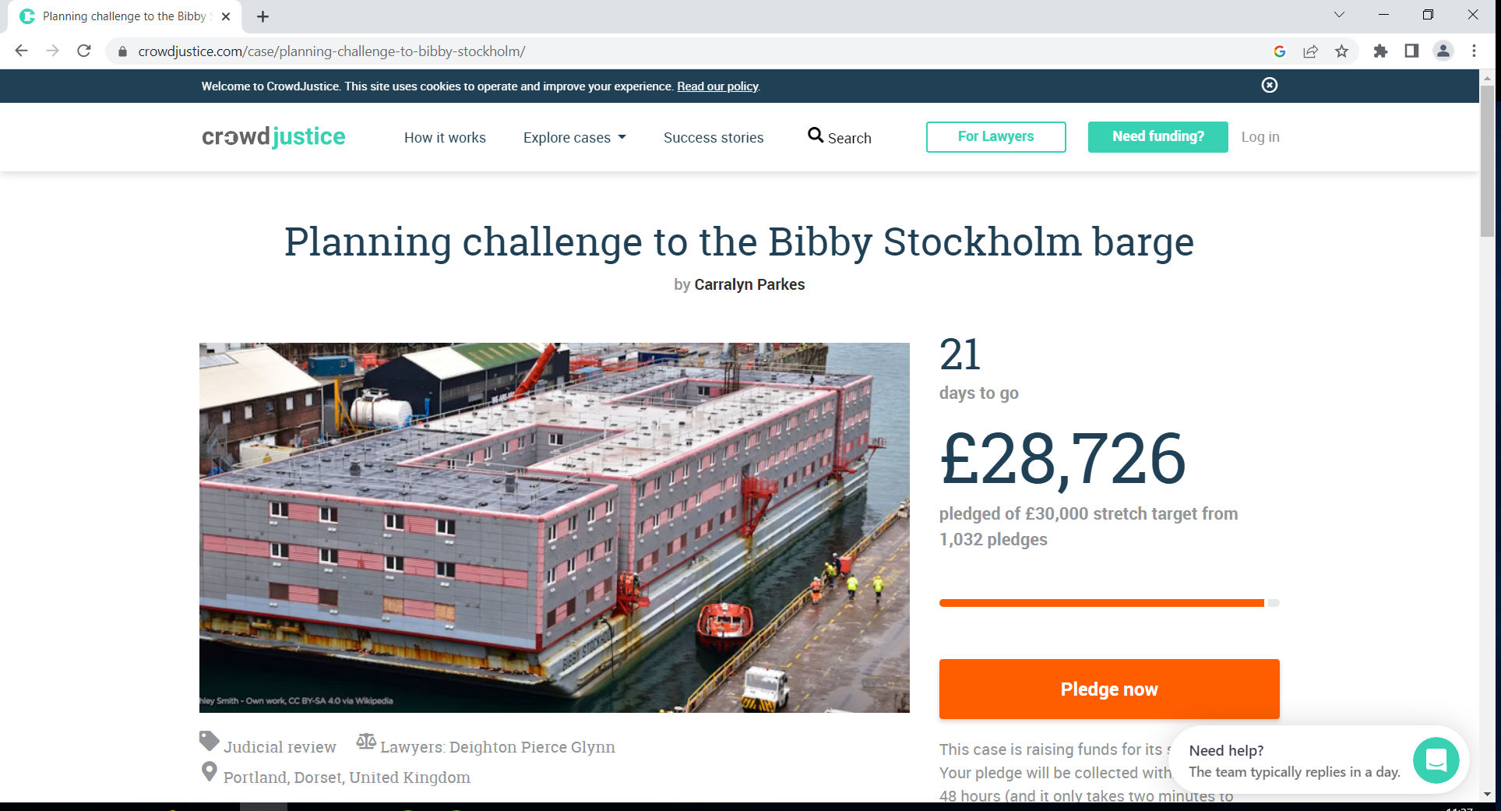
Crowdfunding

Slide 15
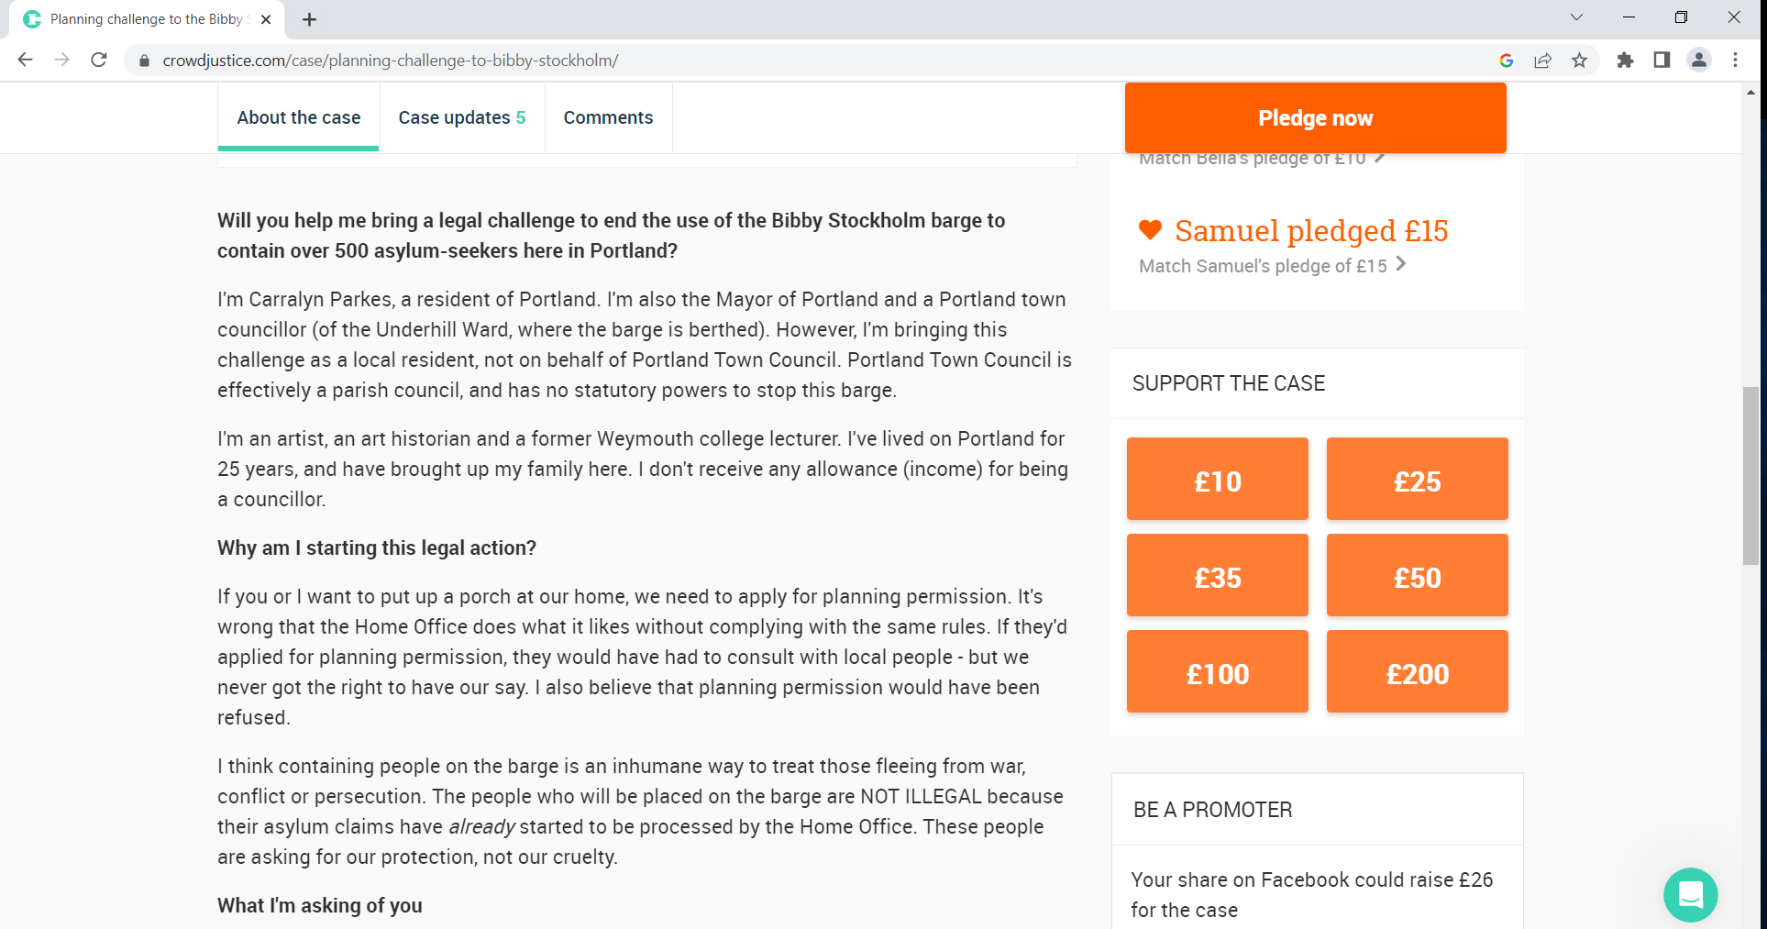

Slide 16
5 Top Tips for successful Crowdfunding
Make sure it is an issue which will be able to grab the wider public’s attention outside of the specific community.
Have key backers lined up to make early donations.
Set initial limit at a fairly low level which you know you should meet.
Draft a clear overview of the case and provide regular case updates to donors.
If using Crowdjustice, ask them to send a campaign email out to their members.

Slide 17
Top tips when representing communities in JR
Consider who is the best-placed Claimant to bring a claim on behalf of the community.
NGOs will often have an important role to play in linking communities and law firms.
Recognise that there may be divergent views – and motivations - among members of the community
Consider early on how the case will be funded and how to protect against adverse costs
Manage expectations of what litigation can likely achieve
Remember that sometimes the most important victories involve losing in Court

Slide 18
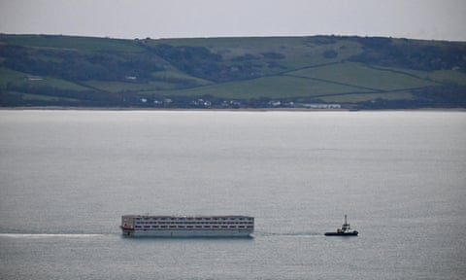
Bye bye Bibby!

