Slide 1
Making the Freedom of Information Act (FOIA) and ICO work for you
18 June 2024 | Sahil Kher and Peter Lockley

Slide 2
What will we look at today?
Architecture of a request
Key exemptions
Strategy – ‘know your enemy’ and blocking tactics
Basics of complaining to the ICO and the Tribunal

Slide 3
Brief background
Brought in in 2000 –”mutual trust” being the key aspect
Your Right to Know white paper : “unnecessary secrecy in government leads to arrogance in governance and defective decision-making”.
Key points:
Full list of orgs covered in Schedule 1 FOIA: govt departments and agencies, public bodies, armed forces, NHS, schools, universities, police forces…
Covers nearly all information held, including documents, correspondence, drafts, notes, recording of phone conversations, Whatsapps, CCTV footage…
Presided over by ICO and First Tier Tribunal (General Regulatory Chamber) within 28 calendar days.

Slide 4
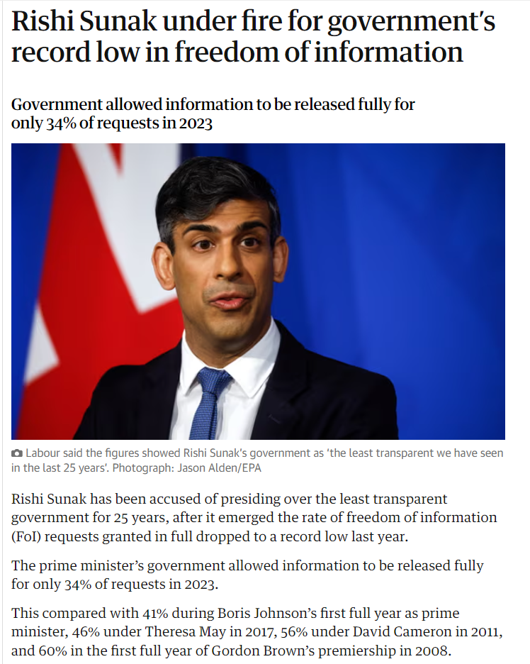
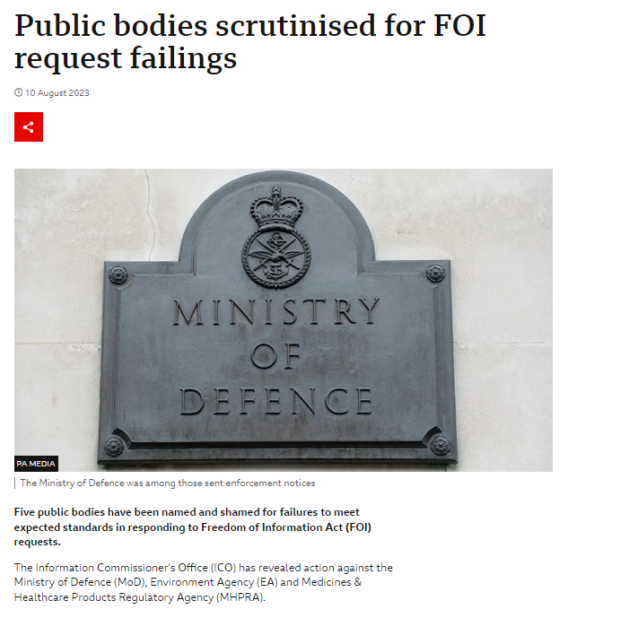
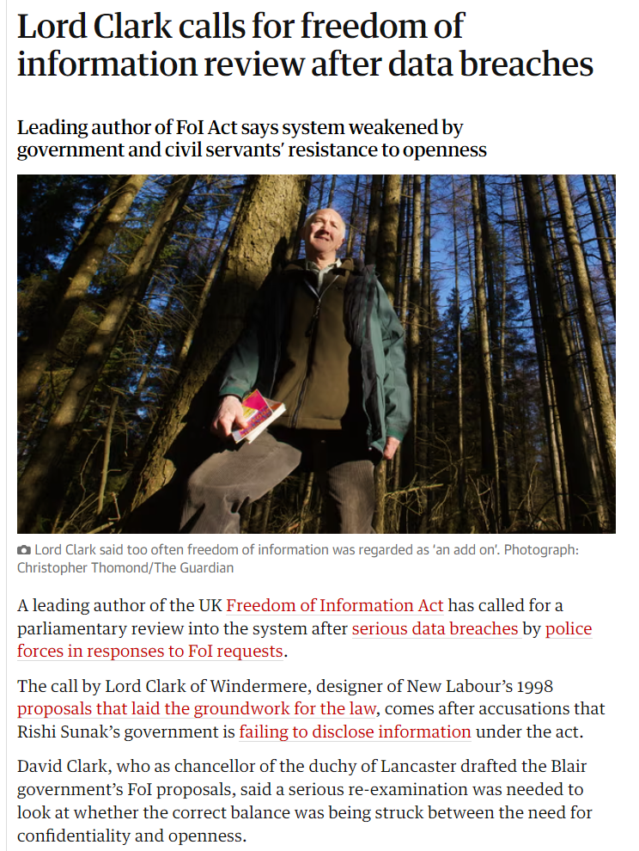
Current environment
Source: (1) The Guardian; (2) BBC; (3) The Guardian

Slide 5
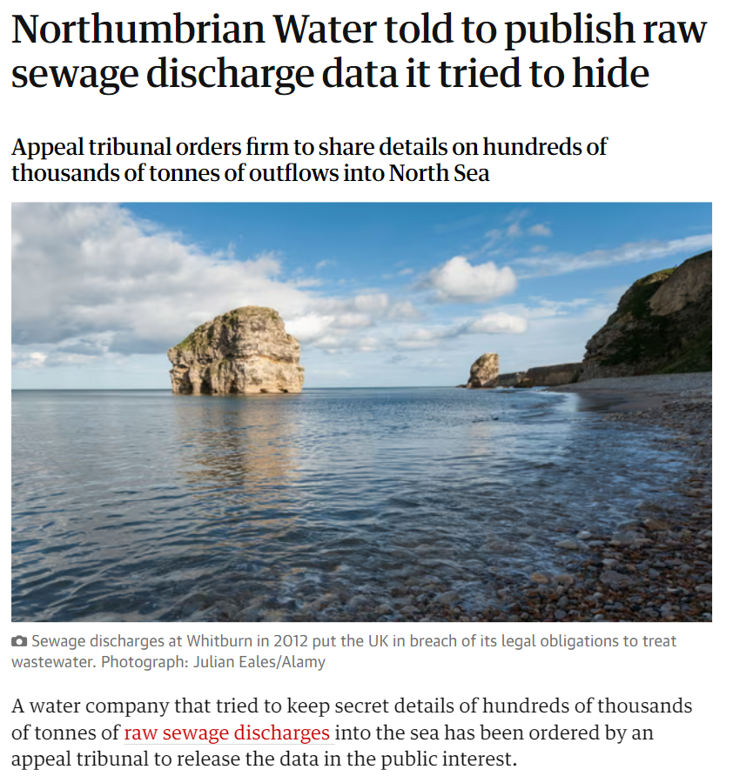
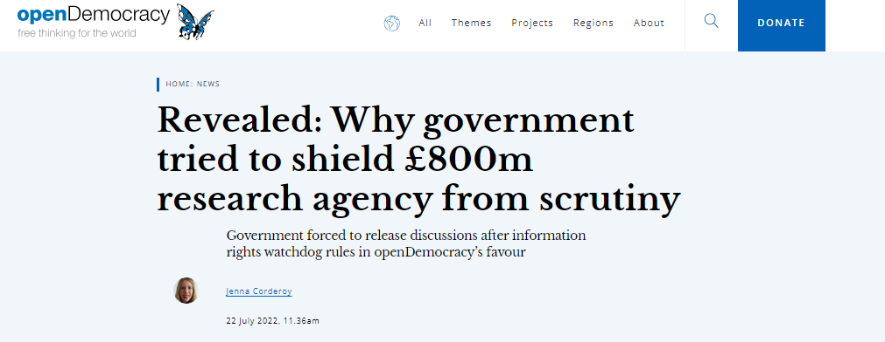
But it’s not all doom and gloom
Source: (1) Open Democracy; (2) The Guardian

Slide 6
Procedure
You make a Request for info
Info in Recorded form – can’t request ‘what is your position on X’ (unless written)… ‘what would you do if Y happened.’
As held at date of request – s.1(4)
Valid request – s.1(8)
must be in writing
state name of applicant = real name and not twitter handle – Ghafoor
Can be on behalf of an organisation
address for correspondence – can include an e-mail
describes info
PA must tell you
Whether it holds info (subject to “neither confirm nor deny”); and
Give it to you within 20 days
Unless…

Slide 7
When can a PA refuse to supply the info?
‘Gateway’ grounds for refusal applies:
S.12 – cost limit
S.14 – vexatious
Then don’t have to respond
But will (should) look at obligations to give advice and assistance (S.16 FOIA)
OR: one or more of the exemptions in Part II FOIA applies:
S.22 – future publication
S.35, s.36 – government policy and prejudice to the effective conduct of public affairs
S.31 – prejudice to law enforcement
S.40 – Personal Data
S.43 – trade secrets and prejudice to commercial interests

Slide 8
Absolute and qualified exemptions
Source: ICO

Slide 9
What should you do if the PA refuses?
You can request an IR
Not a statutory requirement but in practice all PAs have one
No set time limit but Code says 20 days or 40 if exceptional
Once you have the IR can complain to ICO:
OR if PA dragging its heels ICO will often intervene, or waive requirement to exhaust
Complainant must be same person as requester – s.50(1)
Unless both on behalf of the organisation – then the organisation is the person: Home Office v IC (EA/2019/0319) – mark “on behalf of” where possible and appropriate to do so.

Slide 10
ICO considerations
Complaining to the ICO is often well worth doing
ICO has various enforcement powers, eg to get info from a non-cooperative PA
ICO will demand a proper explanation from PA (and find against them if they don’t provide one)
Very sceptical of the generic arguments trotted out by, especially, Central Govt.
You will get a chance to make your points
ICO often puts your points to the PA
Often PA will disclose some information in the course of this procedure
ICO issues a decision notice – if in your favour you get information within 28 days, unless PA appeals

Slide 11
ICO limitations
ICO may uphold a refusal
It will be slow to find wrongdoing or bad faith by a PA
ICO may take ‘not held’ at face value
Accepts the need to protect certain info – tries to apply the balance struck in the Act
Process can be lengthy – 6-12 months

Slide 12
Next stage - appeal
Either party can do this as of right – no permission threshold
Complete re-hearing – some appeals are just asking the Tribunal to take the decision again and differently
Sometimes there is a concern that defendants do this to buy delay
Appeal stays the requirement to release
Costs-free
You can represent yourself
Law / procedure of FOIA is probably comprehensible
Online sources:
ICO guidance
11KBW’s blog – Panopticon
What Do They Know
Otherwise there are law firms and barristers willing to act pro-bono on high-profile appeals

Slide 13
Exemptions – common pitfalls

Slide 14
S.12 – costs limit
The hard limit is £600 = 24h work for central government
£450 = for other PAs
On the basis of PA’s own estimate
No balance against PI
If records are poorly organised – that is OK
… even where unlawfully poor
Cruelty Free International v Information Commissioner [2017] UKUT 318 (AAC).

Slide 15
S.12 – costs limit (cont’d)
The Freedom of Information and Data Protection (Appropriate Limit and Fees) Regulations 2004 lists what can go towards the limit
Applying exemptions does not
Same regulation ALSO states that PA can aggregate costs of multiple requests made:
by one person, or
by different persons who appear to the public authority to be acting in concert or in pursuance of a campaign,
where
the two or more requests referred to in paragraph (1) relate, to any extent, to the same or similar information, and
those requests are received by the public authority within any period of sixty consecutive working days.

Slide 16
S.14 – refusal
Section 1(1) does not oblige a public authority to comply with a request for information if the request is vexatious
S.14 is mainly confined (in practice) to trivial issues, spiralling requests, abusive language
BUT can be abused… so…
Key message for requesters is not to give ANY ammunition re s. 14
One area where FOIA is not applicant-blind – your past conduct is relevant
You can also aggregate past requests

Slide 17
S.22 – future publication
Section 22 provides an exemption for information that is intended to be published in the future.
Information is exempt if, at the time when the public authority receives a request for it:
the public authority holds the requested information;
the public authority intends the information to be published;
at some future date, whether that date is determined or not; and
in all the circumstances it is reasonable to withhold the information until its planned publication
Slater v DWP cases –
DWP has schedule for publishing internal assurance reviews of Universal Credit programme
Cases turn on whether delay until publication is ‘reasonable’

Slide 18
S.35 – formulation of government policy
35 Formulation of government policy, etc.
Information held by a government department is exempt information if it relates to—
the formulation or development of government policy
2 key points:
must relate to formulation
Distinction between ‘implementation’ and ‘formulation’ – can assist requesters
the content can be very innocuous and still be caught by s. 35
Important to remember that FOIA applies to information and not documents – PA has to go through and redact ONLY what genuinely merits being withheld.

Slide 19
S.36 – effective conduct of public affairs
S. 36 provides for information to be exempt from disclosure where that information would, or would be likely to, inhibit: the free and frank provision of advice, or. the free and frank exchange of views for the purposes of deliberation, or. the effective conduct of public affairs.
Needs a qualified person’s opinion – someone very senior who decides (in their reasonable opinion) that it would, or would be likely to, inhibit:
the free and frank provision of advice, or
the free and frank exchange of views for the purposes of deliberation
Would = balance of probabilities; would be likely = “may well happen”

Slide 20
S.31 – law enforcement
(1) Information which is not exempt information by virtue of section 30 is exempt information if its disclosure under this Act would, or would be likely to, prejudice—
the prevention or detection of crime, […]
(c) the administration of justice […]
(e) the operation of the immigration controls
Another exemption that is often over-claimed: assumption that telling people how system works will help them evade it
Can counter these points:
Information about how controls work is in the public domain already; or
Just totally unsurprising, eg, that checks are made
Lavelle v The Information Commissioner & Ors [2024] UKFTT 343 (GRC) – reg. 12(5)(b) EIR ‘course of justice’
Information about sewage discharges refused by water co. in context of EA/Ofwat inquiry
ICO upheld, FTT ordered disclosure – criticised unthinking / blanket approach

Slide 21
S.40 – personal data
The rule of thumb is redact junior officials and keep senior officials
Redact contact info and signatures
Unless you are genuinely interested knowing WHO – it is best not to challenge this
Best even to say explicitly that you are happy for appropriate redactions of PD

Slide 22
S.43 – trade secret / commercial interest
(1) deals with trade secrets – rare in practice
(2) prejudice the commercial interests of any legal person (including the public authority holding it) – ICO takes a broad approach to this.
ICO takes a broad view of ‘commercial’ – can include eg impacts on a LA’s finances
Consider impact on third parties – must have evidence that this reflects their concerns: Hartlepool BC v IC (EA 2017/0057)
Always probe for a genuine causal link between information and claimed prejudice

Slide 23
What is ‘environmental information’?
Any request for ‘environmental information’ dealt with under EIR
Nested, ever-widening definition of environmental information (reg. 2(1)) = any info on
(a) Elements of environment: air, water, land etc
(b) Factors affecting the elements in (a): noise, energy, discharges etc
(c) Measures such as policies, programmes etc affecting (a) or (b): BEIS v Henney [2017] EWCA Civ 844
(d) Reports in implementation of environmental legislation
(e) economic analysis ‘used within framework’ of measures in (c)
(f) state of human health, conditions of human life and of built structures, as affected by (a), (b) or (c)

Slide 24
Advantages of EIR
PA will often fail to appreciate breadth of ‘env info’
EIR usually better for requester:
Fewer exceptions (reg 12), more narrowly drawn
All qualified ie subject to PI balancing: reg. 12(1)(b)
PA must apply ‘presumption in favour of disclosure’: reg. 12(2)
Several key exceptions disapplied for ‘info on emissions’: reg. 12(9)
So insist on response under EIR where applicable –
but don’t let this become the only issue before the ICO
Or you will have to go round the loop again

Slide 25
Uses of information requests
Campaigning – tell stories, drive change, highlight contradictions
Investigative journalists – follow the money, ensure greater accountability
Pre-litigation or parallel to litigation (but be aware of pitfalls)
Academic research – evidence for a core argument, dispelling myths/misunderstandings
Curiosity

Slide 26
Recap and top tips
Be polite
Be clear and specific – rather make multiple focussed FOIs than one scattered one
Check first if something is already published – What Do They Know
Speak their language
Ask for underlying documents rather than information derived from elsewhere
Avoid the avoidable traps
Be persistent and test the response – ICO guidance is very useful
Look at the response
Request an IR, pointing this out
You can then go to the ICO pointing out any problems with the response

Slide 27
Any questions?

