Slide 1
What the f*** does that mean? An overview of Judicial Review
Unkha Banda
Solicitor, Deighton Pierce Glynn
19 April 2024
Notes:
Introduce myself

Slide 2
Outline
What is judicial review
Who can bring a JR
What can you challenge
Stages of a JR
Remedies
Important things to consider

Slide 3
Why do we need judicial review ?
Balance of powers
Government is required to obey the law – which is a serious issue at present.
The courts role is to ensure laws are complied with. JR is an important aspect of ensuring that the Government is not authoritarian and we maintain a balance in the system.
Without this, how do you get people to obey a law that government or members of the government disobey.
JRs help to ensure the law (as passed by parliament) is obeyed by government.
There are limitations to what the law can achieve

Slide 4
What is Judicial Review
Judicial review is a type of legal case where a judge (or judges) reviews the lawfulness of a decision or action made by a public authority.
NB: the judge reviews the process of decision-making and whether that was lawful. They DO NOT decide if the original decision was right or wrong.
Public authorities = local councils, government departments and Ministers, police forces, regulators (such as the CQC) and health authorities.
JRs are a last resort – if there are viable alternatives, use those first.

Slide 5
Who can bring a JR
A judicial review case can be brought by a person (or group of people or organisation) that has been affected by the decision of the public authority.
The person needs to have ‘sufficient interest’
Tricky for an org to on behalf of service users – Courts prefer when individuals who are directly impacted to bring cases where possible.
Easier for orgs to join as interested parties or as interveners.

Slide 6
What can you challenge
Decisions, acts and failures to act by public bodies exercising their public functions.
‘exercising public functions’ = carrying out the work they were created for.
What about context of privatisation?
Increasingly, public functions are being contracted out to private companies e.g., private companies run detention centres.
If a private company is exercising a public function, its behaviour will be governed by public law principles

Slide 7
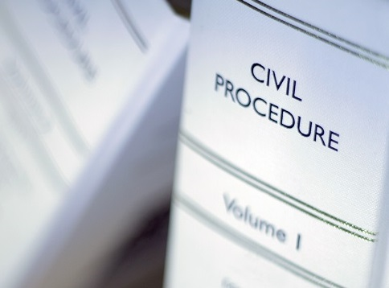
Stages of a JR
Pre-action
Purpose is to try to resolve issues without going to court
Pre-action letter must be sent – can assist in narrowing issues early on
14 days to be allowed for a response – can be reduced if circumstances require this
Failure to comply can result in negative consequences including costs
Issuing
If issues not resolved in pre-action stage, then need to make an application for permission to apply for JR.
You have to ‘issue’ the case in court nearest to you/the Claimant.
Urgent cases
Apply for interim relief (if appropriate)
Avoid making an urgent application if it is not urgent
Defendant has 21 days to file their Acknowledgement of Service and Summary Defence
You get 7 days to file your response
Permission
Judge considers paper and whether to grant permission for the claim to proceed.
Test = is there an arguable case
Various options available to judge – grant, refuse, order an oral hearing or rolled up hearing
Final Hearing
If permission is granted and issues remain, then case goes to a final hearing.
Each parties is allowed time to argue their case.
Judge then makes a final decision

Slide 8
Remedies
NB: Remedies are at courts discretion
Quashing order – overturning/undoing the decision being challenged so it has no legal effect.
Injunction – Temporary order requiring a public body to do/not to do something until a final decision is made.
Prohibiting order – Stops a public body from making an unlawful decision or action that has not yet been taken.
Mandatory order – Public body forced to take an active step e.g., a new decision within a specific period.
Declaration – A clear and concise statement of what the law says.
Declaration of incompatibility – A declaration that an Act of Parliament contravenes the Human Rights Act 1998.
Damages

Slide 9
Things to consider
Costs
JRs are expensive
Legal aid
Funding for claimant organisations
Remember: Loser pays costs
Complexity
Well-informed legal advice is essential
Risk
Courts has to balance justice for the claimant v decisions that make it hard for public bodies to do their jobs.
Remedies are at courts discretion

Slide 10
Any questions?
Thank you

