Slide 1
Current and future issues in legal aid
Dr Jo Hynes, Public Law Project

Slide 2
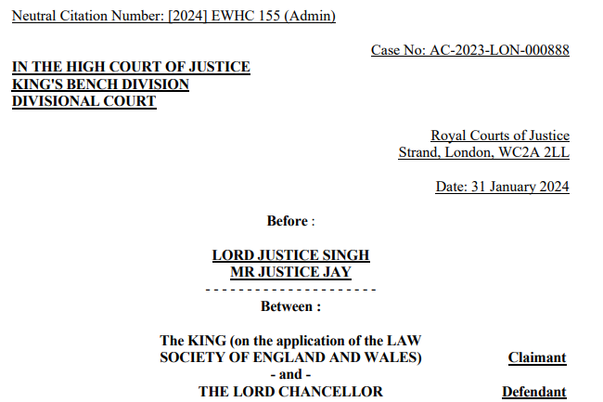
Symptom of current issues – unmet legal need
Law Society v Lord Chancellor [2024], at para. 173:
“[W]hether we are satisfied on the balance of probabilities that the system of criminal legal aid, particularly in relation to the Duty Solicitor Schemes, is inherently so defective, in the sense that it will produce unfairness in at least a significant and identifiable number of cases, that a breach of section 1 of LASPO has been made out. Proof of an actual or at least an imminent breach is required[...].”

Slide 3
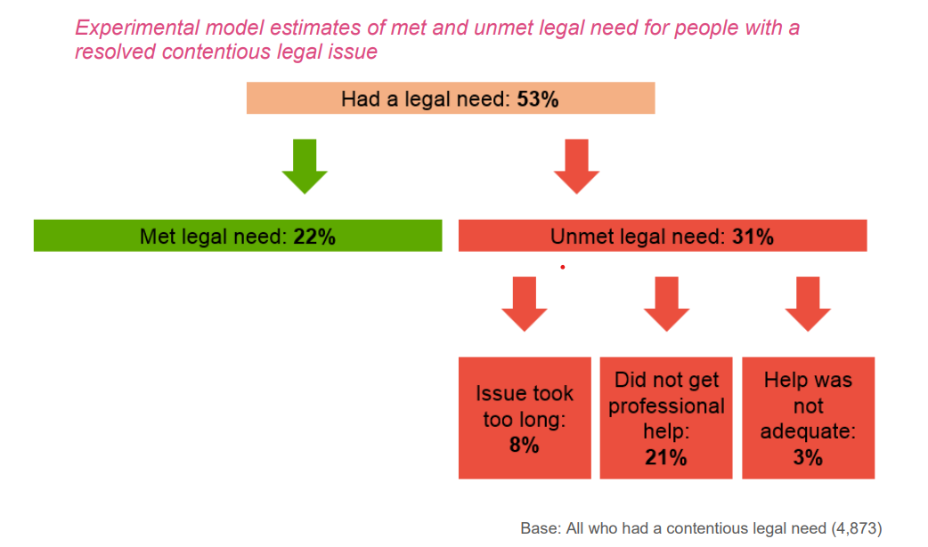
Scale of unmet legal need
Wilding, J. (2019). Droughts and Deserts: A Report on the Immigration Legal Aid Market.
Wilding, J. (2021). The Legal Aid Market: Challenges for Publicly Funded Immigration and Asylum Legal Representation (1st edition). Policy Press.
Wilding, J. (2022). No access to justice: How legal advice deserts fail refugees, migrants and our communities. Refugee Action.
Hogan Lovells & Law Works (2023) Mind the Gap: The unmet need for legal advice in England and Wales.
Legal Services Board (2020) Legal Needs of Individuals in England and Wales.

Slide 4
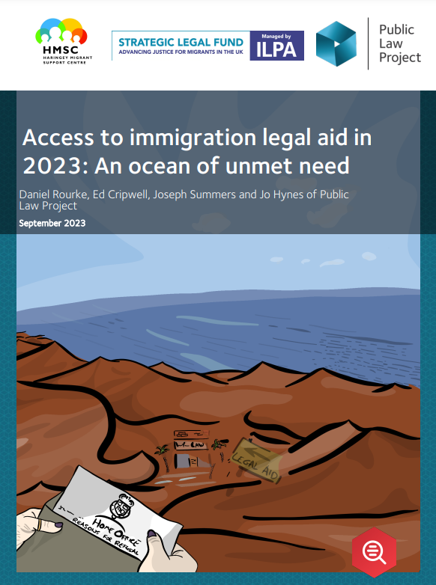
Issue 1: Providers rely on mixed funding
Grant funding - Greater Manchester Immigration Aid Unit drew on funding from 17 different charitable funders, subsidising legal aid work by around £285,000 and relaying on a further grant funding to be able to train staff.
Supplementing with better paid work - Wilsons Solicitors indicate their lawyers must take on a private case paying £88 p/hr, to subsidise a legal aid case paying (£52 p/hr), as the break-even cost is around £70 p/hr.

Slide 5
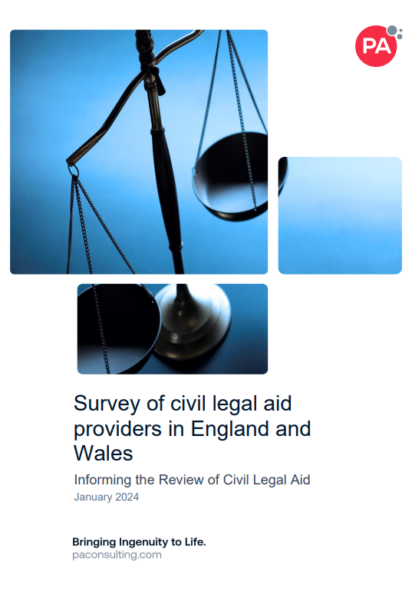
Issue 1: Providers rely on mixed funding

Slide 6
Issue 2: Support organisations’ referrals are going unanswered
HMSC were unable to place 58% of visitors over a 6 month period (compared with 38% over an early period).
Migrants Organise were unable to place 41% of their service users (between April and October 2022), despite undertaking parts of the preliminary work themselves and making around 35 referrals per person.

Slide 7
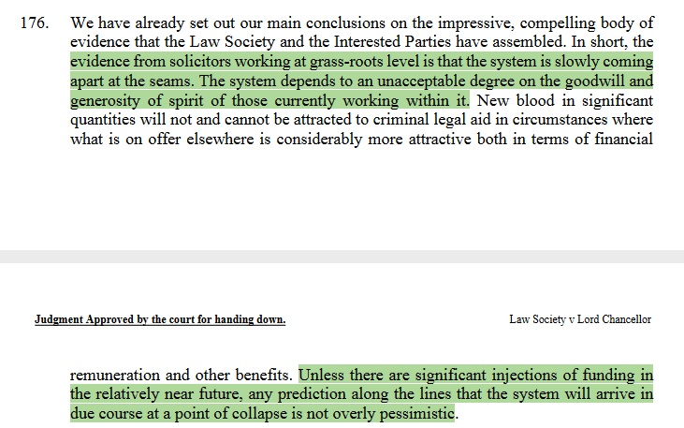
Issue 3: Providers’ capacity is saturated

Slide 8
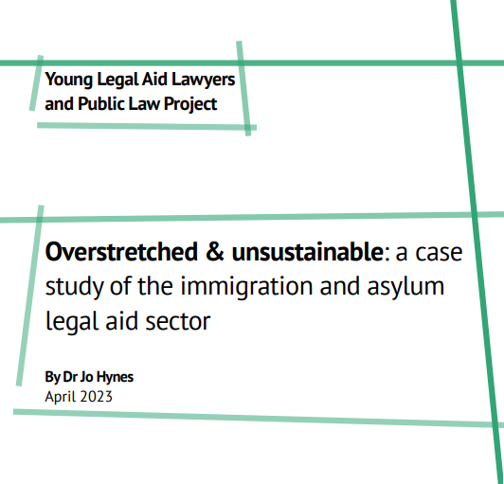
Future issues
YLAL & PLP 2023 report: Over half of young practitioners we surveyed said they were unable to advance their career in legal aid practice in the way that they would like to or were finding it extremely difficult.
Legal aid sector as an ecosystem – providers are a keystone species! How to build capacity from a dwindling provider base?

Slide 9
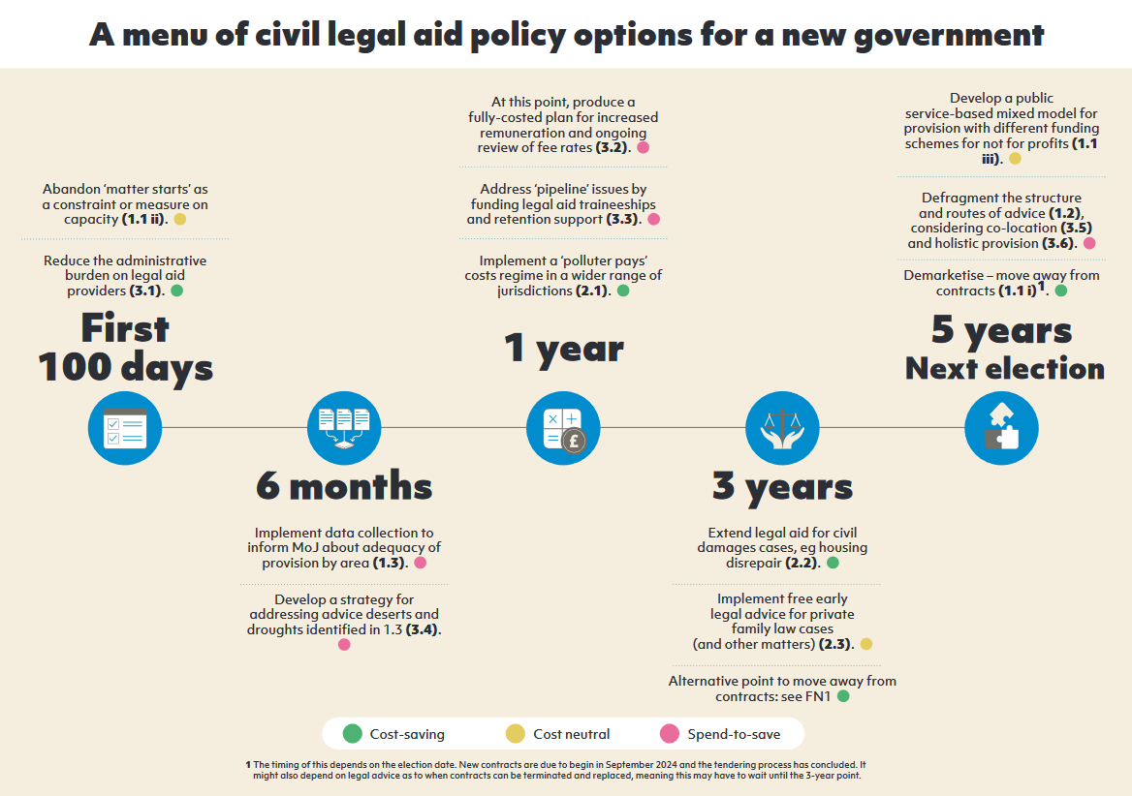
Future opportunities
NAO (2024) Government’s management of legal aid, p. 7.
“MoJ does not collect sufficient data to understand whether those who are entitled to legal aid are able to access it.”
Wilding, J. (2024). A menu of civil legal aid policy options for a new government: A Timeline.

