Slide 1
Maya Goodfellow
m.goodfellow@soton.ac.uk

Slide 2
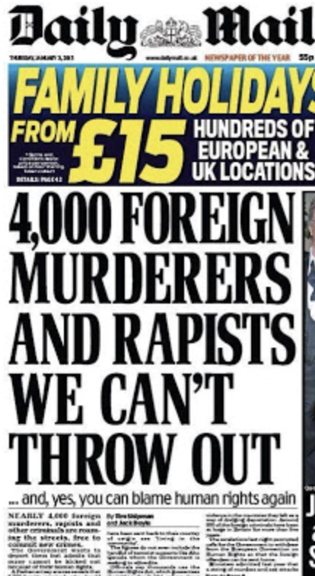
Desirable vs. undesirable

Slide 3
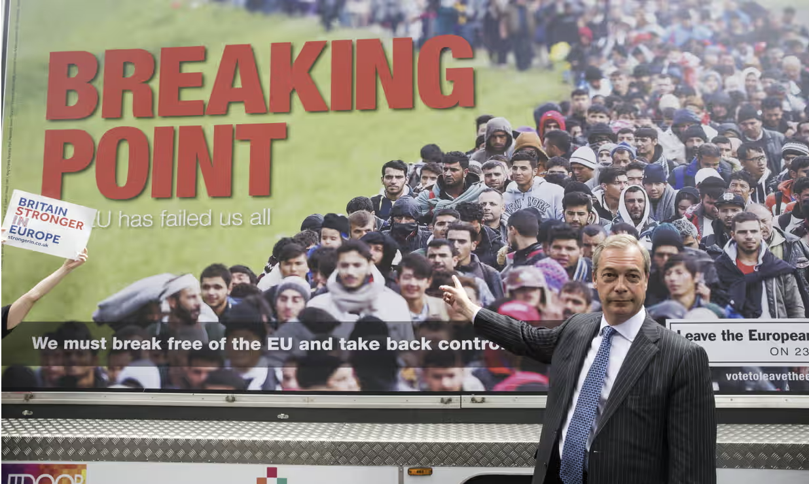

Slide 4
“An image of a 'normal' refugee was constructed—white , male and anti-communist—which clashed sharply with individuals fleeing the Third World”
- B. S. Chimni, ‘The Geopolitics of Refugee Studies: A View from the South’, Journal of Refugee Studies, vol. 11, issue 4, 1998, pp. 350–74.

Slide 5
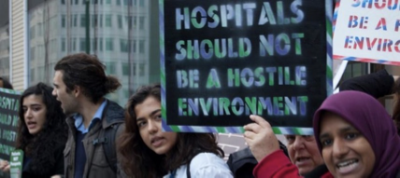
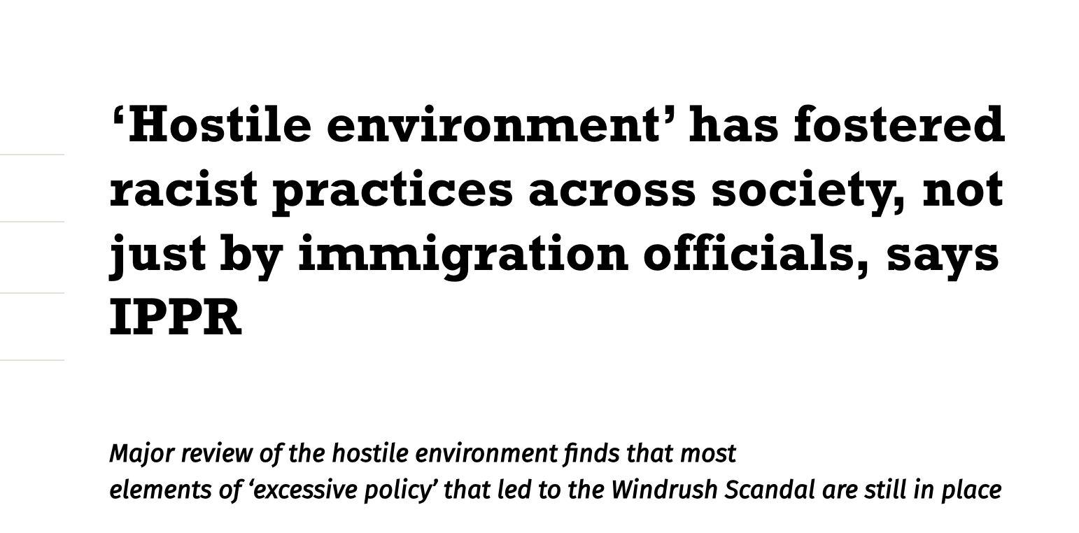

Slide 6
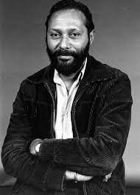
Racialisation
‘Black’ is ‘constructed politically and culturally’ and ‘cannot be confined to a set of transcultural or transcendental fixed racial categories’ (1988: 443).

Slide 7
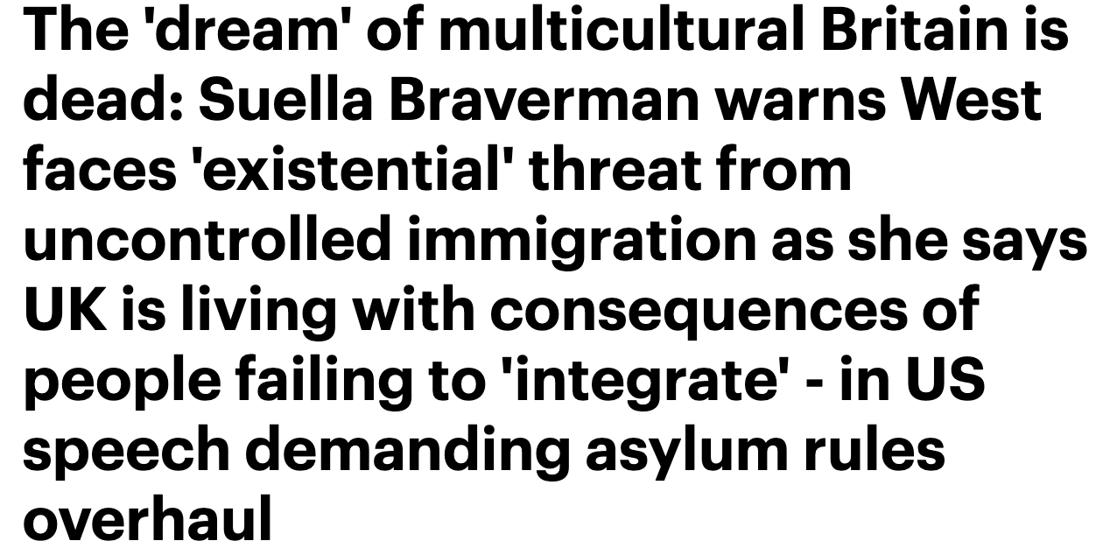

Slide 8
