Slide 1
Delays in the asylum system – legal challenges
Alison Pickup
Asylum Aid

Slide 2
R (FH & Ors) v SSHD [2007] EWHC 1571 (Admin)
“The delays, which in three cases exceed 3 years and in the others (save one) have reached 2 years, are on their face excessive.” (para 6)
“…claims such as these based on delay are unlikely, save in very exceptional circumstances, to succeed and are likely to be regarded as unarguable. It is only if the delay is so excessive as to be regarded as manifestly unreasonable and to fall outside any proper application of the policy or if the claimant is suffering some particular detriment which the Home Office has failed to alleviate that a claim might be entertained by the court.” (para. 30)

Slide 3
Paragraph 333A of the Immigration Rules
The Secretary of State shall ensure that a decision is taken on each application for asylum as soon as possible, without prejudice to an adequate and complete examination.
Where a decision on an application for asylum has not been taken within:
  a) six months of the date it was recorded; or
  b) within any revised timeframe notified to an applicant during or after the initial six-month period in accordance with this paragraph, and
  c) where the applicant has made a specific written request for an update,
the Secretary of State shall inform the applicant of the delay and provide information on the timeframe within which the decision on their application is to be expected. The provision of such information shall not oblige the Secretary of State to take a decision within the expected timeframe.

Slide 4
R (EG) v SSHD – individual facts
51-year-old citizen of Cote d’Ivoire
PTSD diagnosis – receives counselling from Freedom from Torture
2 March 2019 – asylum claim recorded at screening interview
12 May 2021 – PIQ issued
12 July 2021 – substantive asylum interview
21 September 2021 – SSHD refused request for a timeframe
17 March 2022 – SSHD indicated decision by end April 2022
26 August 2022 – SSHD indicated decision within 3 months (by 26 November 2022)
21 November 2022 – SSHD indicated decision by end February 2023
21 December 2022 – judicial review challenge to delay issued
5 April 2023 – permission granted on ground 1 (individual delay unlawful)
28 April 2023 – asylum claim refused with right of appeal
25 September 2023 – permission granted on remaining grounds following OPH

Slide 5
Evidence of systemic failure to comply
In Asylum Aid’s experience:
  Most clients wait significantly more than 6 months for a decision
  SSHD routinely either does not provide a timeframe or provides one which is not reliable
  SSHD routinely does not explain why she has not met any timeframe given or what special circumstances or exceptional complexities have arisen that meant she was unable to meet it
31 case studies of clients who have waited more than 6 months for an initial decision on their asylum claim.
The longest delay in our sample was 5 years 2 months. The quickest decision was 11 months.

Slide 6
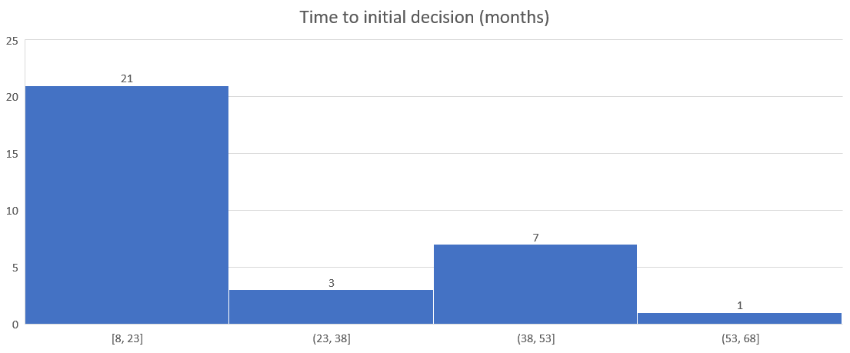
Asylum Aid case sample – 20.6.23

Slide 7
Examples of SSHD’s response re timescales
‘there are no timescales for concluding asylum cases’.
‘unable to offer specific timescales to individuals at this time’
‘does not currently have a target time for processing claims for asylum’
‘unable to offer specific timescales to individuals at this time’ but is ‘working hard to improve the level of service’.
‘unable to guarantee that a decision maker will be available to decide the claim’ within a 3-month timescale given

Slide 8
R (EG) v SSHD – Grounds
SSHD’s delay is unlawful as in breach of the duty to make a decision as soon as possible, and is in any event unreasonable
SSHD’s para. 333A timeframe has no sufficient basis (& so unlawful)
SSHD is failing to operate a system which allows her to comply with her para. 333A duty to provide timeframes
Unlawful delay is in breach of Article 8 ECHR
Provision of timeframes which were not proper timeframes complying with the para. 333A requirement is a breach of A’s rights under Article 8
Damages are necessary by way of just satisfaction for these breaches

Slide 9
What does the para 333A duty imply?
An obligation of ‘promptness’ / a decision within a reasonable time
A duty when providing a timeframe to ensure that:
  a. The timeframe is stipulated in good faith
  b. The timeframe stipulated is based upon proper and rational enquiry as to when a decision can properly be expected to be made in the case concerned.
  c. A proper and rational enquiry requires sufficient enquiry as to the workload and work speed of the officers concerned with taking the decision and of foreseeable events which may change the speed with which such cases are being decided.

Slide 10
Is Article 8 breached by unlawful delay?
The positive obligations under Article 8 ECHR “include the competent authorities’ duty to examine the person’s asylum request promptly, in order to ensure that his or her situation of insecurity and uncertainty is as short-lived as possible ...”: B.A.C. v. Greece, First Chamber (no. 11981/15, § 37, 13 October 2016).
The Court concluded in that case (in which the Applicant had lived for 12 years in a state of precarity):
  “46. The Court holds that in the circumstances of the present case the competent authorities failed in their positive obligation under Article 8 of the Convention to establish an effective and accessible procedure to protect the right to private life by means of appropriate regulations to guarantee that the applicant’s asylum request is examined within a reasonable time in order to ensure that his situation of insecurity is as short-lived as possible (see also paragraph 37 above). There has therefore been a violation of Article 8.”

Slide 11
Inadmissibility
“Between 1 January 2021 and 30 June 2023:
60,595 asylum claimants were identified for consideration on inadmissibility grounds
29,258 ‘notices of intent’ were issued to individuals, to inform them that their case was being reviewed to determine whether removal action on inadmissibility grounds was appropriate and possible
83 individuals were served with inadmissibility decisions, meaning the UK would not admit the asylum claim for consideration in the UK system, because another country was considered to be responsible for the claim, owing to the claimant’s previous presence in, or connection to a safe country
there were 23 enforced removals of individuals considered for removal on inadmissibility grounds
38,238 individuals were subsequently admitted into the UK asylum process for substantive consideration of their asylum claim
The 23 returns were made to Belgium, Denmark, France, Germany, Ireland, Italy, Slovenia, Spain, Sweden and Switzerland.”
https://www.gov.uk/government/statistics/immigration-system-statistics-year-ending-june-2023/how-many-people-do-we-grant-protection-to#asylum-claims-considered-inadmissible (accessed 20.11.23)

Slide 12
How many people are still waiting to be admitted? (based on data table 9a)
Cases considered under inadmissibility rules, 1 April 2022 - 30 June 2023
Date | Q2 2022 | Q3 2022 | Q4 2022 | Q1 2023 | Q2 2023 | Total
Total identified for consideration on inadmissibility grounds | 6,040 | 9,950 | 14,511 | 9,622 | 5,229 | 45,352
Notice of intent issued | 3,627 | 2,591 | 3,026 | 2,553 | 5,173 | 16,970
Inadmissibility decision served | 7 | 0 | 0 | 0 | 0 | 7
Removals | 4 | 1 | 1 | 0 | 0 | 6
Subsequently admitted into UK asylum process | 1,403 | 1,796 | 3,844 | 14,025 | 10,592 | 31,660
still in inadmissibility procedure | 4,626 | 8,153 | 10,666 | -4,403 | -5,363 | 13,679
Notes:
Note that the figures do not add up because cases are counted in the period when the action was done i.e. someone who was identified for consideration on inadmissibility grounds in April 2022 might have been admitted in April 2023 so appear in both Q2 2022 and Q2 2023.

Slide 13
Impact on clients
Being unable to be recognised as refugees even where they have strong prima facie claims. The countries with the highest numbers of Notices of Intent include countries with extremely high recognition rates such as Eritrea, Afghanistan, Syria and Sudan.
Negative impacts on physical and mental health as a result of prolonged uncertainty and fear of being sent to Rwanda or similar
Inability to progress in education, employment, etc
Inability to access family reunion
Inability to travel outside the UK
Continued requirement to report to immigration service
Poverty (Home Office accommodation is of a very poor standard and supported persons are provided with an extremely minimal subsistence allowance)

Slide 14
Inadmissibility Guidance
Timescales
There are no rigid timescales within which third countries must agree to admit a person before removal. However, the inadmissibility process must not create a lengthy ‘limbo’ position, where a pending decision or delays in removal after a decision mean that a claimant cannot advance their protection claim either in the UK or in a safe third country.
If, taking into account all the circumstances, it is not possible to make an inadmissibility decision or effect removal following an inadmissibility decision within a reasonable period, inadmissibility action must be discontinued, and the person’s claim must be admitted to the asylum process for substantive consideration.
As a general guideline, it is expected that in most cases, a safe third country will agree to admit a person within 6 months of the claim being recorded, enabling removal to follow soon after (subject to concluding any legal challenges or other barriers to removal).
caseworker guidance on inadmissibility

Slide 15
Inadmissibility Guidance
There will be some cases where a reasonable timescale may be shorter than 6 months, because there are not realistic prospects of effecting removal within a reasonable timescale. For example:
where there is no prospect of removal, because all possible countries of removal have emphatically refused to accept the person
where there is a very low prospect of removal within a reasonable timescale, because the countries of removal refuse to engage in any discussions around admitting the person
In other cases, what is reasonable may be longer than 6 months. For example:
if early inadmissibility processing has been delayed, because a claimant’s presence in or connection to a safe country was not disclosed or clearly evidenced at the time the protection claim was made and registered, but instead is disclosed at a later time, for instance, during an asylum interview
where third countries have actively engaged with the Home Office in discussions around admitting a person (or people), but where through no fault of the Home Office, progress towards agreement has been delayed
where a claimant is referred into the National Referral Mechanism, it will be usually be appropriate to pause inadmissibility action until the consideration of whether or not the person is a victim of modern slavery has been completed

