Slide 1
Systemic legal challenges: Case Study
Matthew Court, Public Law Project

Slide 2
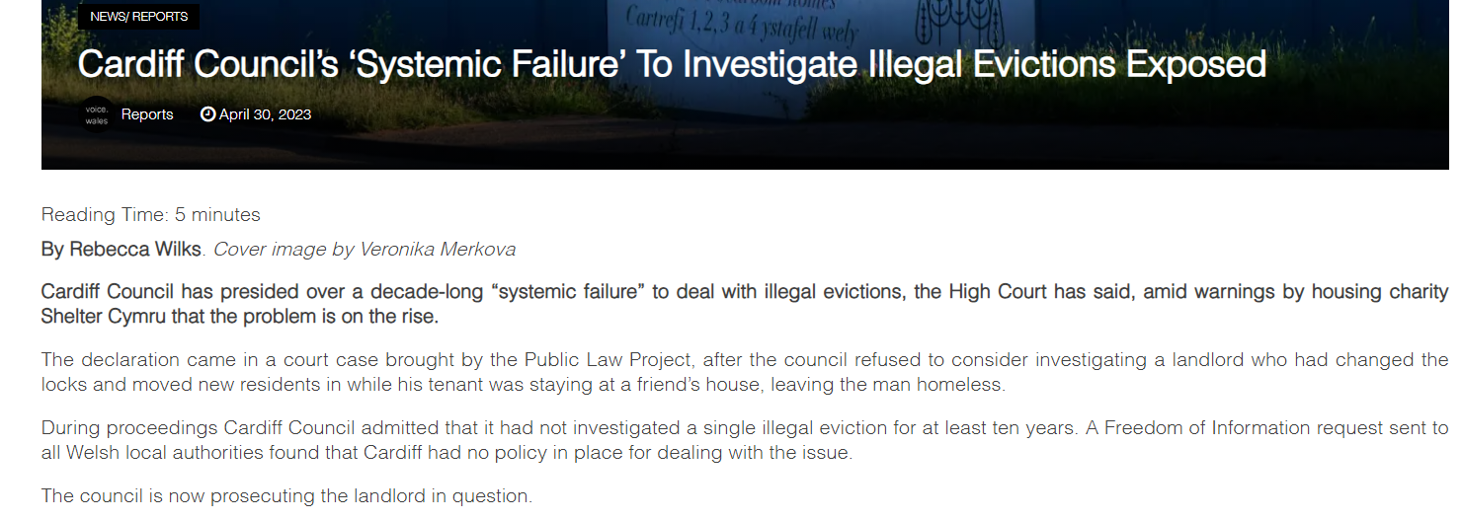

Slide 3

Building the case
Referrals from Speakeasy Law Centre
Appeared to be a systemic issue, but how to show:
  “something inherent in the scheme that gives rise to an unacceptable risk of procedural unfairness” (Woolcock)
Disclosure request in pre-action letter (Treasury Solicitor’s Department, ‘Guidance on Discharging the Duty of Candour’ para 1.2 / 23(d) of the Judicial Review Pre-Action Protocol )
Freedom of Information Act 2000 requests (WhatDoTheyKnow - Make and browse Freedom of Information (FOI) requests)
Witness statements / case studies

Slide 4
The claim
Failure to investigate allegations of unlawful eviction
The system adopted by the local authority was unlawful
System effectively guaranteed unfairness
Breach of the EA 2010 (s.1)

Slide 5
Outcome
Further evidence from the local authority at hearing
Consent order – “failure to consider exercising its statutory powers pursuant to s.6 PFEA 1977 was unlawful, such unlawfulness resulting from the Defendant’s systemic failure since 2012 to resource itself adequately to consider such action”
Cardiff Council’s ‘Systemic Failure’ To Investigate Illegal Evictions Exposed | (voice.wales)

