Slide 1
Prof. Helen Carr. University of Southampton &
Martin Collett, Chief Executive, English Rural Housing Association

Slide 2
What’s the problem? Background
Rough sleeping had been rising for almost a decade going into the pandemic.
The government’s rough sleeping strategies contained no references to rural or targeting interventions.
Signs that policy wasn’t working in rural areas – while overall rough sleeping fell for the first time in a decade between 2018 and 2019 (9% reduction in England) in rural areas numbers increased.
Signs that regions such as the South West had been particularly hard hit by cuts to homelessness services.
Lack of attention from policymakers and insufficient funding for support services leave people facing isolation and danger. But international evidence showed change was possible.

Slide 3
What we did
Convened a group of rural and homelessness organisations and housing associations, including National Housing Federation, CPRE, Homeless Link to identifying research and evidence gaps.
Commissioned Universities of Kent and Southampton to conducted research, including survey of providers and local authorities and interviews with individuals who experienced homelessness and support workers.
Field sites: South Cambridgeshire, Kent, Herefordshire, North Yorkshire.
Examined the impact of austerity and welfare reforms on rural homelessness.

Slide 4
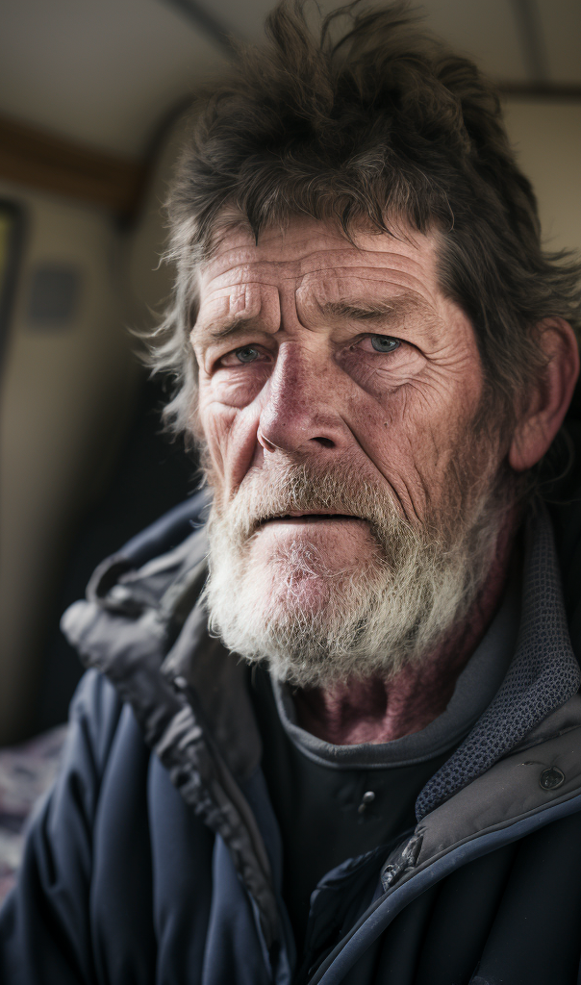
What we found
The rising levels of homelessness in rural areas: rough sleeping numbers has risen by 24% in one year.
Insufficient resources to tackle the problem: 83% of survey respondents in rural areas reported their job has become more difficult in the past 5 years. 65% funding gap between per capita spending on the homelessness prevention grant in rural areas compared to urban areas.
Shame and stigma in rural communities acting as a barrier to support: particularly in more prosperous rural areas.
Physical isolation increases risk: limited transportation options and greater distances to support services create unique challenges,
Informal support networks can play a key role in rural areas: positive examples of farmers, communities providing support, but not helped by local authority often enough.
The challenges in rural areas push people into urban centres, at which point needs are higher: the above problems mean that many people experiencing homelessness in rural areas leave for urban areas against their wishes, to seek out support services.

Slide 5
Policy asks
We unified a broad coalition of organisations behind a set of local and national recommendations:
Central government needs to commit to ending homelessness and rural-proof future strategies.
Pilot one-stop-shop homelessness services in rural areas.
DLUHC needs to improve processes for better counting and funding local authority efforts to use data to tackle rural homelessness.
Funding must be provided to build more social housing and raise Local Housing Allowance (LHA) to cover the cost of rent in rural areas.

Slide 6
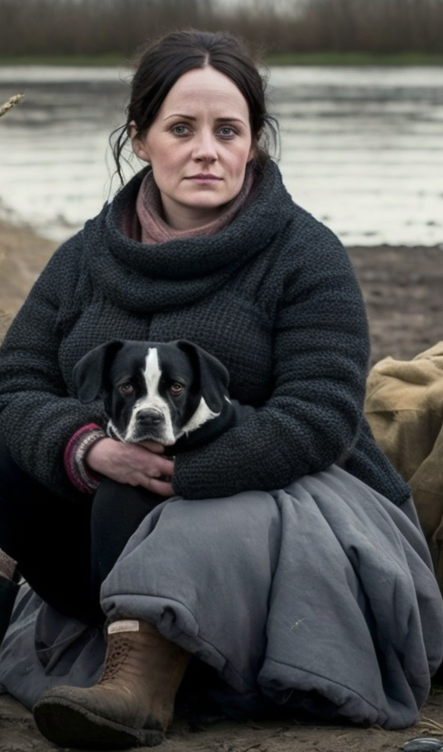
Media & Communications
Transformed core research findings into impactful media content and supplied a comprehensive media pack for stakeholders
Launched a dynamic social media campaign with powerful messages and visuals, achieving over 1 million impressions – a record-breaking feat
Secured coverage on BBC News and 30 other sources (including online, radio, and TV outlets like Sky, ITV, The Independent, Yorkshire Post, Radio2, Jeremy Vine and Radio4 – BBC One Show)
Experienced a 700% surge in website referrals and a 30% increase in user engagement
Initiated a dialogue with the ONS to explore potential collaboration on future research projects
KMTV documentary and animation

Slide 7
Media & Communications
Fortified media connections, particularly with the BBC rural affairs team
Established powerful collaborations with other aligned organisations
Amplified awareness of rural homelessness and rural housing concerns – positioning rural housing as a vital solution among various approaches to combat rural homelessness
Connected with influential figures capable of driving action
Assumed a pivotal role in commissioning, directing, and promoting the research
Ensured the research remains at the forefront with upcoming initiatives (roundtable, CHI – imagery, ONS, RHW, webinars, potential pilot)

Slide 8
Public affairs activity
Roundtable with Rough Sleeping Minister: Parliamentary roundtable held withy Felicity Buchan MP (Con) and select group of senior stakeholders from across homelessness and rural sectors, as well as lived experience perspectives.
Meeting with Shadow Minister’s team: following public support for the research from Paula Barker MP, we have convened a meeting with her and also been engaging directly with the team of Matthew Pennycook (Lab). A meeting has also been convened with Helen Morgan MP (Lib Dem).
Webinar: organised to present research to key stakeholders, with particular focus on local authorities, membership and service delivery organisations.

Slide 9
What next?
Establishing the ‘rural homelessness counts’ coalition: building on momentum and channelling broad support through establishing a formal coalition. Aiming to keep rural homelessness on the national agenda and develop policy and practice at the local level.
Labour frontbench roundtable: To influence Labour’s manifesto policymaking process through a joint roundtable with rough sleeping and DEFRA teams during the summer.
Co-producing local practice with Centre for Homelessness Impact (CHI) and LGA: we are convening an engaged group of local authorities to develop best practice on data collection and service delivery.
Rural photography project: as part of collaboration with CHI we are collaborating on a photography project to challenge the urban conception of homelessness and confront stereotypes, and raising awareness of the coalition’s work.
Key theme during Rural Housing Week 2023, including pledge to end rural homelessness. Invitations for speaking and engagement continue….

Slide 10
Academic next steps
Academic outputs
Updates work by Cloke et al from 2002
austerity
Agency
The variegated meaning of the rural
Funding bid
Treat this work as a pilot project for a larger bid
Continued relationship with the consortium
Letters of support and project panel
Internationalise the research

Slide 11
Some reflections on co-production
Shared but complementary passion for the project
Speed
Academics take time to get started
ethics
Quite different speed in the NGOs
But co-production takes time
Ownership of research
Potential tensions in that research owned by the academics
But the independence of the research is a strength
Amplification of research
Astounding media connections with NGOs
Impact Acceleration account monies enabled more sophisticated outputs
Policy and political influence of NGOs

