Slide 1

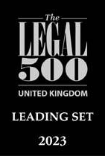
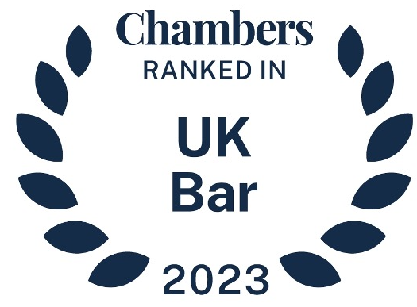

‘Positive’ duties to avoid destitution: Article 3 and systemic judicial reviews
Ben Amunwa
6 July 2023

Slide 2
Introduction:
Systemic Article 3 ECHR claims (‘A3’) in practice.
Claim design
Positive duties
Comment

Slide 3
Systemic A3 claims in practice:
Misunderstood as an impossibly high threshold;
Under used;
‘Positive’ duties often de-emphasised;
  eg. Morris J in AO v Home Office [2021] EWHC 1043 (QB) – discussing authorities at §257; dismissing claim at §§258-259.
Notes:
In AO, the claim was based on:
failure to decide an application for bail accommodation under s4(1)(c) IAA 1999 within a reasonable time;
resulting in sofa surfing but no street homelessness
Inconsistency with other destitution-based A3 cases where the breach has been based on the risk of imminent IDT, rather than actual IDT
§259 - “the facts here bear no resemblance in seriousness to those in Humnyntskyi or even in Limbuela.”
There remains a risk that Judges base their reasoning on comparisons that measure the perceived severity on the facts of different cases, rather than on legal principle
In other words, the fact that in one case the suffering was severe does not mean that a case of less severe suffering doesn’t breach A3 duties

Slide 4
Claim design
  Clarify the type of duty alleged alleged to have been breached.
  Breach of primary substantive duty?
    Treatment suffered must reach minimum level of severity.
  Breach of investigative duty?
    Arguable case of suffering IDT triggers state duty to conduct effective investigation.
  Is it a breach of a positive duty?
    Variety of considerations arise…

Slide 5
Positive duties: destitution
  The positive A3 duty in the context of destitution:
    Administrative systems will be incompatible with the positive A3 duty & contrary to s6 HRA 1998 if they fail to anticipate and proactively avoid the risk of imminent suffering of IDT;
      R (Limbuela) v SSHD [2005] 3 W.L.R. 1014 – refusal to provide support to asylum seekers who brought ‘late’ claims for asylum (§§6-8, 46-47).
      R (W) v SSHD [2020] 1 WLR 4420 – ‘no recourse to public funds’ (‘NRPF’) condition on family migrants only lifted once ‘destitute’ (§§34-36, 42, 61-66 & 73).
      R (DMA & others) v SSHD [2021] 1 W.L.R. 2374 – systemic delays to s.4(1)(c) IAA 1999 accommodation for failed asylum seekers (§§183, 198-200).

Slide 6
Positive duties: destitution
Home Office v ASY [2023] EWHC 196 (KB)
  ‘Low-level’ systems duty case concerning family migrants subject to the NRPF condition. Judgment of May J;
  Applied Limbuela and W – held A3 did not permit SoS to wait until a person falls into destitution before taking action (§68);
  On facts, A3 required that where a family migrant applied to SoS to lift the NRPF condition, SoS had to decide application correctly and within a reasonable time (§§71-72 & 85).

Slide 7
Positive duties: further descriptors
A3 positive duties
High-level framework
(eg. effective deterrence)
Breached where failure to est. a legislative and regulatory (incl. criminal law) framework to effectively protect individuals from the risk of IDT.
Operational duty
(eg. safeguarding)
Breached if state knows or ought to know of a real and immediate risk of IDT but fails to take measures (within its powers) that reasonably might have been expected to avoid it, but benefit of hindsight.
‘Low-level’ systems
(eg. supervision, training, procurement)
Breached if state undertakes, organises or authorises a dangerous activity & fails to take measures to reduce the risk of IDT to a reasonable minimum (having regard to the need not to impose an impossible / disproportionate burden on authorities).
X and Others v. Bulgaria at §179.
Smith v Ministry of Defence at §§68 & 105;
R (CSM) v SSHD §§90-9
Home Office v ASY §§50, 81, 71-72 & 85
Osman v UK at §§115-6;
R (MG) v SSHD §§6-8, 66-69
Notes:
Terminology is not always used consistently;
Sometimes the tests may overlap / intersect

Slide 8
Comment
Operational duty & ‘low-level’ systems duty apt for systemic judicial reviews;
  Lower thresholds than the primary substantive duty, but still demanding (eg. possibility of serious harm required in CSM §97 re: the systems duty);
ASY unlikely the last word on scope of A3 positive duties in the context of destitution.
Notes:
NB. The author is acting for the claimants in ASY.
ASY appears to have assumed the lawfulness of SoS’s scheme, downplayed the anticipatory nature of the positive duty and built in a reasonable time for the SoS to respond to an application by a person who is already destitute.

Slide 9
The 36 Group
4 Field Court, London WC1R 5EF
020 7421 8030
clerks@36civil.co.uk
36civil.co.uk

