Slide 1
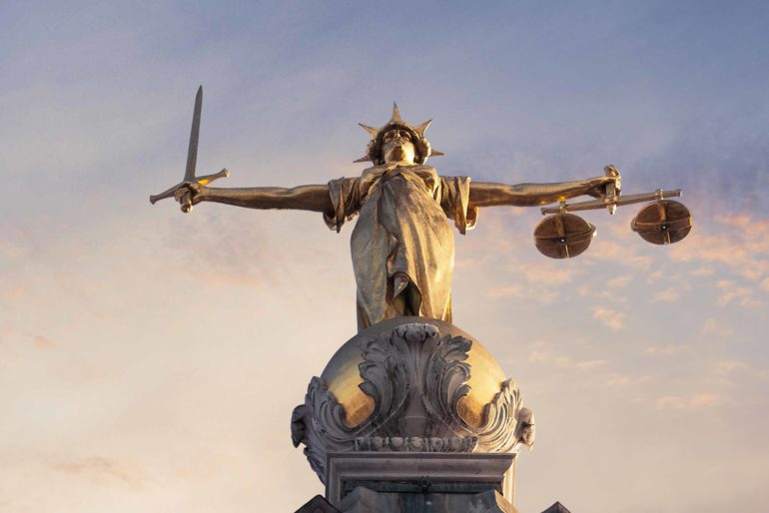
Unconscious bias and Discrimination
Access to Justice in the South West 2021

Slide 2
The Process of Discrimination
Unconscious bias
(Unconscious associations)

Slide 3
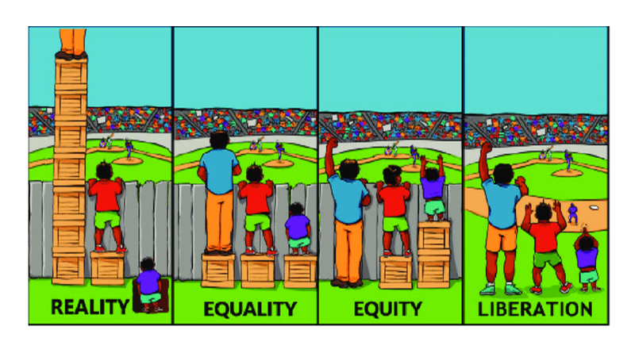

Slide 5
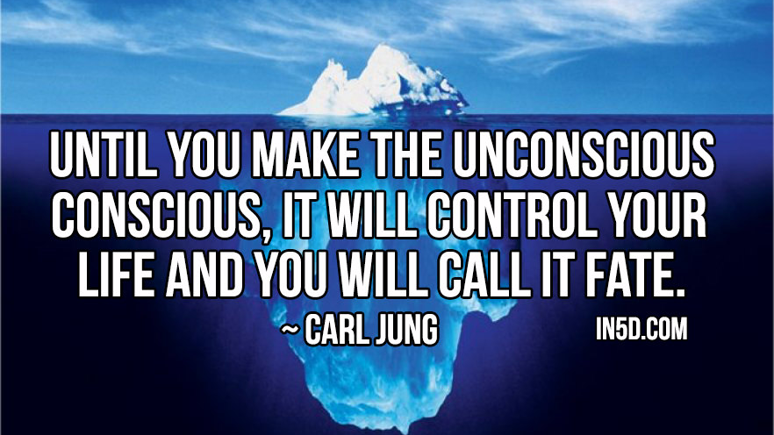
This Photo by Unknown Author is licensed under CC BY-NC

Slide 7
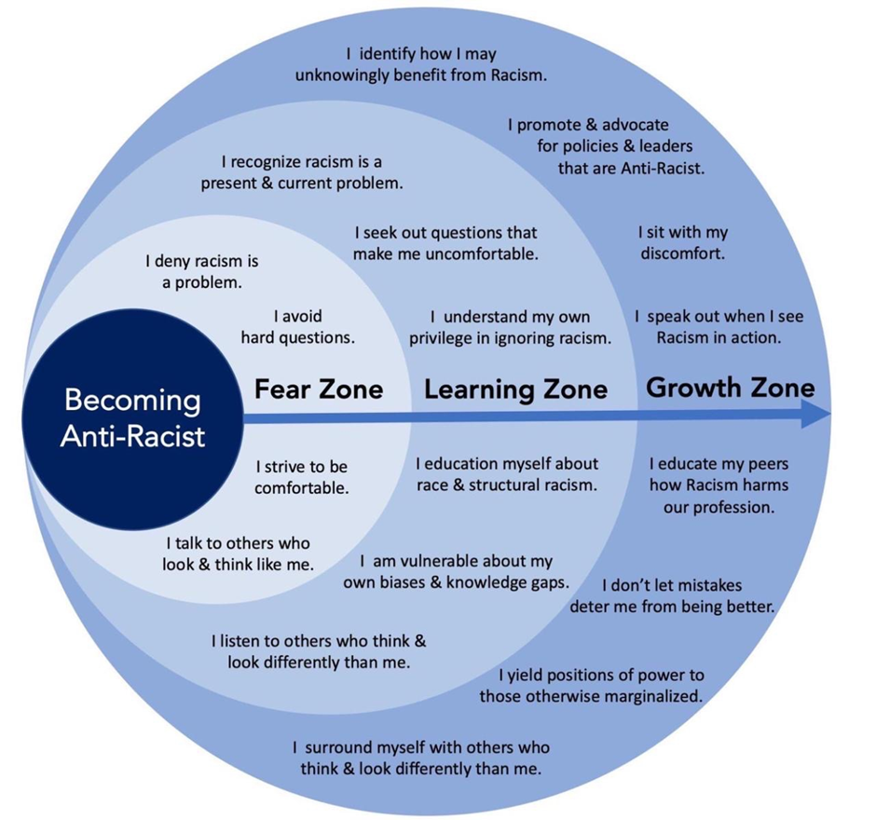

Slide 8
Ten Principles of anti-discriminatory practice
Open minded
Respectful
Inform staff of acceptable
behaviour
Empathy
Act on it
Challenge Practice
Communication
Don’t exclude staff/Volunteers
Assertiveness
Know yourself

Slide 9
What are White privileges?

Slide 10
What can we do?
Acknowledge the issues
Be willing to change
Understand our personal bias and how they affect our lives and other people’s lives
Have the courage to talk about racism
Have the courage to stand up for any kind of discrimination
Educate people and encourage people to educate themselves
Lobby the government against the hostile environment policies
Take those policies to judicial reviews
Support people who are potential victims of the inequalities
Be aware of the inequalities and be willing to challenge those inequalities
Embrace and encourage diversity

Slide 11
IF WE DO NOT WILLINGLY AND PRO-ACTIVELY INCLUDE
WE AUTOMATICALLY EXCLUDE

