Slide 1
Digital processing in the EUSS: delays, decisions, and transactional status
Dr Kuba Jablonowski
University of Exeter
8th March 2022

Slide 2
What does the ‘digital’ do in the EUSS?
The role of the digital in the EUSS…
feeding data from applicants: biometric and identification data, digitized evidence documents
linking data between different parts of government to determine status
processing data to facilitate decision making including validity, suitability and eligibility checks
generating immigration status: recording, storing, and accessing data
the politics of data in the EUSS: government publicity and non-governmental challenges

Slide 3
Three cheers for the digital?
Efficiency: the digital enables speedy processing of high volumes of information
Quality: the digital ensures consistency of information processing and decision making
Security: the digital ‘cannot be lost, stolen or tampered with’

Slide 4
So… what’s to be challenged?

Slide 5
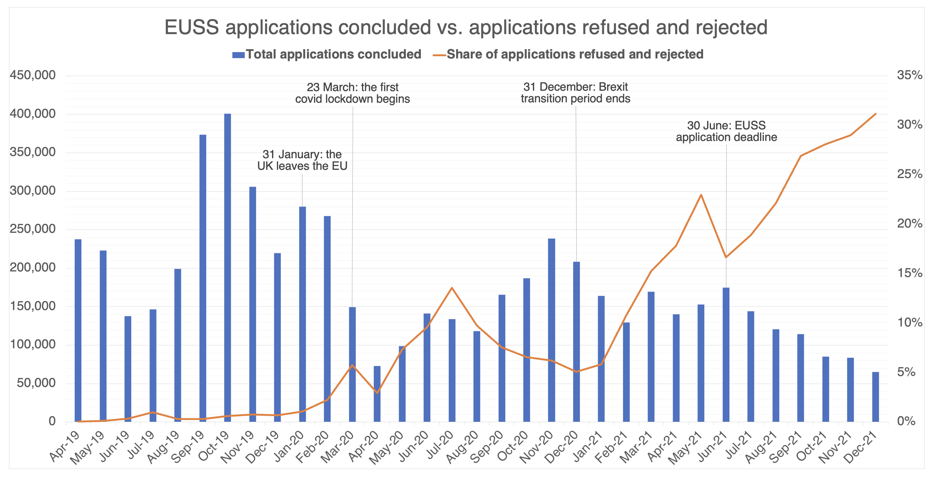
Challenges: decisions, refusals and rejections

Slide 6
Delays: processing times and aged cases

Slide 7
Delays: processing times and aged cases
Cases aged over 12 months are likely to be held up by suitability checks
Certificate of applications are only valid for 6 months
No remedy for application delays (but how about certificate of application delays…?)

Slide 8
Challenges: repeat applicants by outcomes
As of 31st December 2021…
Total number of applicants: 5,746,180
Total number of status holders: 5,268,440 (of which 2,151,270 hold pre-settled status)
Total number of repeat applicants: 593,170 (of which 530,170 granted status)
Total number of upgraded applicants: 289,180
Those with (a) ‘other outcome(s)’ who later got Pre-Settled or (b) had Pre-Settled and got it again are not separated in the stats…

Slide 9
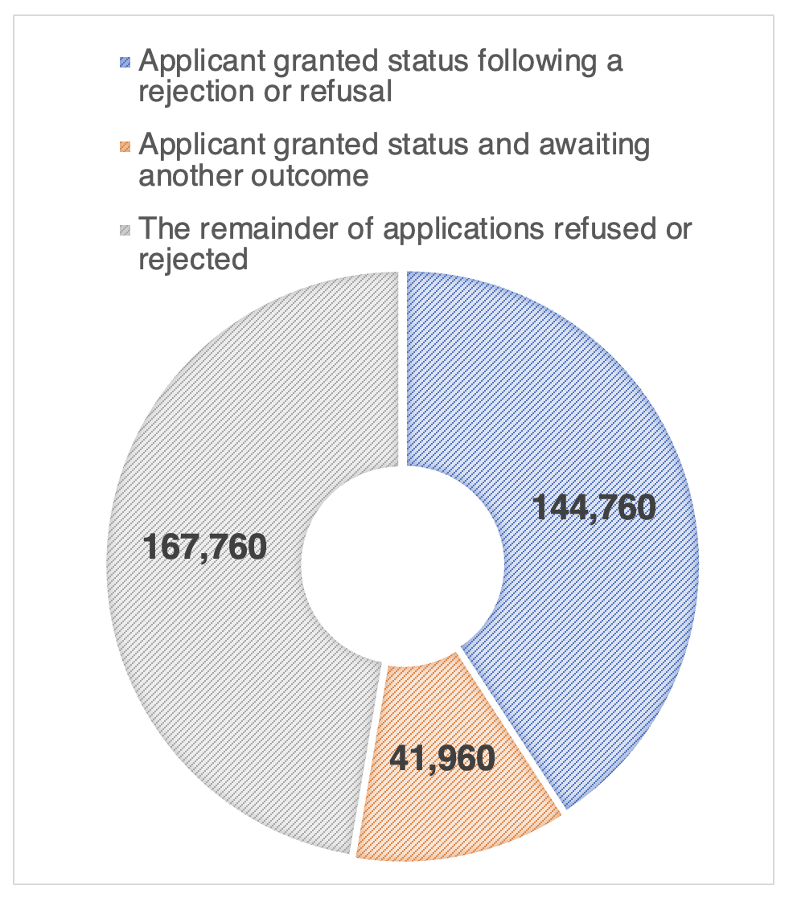
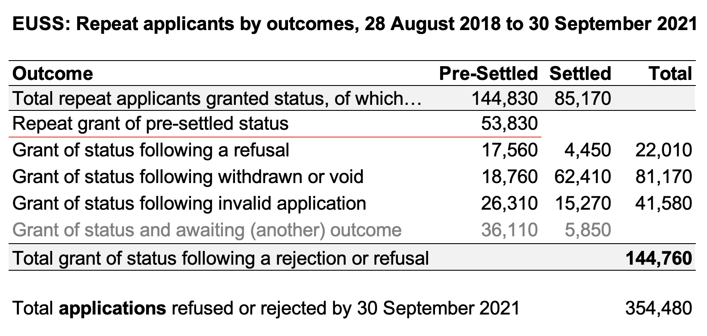
Challenges: repeat applications for rejected or refused applicants

Slide 10
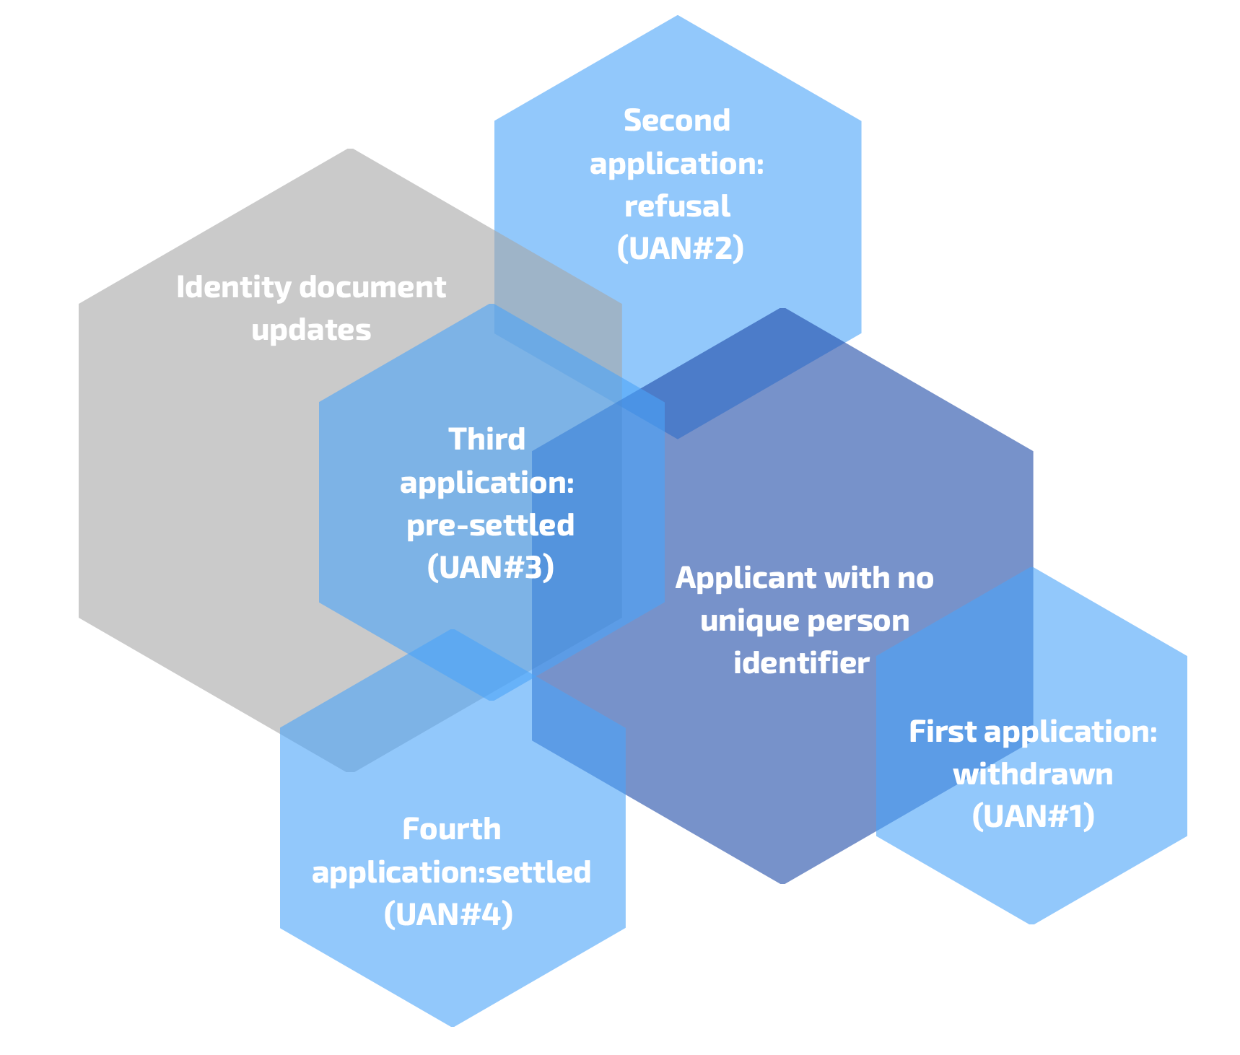
Transactional status in the EUSS
No unique and stable person identifier in the system…
Email address can change
Identification document can change
Name not unique and can change
Date or birth not unique

