Slide 1
Non-Litigation Remedies: issues in the roll-out of digital decision making in immigration
Jo Hynes
Research Fellow- Public Law Project

Slide 2
HMCTS reform programme
‘The vision is to modernise and upgrade our justice system so that it works even better for everyone, from judges and legal professionals, to witnesses, litigants and the vulnerable victims of crime. When they have to engage with the system, we want everyone to have available to them the finest justice system in the world.’
Transforming Our Justice System, by the Lord Chancellor, the Lord Chief Justice and the Senior President of Tribunals (September 2016).

Slide 3
Online immigration & asylum appeals
14,282 digital applications received by HMCTS from legal representatives as of 30 June 2021.
27.5% of cases in 2020 to 2021 did not require a hearing due to the service re-design.
24 weeks average clearance time for cases (almost half the time of previous system).

Slide 4
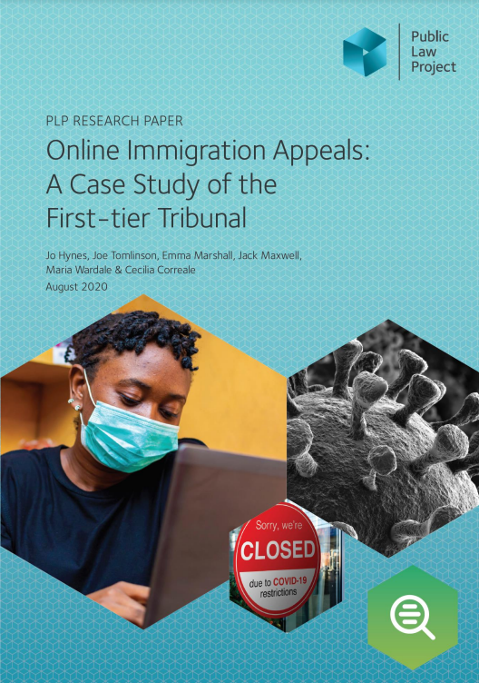
Online immigration appeals: a case study of the First-tier Tribunal
Conducted interviews, observations, and Freedom of Information Act requests between 20 April and 24 June 2020.
https://publiclawproject.org.uk/resources/online-immigration-appeals-a-case-study-of-the-first-tier-tribunal/

Slide 5
1. Home Office engagement
‘[T]he Home Office have not done anything at all, so not responded to us, not engaged. We still don't really know what their case is. The [other case] they have responded to it by basically just copying, pasting our list of issues and saying we disagree with all of these. You know I think the Tribunal is overly optimistic about the idea that they would really be able to narrow issues.’ [Interview #18]

Slide 6
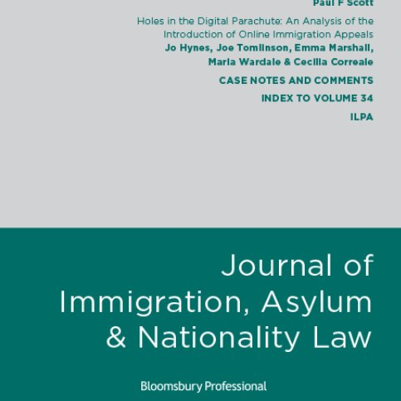
2. Parachuting in of digital systems
‘[C]onsultation has been non-existent.’ [Interview #21]

Slide 7
3. Digital exclusion
‘[T]he design relies on the use of an email address to access the system. … And we know that the use of email addresses in that system has caused some difficulty for people who are being supported by charity organisations where the advisor or the worker will put in an email address and then the person whose application it is doesn't actually have a record of the email address and does not have access to it. These tend to be quite vulnerable people who won't be necessarily familiar with these kinds of systems or who struggle with kind of being included in these kinds of systems.’ [Interview #27]

Slide 8
Challenges of digitalisation: broader trends
‘Buy-in’ and engagement with a reformed process.
Parachuting digital systems into complex ecosystems.
Digital exclusion.

