Slide 1
ECF Family Law
Lisa Okoroafor
Solicitor at Legal Advice Centre (University House)
February 2022

Slide 2
This session will cover:
Part 1 –
Legal Aid and ECF
Criteria for making an ECF application
How to prepare an ECF application
Part 2 -
Case study (ECF for a Children Act 1989 case)

Slide 3
Legal Aid and ECF

Slide 4
The Legal Aid Sentencing and Punishment of Offenders Act 2012 (“LASPO”) governs the provision of Legal Aid across England and Wales.
LASPO restricted entitlement to Legal Aid and removed areas of family law from the scope of Legal Aid.
Under LASPO a client was eligible for Legal Aid for CAO proceedings if they could evidence that they were: a victim of domestic violence; or if they had evidence that a child was at risk of abuse from the other party.

Slide 5
Without evidence of domestic abuse or child abuse, the only way an application for a CAO can be funded is through a successful application for ECF. The government included a provision in LASPO for ECF to allow for funding to be granted where, if it were to be withheld, there would be a breach or the risk of a breach of an individual's rights under the European Convention of Human Rights (ECHR).

Slide 6
Criteria for making an ECF application

Slide 7
Criteria for ECF – Means Test
Individuals applying for ECF must meet all three of the below criteria
Means test, which is the test to make sure the Applicant does not have the financial means to pay for a lawyer themselves.
Eligibility limits
Gross income limit
Our client’s gross monthly income should be £2,657 or less. If they have more than 4 child dependants, add £222 to this figure for the fifth child and each further child.
Disposable income limit
This limit is set at £733 per month.
Disposable capital limit
This limit is set at £8,000
Please note that the Legal Aid Agency collects contributions for licensed work where disposable income exceeds £315 per calendar month and/or capital exceeds £3,000.
Please refer to the LAA Keycard for further information.
Legal aid calculator https://civil-eligibility-calculator.justice.gov.uk/ .

Slide 8
Criteria for ECF – Merits Test
Merits test - which means there must be a sufficient benefit to be gained by the provision of advice and assistance, and prospects of success must be 50% or more.

Slide 9
Criteria for ECF- Human Rights Test
Human rights test - that a grant of funding is necessary to prevent a breach or risk of a breach of human rights.
ECF STATUTORY FRAMEWORK
Sub-section 10(3)(a) LASPO – states that an exceptional case determination is a determination—
(a) that it is necessary to make the services available to the individual under this Part because failure to do so would be a breach of—
(i) the individual’s Convention rights (within the meaning of the Human Rights Act 1998), or
(ii) any rights of the individual to the provision of legal services that are enforceable EU rights, or
(b) that it is appropriate to do so, in the particular circumstances of the case, having regard to any risk that failure to do so would be such a breach.

Slide 10
Criteria for ECF- Human Rights Test
A Convention right to civil Legal Aid is most likely to arise under
Article 6 ECHR - the right to a fair hearing within a reasonable time by an independent and impartial tribunal established by law.
Article 8 ECHR - the right to respect for private and family life
Article 3 ECHR - the right to be free from inhuman or degrading treatment.
Article 47 of the Charter of Fundamental Rights of the European Union - states that everyone shall have the possibility of being advised, defended and represented.

Slide 11
Criteria for ECF- Human Rights Test
The case of Gudanaviciene
The Court of Appeal in this case decided that the Lord Chancellor’s Guidance on Exceptional Case Funding (ECF) is unlawful and incompatible with the right of access to justice under Article 6 of the ECHR and Article 47 of the Charter of Fundamental Rights of the European Union.
The Court has further decided that this Guidance was not compatible with Article 8 of the ECHR in immigration cases.
The Gudanaviciene case involved five Claimants who had immigration cases and who were refused exceptional funding to assist them in the court action they were involved in.
In the Court’s view, there was nothing in the language of section 10(3) to suggest that exceptional case determinations will only rarely be made.

Slide 12
Criteria for ECF- Human Rights Test
The same legal principle applies in family law cases. When assessing whether Convention rights require funding is effectively a three-way balancing act. The factors which need to be addressed are:
The legal, factual and procedural complexity of the matter;
The importance of what is at stake; and
The ability of the applicant to represent themselves without legal assistance.

Slide 13
Criteria for ECF- Human Rights Test
Legal, factual and procedural complexity
Client’s lack of understanding of legal and factual issues
Lack of understanding of the legal principles statute and case law
Complex procedural steps
Lack of legal expertise and training: eg Advocacy/ cross examination, legal drafting, and research
The importance of the issues at stake
Any proceedings affecting a family relationship will be of importance to the client. Eg, the proceedings could determine whether the client has contact with their child.

Slide 14
Criteria for ECF- Human Rights Test
The ability of the applicant to present their case effectively
Level of education
Low IQ
Mental or physical issues
Language barriers

Slide 15
Criteria for ECF- Human Rights Test
Other Reported cases
D v K [2014] EWHC 700 (Fam) – Case concerned family proceedings at disputed final hearing stage (i.e. full representation); Father accused of serious (and potentially criminal) conduct (in this case, rape) in family proceedings; Cross examination was necessary for fairness, and, if the father was unrepresented he would have to cross-examine the mother in respect of the rape allegations. Important because contact with child at stake; Complex because cross-examination is a specific skill; “Where allegations of this seriousness arise it is very important that the respondent to the allegation is given advice.
Q v Q [2014] EWFC 7 - A father who had been convicted of a sexual offence against a minor had applied for contact with his child; expert reports said that he should not have contact; the father spoke very poor English, and could not effectively mount a defence at the final hearing; Munby P stated he was “unpersuaded that there are not matters in these reports which could properly be challenged, probed, by someone representing the father” and as a result could not dismiss the application as the mother requested.

Slide 16
How to prepare an ECF application

Slide 17
Legal Aid Forms
Do the means test first (CIV MEANS 1 OR 2 FORM). This will ensure that the test is met and avoid possibly wasting time drafting an application then finding that the test is in fact not met.
For the Means Test form (a CIV MEANS 1 FORM is to be completed for client’s not receiving a passporting benefit and a CIV MEANS 2 FORM is to be completed for client’s receiving passporting benefits)
Complete a CIV APP 3 FORM
Complete a CIV ECF1 FORM

Slide 18
CIV ECF1 FORM
Urgency – Provider Pack states that urgent applications will be considered within ten working days
Consider requesting an adjournment in very urgent cases

Slide 19
CIV ECF1 FORM (2)
Type of case and Individual case contracts
Effective administration of justice test must be met - R31(5) Civil Legal Aid (Procedure) Regulations 2012

Slide 20
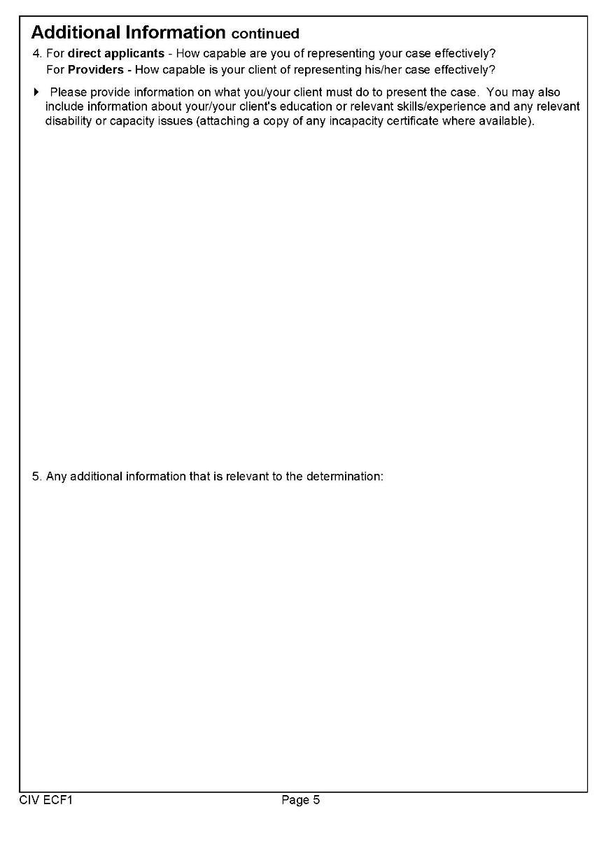
CIV ECF1 FORM (3)

Slide 21
Statement of case
There are specific headings which are required, which must be addressed in the grounds ie, the importance, complexity and humans right test.
summarise the main facts of the case in the statement of case
explain the outcome being sought from the application
explain why the applicant cannot represent themselves and therefore why they need ECF and the help of a Legal Aid solicitor to put their case to the court
Most importantly, avoid making representations in relation to the substance of the case. Rather, flag up complexities and why a lawyer is needed to explore complexities, draft legal argument, obtain supporting evidence etc.
The purpose is to keep it fairly and focused on the complexities and why a lawyer is needed to address them in order for the applicant to have a fair opportunity to put their case and to secure access to justice

Slide 22
What to do if you application is refused
Applications can be submitted via email to: contactecc@justice.gov.uk
Upon receipt of the ECF application, the LAA will send an acknowledgement email
Applicants can apply to the LAA within 14 days for an internal review of a refusal to grant ECF
Use form APP9E, which will be supplied with any refusal
LAA aims to process applications for internal review within 10 working days
No further right of review; a refusal to grant ECF on internal review can only be challenged by judicial review

Slide 23
Case Study

Slide 24
Thank you for listening.
Lisa@legaladvicecentre.london

