Slide 1
Digital Only Status
Public Law Issues with the EUSS
27 September 2021

Slide 2
What is a Digital Only Status?
View and Prove - the future of immigration status
To access your status, you need to enter a portal
‘Right to Rent’ and 'Right to Work' checks
Other immigration checks - public bodies
Other immigration checks - private organisations formal and informal checks
The risks brought about by the Hostile Environment
The clear barriers presented by a digital ONLY process
Those who can’t use the system? Decision makers?
Current support framework

Slide 3
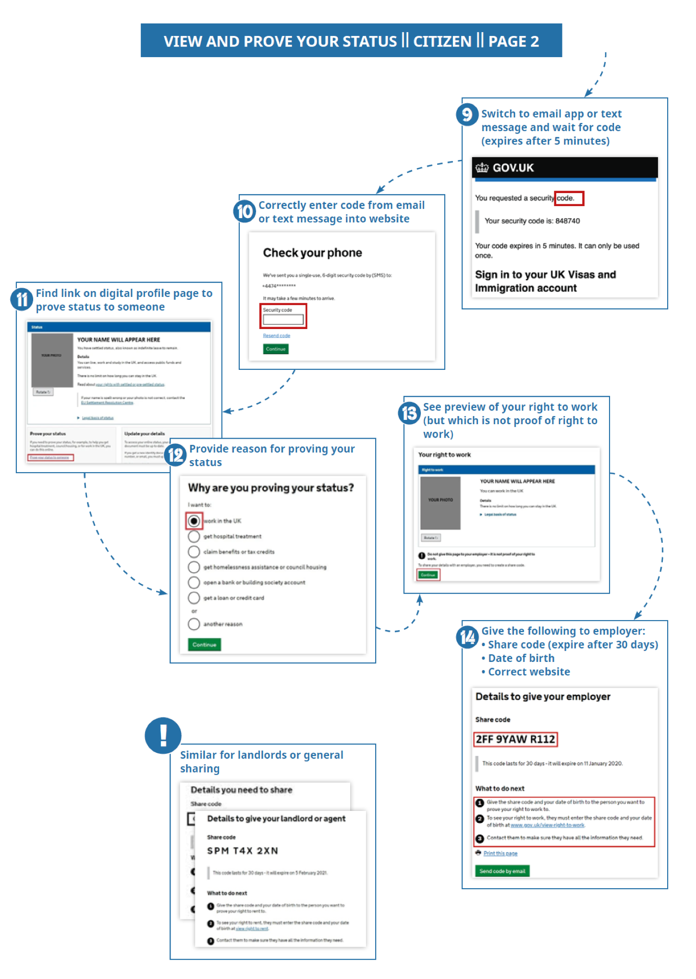
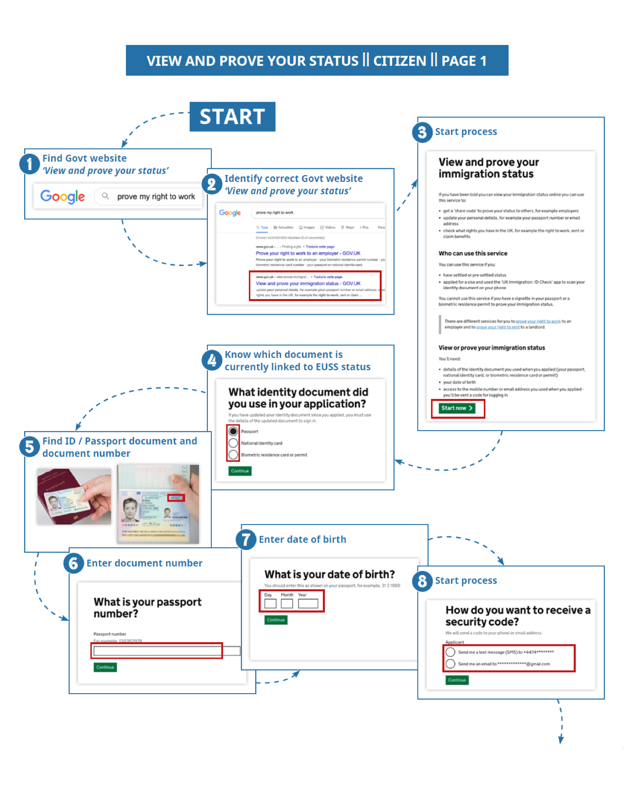
What is the ‘View and Prove’ process?

Slide 4
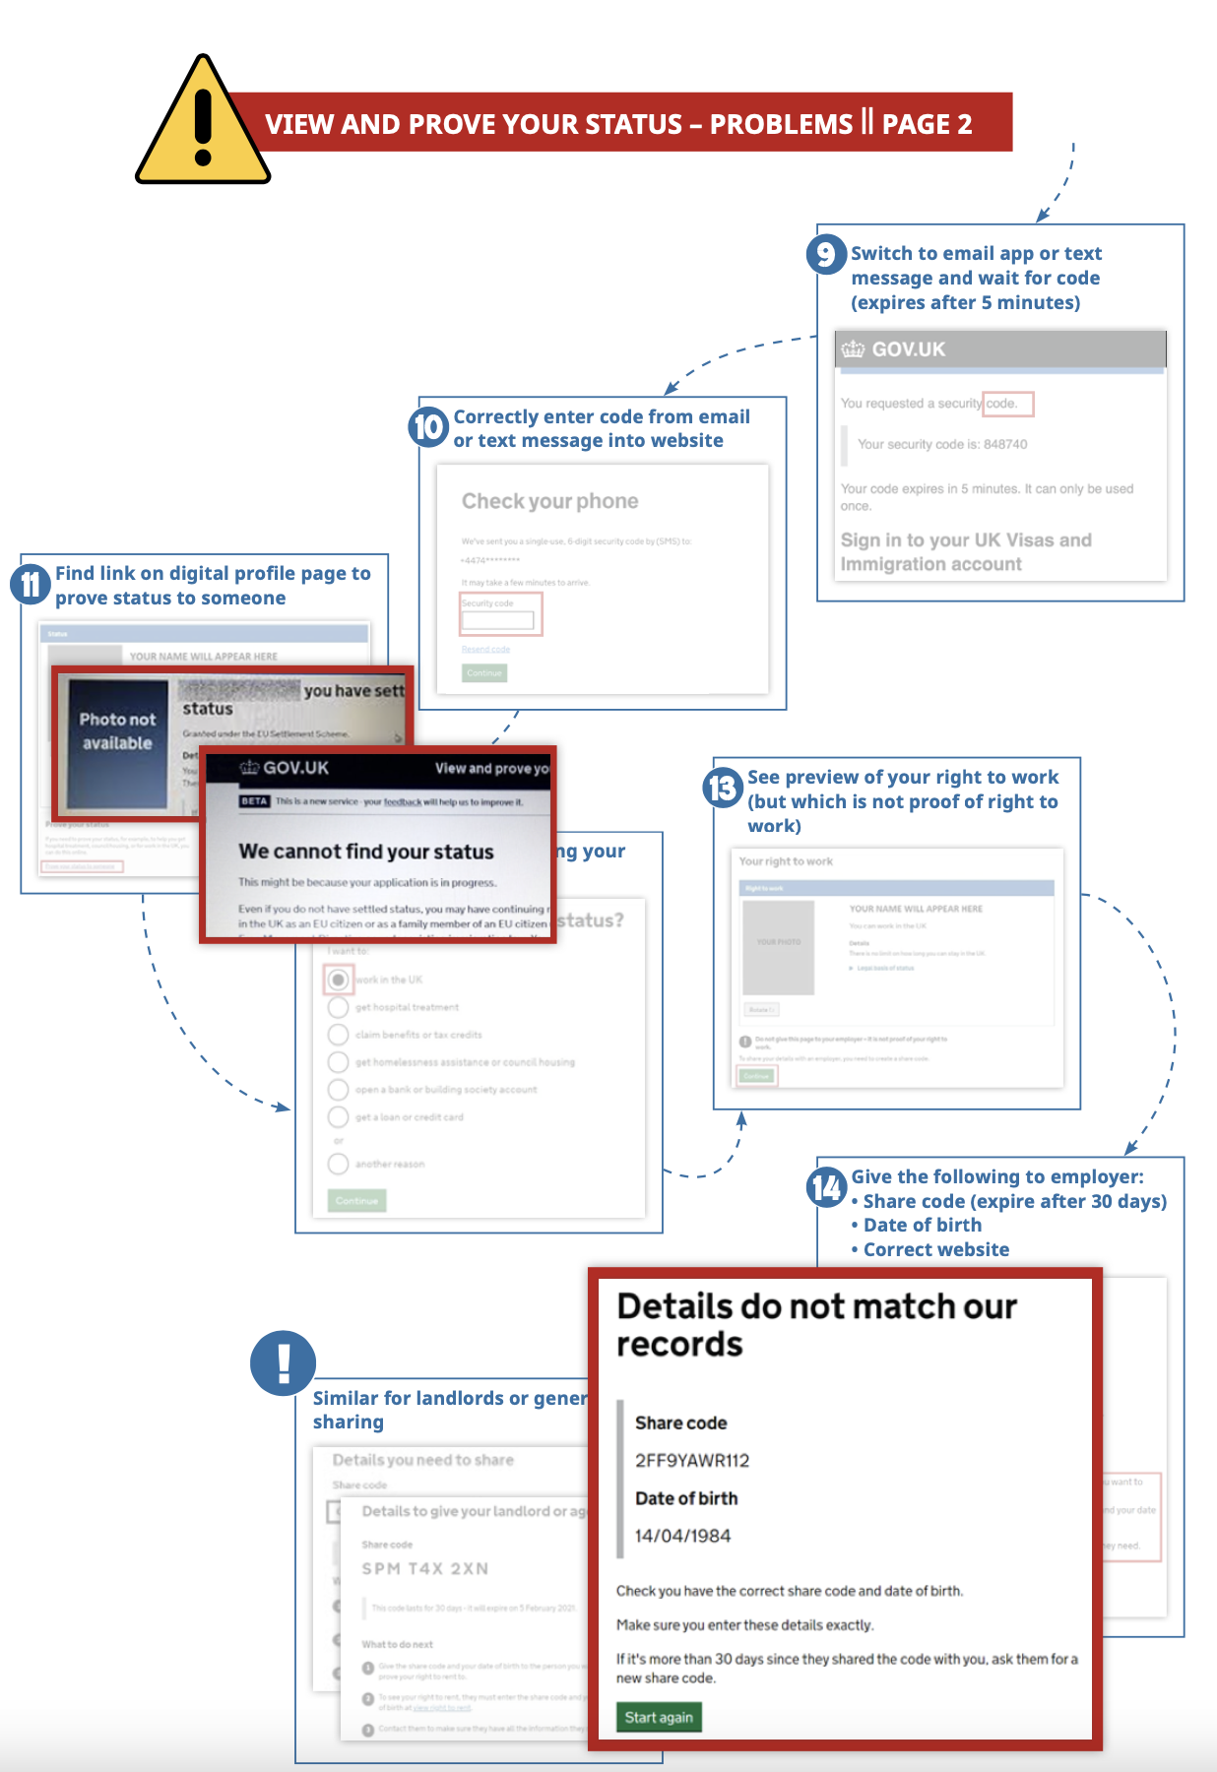
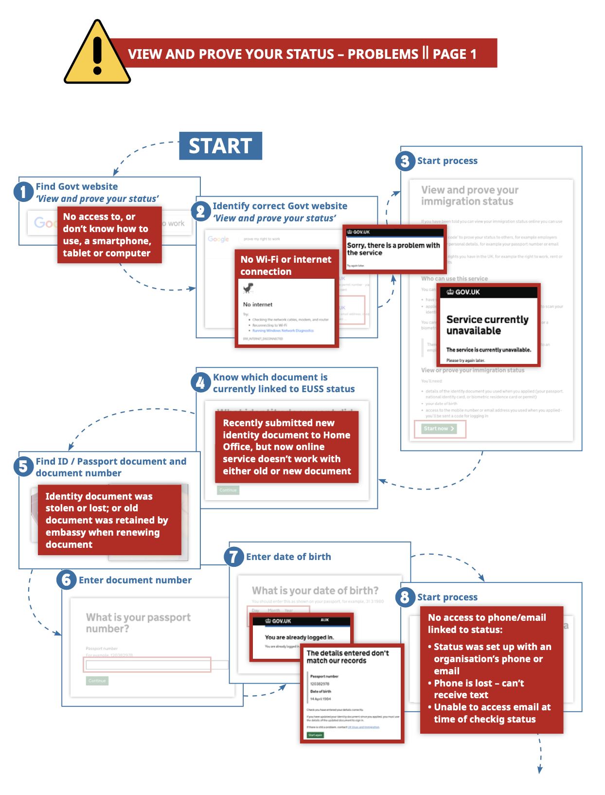
Where does it practically go wrong?

Slide 5
Issues to Consider
What are the headlines?
Is ‘View and Prove’ Discriminatory?
T3M v SSHD [2021] EWHC 1159 (Admin)
Despite losing at permission stage, resources were increased in the Settlement Resolution Centre (‘SRC’) to support those at risk of discrimination
Arguments advanced were broadly rejected because View and Prove was not fully live and there was no evidence available
Does it deliver on the UK’s Commitments in the Withdrawal Agreement?
Does it deliver on the purpose of Article 18?
What about rights to Equal Treatment?
Does it undermine Data Rights?
Disproportionate data collection practices?
Use of data for purposes other than it was originally given for?
Automated and bulk decision making?
Problems with transparency - FOI and WPQs

Slide 6
Alternatives to Digital Only Immigration Status
Parallel strategies to Judicial Review
Evidence gathering and building - ‘report-it’, the IMA and organisation analysis
Parliamentary Advocacy: Owing to advocacy campaigns, the UK Parliament has considered this issue twice, House of Lords support and devolved administrations
Media work: Continue to tell stories of people’s experience in media
The EU : is a key partner to the Withdrawal Agreement and keen to see it succeed
Other bodies: IMA, ICIBI, EHRC, ICO
Alternative Solutions: We have developed a solution that is being considered by the Home Office

