Slide 1
Procuring well-being in Wales
Office of the Future Generations Commissioner for Wales
5th May 2021

Slide 4
Section 20 Review:

Slide 5
Section 20 Review:
We are interested in:
The extent to which public bodies are embedding the Well-being of Future Generations Act into procurement contracts and frameworks, and in particular, how they are taking into account the long-term impact of their decisions
To what extent procurement is supporting delivery of the public bodies well-being objectives

Slide 6
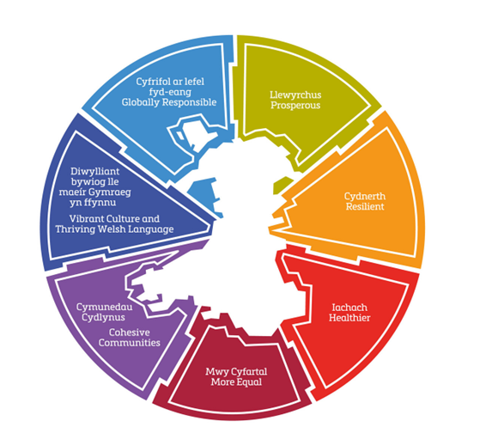

Slide 7
Key findings from the Future Generations Report 2020
There’s political commitment but no clear national procurement strategy
Procurement has improved over the last decade, but there’s still too much focus on process and not outcomes
Community benefits impact not widely shared
Too much focus on short-term cost versus delivering wider outcomes
Lack of national co-ordination and support to allow for collaboration
Opportunities for sharing information and learning are limited
Treated as a transactional process – transformational opportunities are not being maximized
There are frustrated champions within our public bodies often working without wider organisational leadership or support

Slide 8
A Review into how the Well-being of Future Generation Act is informing procurement in Wales.
From the 44 public bodies invited to participate in the initial research phase, nine organisations representing a range of national, local authority and health board organisations were selected for the Review:
Bridgend County Borough Council
Cardiff and Vale University Health Board
Denbighshire County Council
Flintshire County Council
National Library of Wales
Velindre NHS Trust (as hosts of NHS Wales Shared Services)
Wrexham County Council
Welsh Government
Ynys Môn / Anglesey Council

Slide 9
Issues directly relating to Welsh Government in their leadership capacity
Welsh Government has failed to show clear joined up leadership on the role of procurement in delivering Wales’ national well-being goals (and public bodies well-being objectives).
There is poor communication and integration between different Welsh Government priorities, alongside lack of support available for public bodies to ensure these are implemented effectively on the ground.
Opportunities for making spend work harder are being missed due to lack of support for the procurement profession and lack of accountability at a leadership level.
There is no ongoing monitoring of procurement approaches or outcomes either for the purposes of spotting where things are going wrong, and opportunities are being missed, or for identifying and sharing best practice.

Slide 10
Issues relating to public bodies
Opportunities to deliver on all four dimensions of well-being are not being maximised, often due to a lack of leadership and strategic approach that recognises the ‘power of purchase’.
The “procurement system” is too often leading to a focus on process and short-term cost rather than delivering wider outcomes over the long-term, and there is no consistent way of measuring the outcomes that can be achieved in line with the Act.
There needs to be a shift to considering long term costs holistically, in line with the Act. There is no mechanism for promoting effective collaboration for public bodies, particularly cross-sector to improve sharing, learning, capacity and skills.

Slide 13
Recommendations by the Commissioner, and the response by the Public Body
40. Public bodies have a duty to take all reasonable steps to follow the course of action set out in the recommendation by the Commissioner. Their response to the recommendation should include the steps it intends to take, or the steps it will take jointly with others if the review covers two or more bodies.
49. We would encourage the body to publish its response within 25 working days from the date of the Commissioner’s recommendation. This may be a holding reply if the public body needs time to consider the recommendation, but a full response should be provided of what action, if any will be taken by the public body, within three months of the date it first receives the recommendation.

Slide 14
Future Generations Report 2020
Website link
Procuring well-being in Wales Report
Cymraeg / English
Bitesize version
Cymraeg / English

Slide 15
Alice Horn
Analyst Officer
alice.horn@futuregenerations.wales

