Slide 1
Health Data and Data Harms
Isobel Rorison

Slide 2
“ The population’s health data will provide the UK’s pioneers with an opportunity to drive innovation, grow the industry, and take a holistic view to improving the health of the nation. ”
Health Data Research UK, 2019

Slide 4
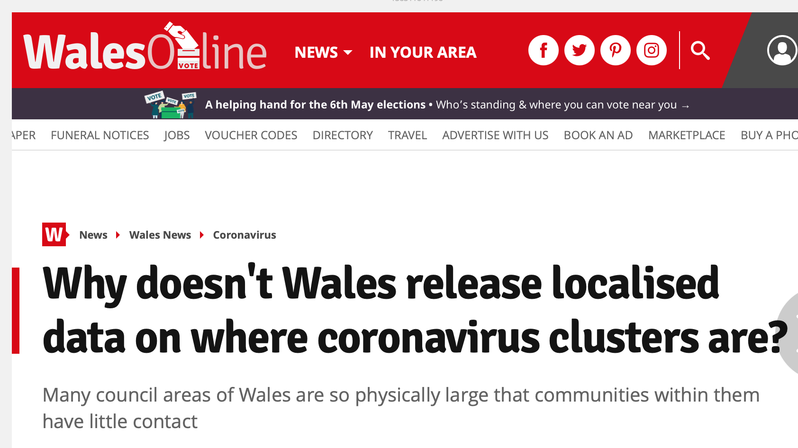
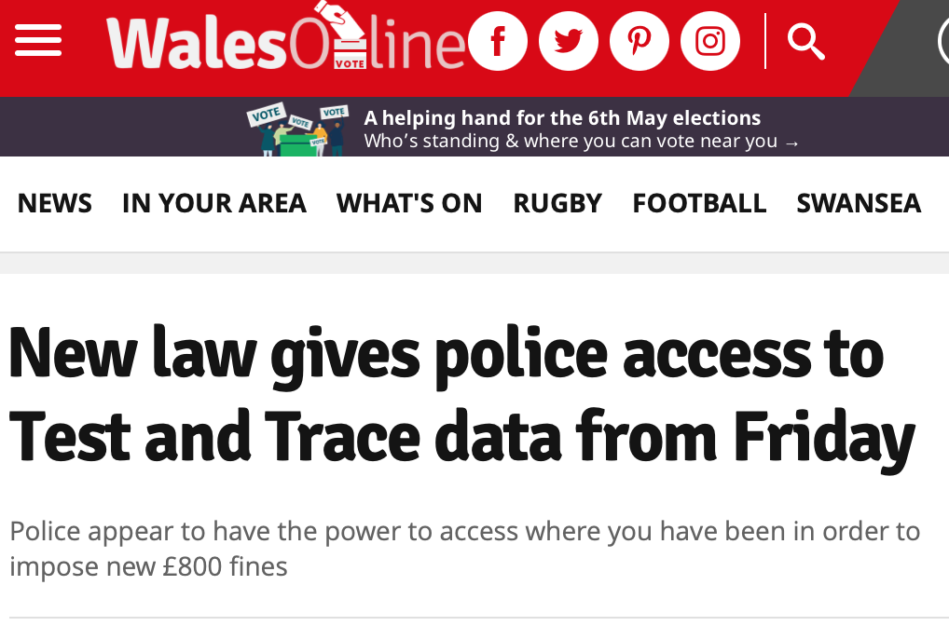
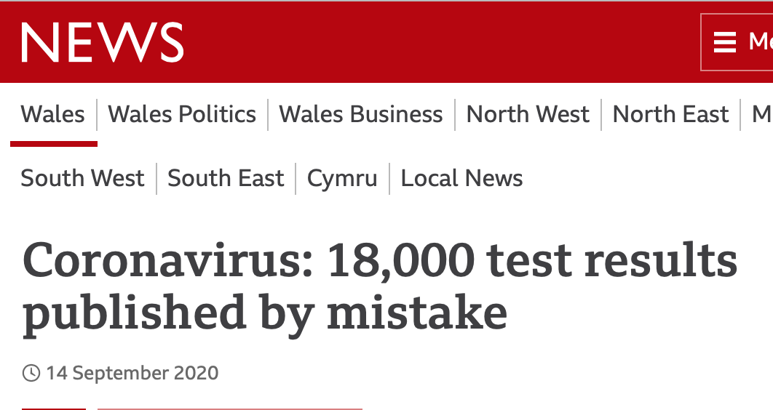

Slide 5
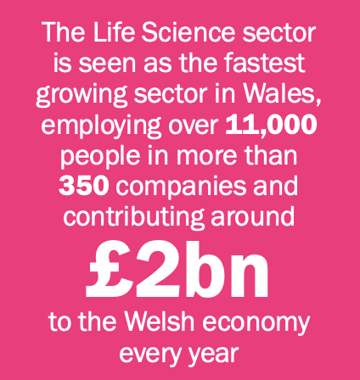
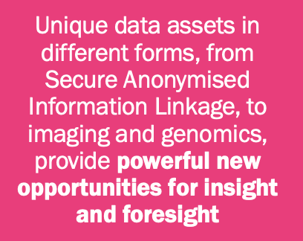
Wales is uniquely positioned as a ‘living laboratory’

