Slide 1
Welfare rights specialist support hub
Olivia Mowll
Welfare Rights Hub Coordinator – Public Law Project
Wales Conference 2021

Slide 2
Unique Challenges
4.5 million claims for Universal Credit between March ‘20 and January ’21.
Over 6 million people now on Universal Credit.
Imminent eviction enforcements.
Long-term mental & physical health impact of Covid-19 and the lockdowns.
Continuing roll-out of digital decision making and online court procedures.

Slide 3
Public Law Project
Ensure marginalised communities have access to public law remedies and can hold the state to account.
Priorities are to promote and preserve the rule of law; ensure fair systems; and improve access to justice.
Our 5 core focus areas:
  Benefit Sanctions
  Brexit/EUSS
  Access to Judicial Review
  Online Courts
  Legal Aid

Slide 4
Specialist Support Hub Project
EU Settlement Scheme Support Hub was started in 2019 by PLP.
Expanded to take on full time coordinator: Christian Davies.
Extended to welfare rights context.

Slide 5
Purpose
Ensure that the welfare benefits system operates in a manner which is
  fair and lawful,
  protecting entitlement and
  reducing risk of homelessness from unfair decision making.
Means to increase resilience and capacity in the sector by forming effective links between
  frontline staff,
  advice centres and
  specialist organisations.
Execute strategic litigation targeted at issues identified by those using the system.

Slide 6
My Experience
Capacity.
  Public law knowledge & experience.
  Urgent & important demands.
Isolated work.

Slide 7
Who?
Frontline & specialist advice services in partnership.
“No decision about me without me.”

Slide 8
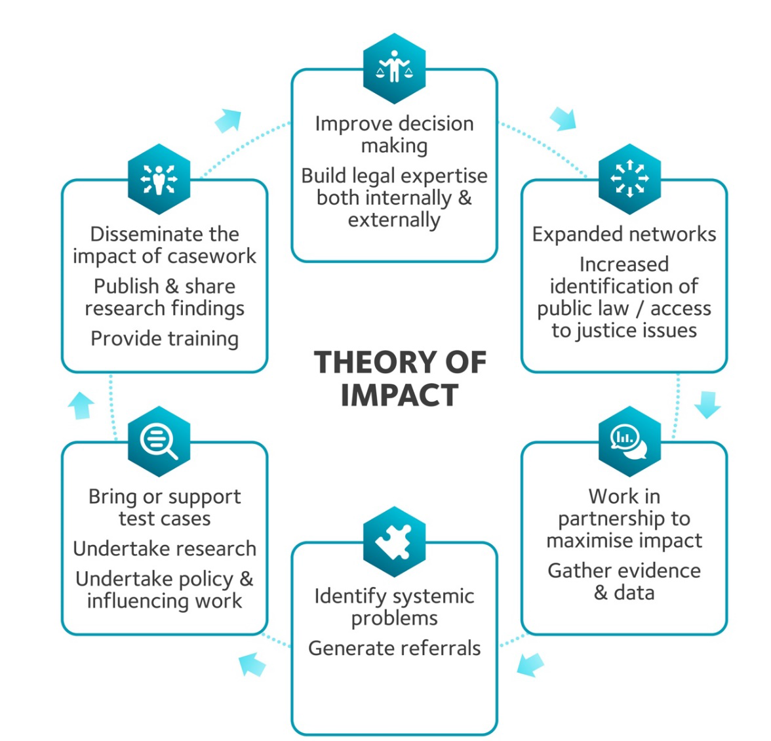
Theory of Impact
Conduct research.
Build & connect networks.
Maximise impact through effective partnerships.
Identify systematic problems.
Bring & support test cases & judicial reviews.
Share lessons, research and guidance.

Slide 9
Public Law & Welfare Rights
Individual Decisions:
  Refusal to make decision; e.g., Work Capability Assessments
  Fettering discretion; e.g., recoverability of overpayments by official error
  Discrimination in practice & the Public Sector Equality Duty
Regulations:
  R (Salvato) v SSWP [2021] EWHC 102 (Admin) - Childcare Costs Element & Proof of Payment Rule
  RF v SSWP [2017] EWHC 3375 (Admin) - PIP Mobility & Psychological Distress

Slide 10
Lessons Learned
Link policy & legal casework.
Proactive in helping respond to consultations and legislative process.
Collaborate with organisations working around the same issue.
Preparation for press attention.
Engaging with the government on guidance & implementation.
Consolidating successes.

Slide 11
Objectives
Work with you to:
Understand the barriers your clients are facing.
Gather and compile evidence in support of legal actions.
Address the government over policy and implementation.
Increase knowledge of public law remedies and results.
Best support your clients through litigation.
Ensure that marginalised groups are able to attain their rights.

Slide 12
Get Involved
Get in touch.
Contact a Law Centre.
CPAG’s template pre-action protocol letters.

