Slide 1
Public Law Project 2021 Conference
Public Procurement in Wales
Professor Dermot Cahill
Head of Procurement Research & Strategies
HelpUsTrade
www.helpustrade.com

Slide 2
Research Published in ….
“An Empirical Study of the Frequency and Distribution of Judicial Review in Resolving Public Procurement Disputes Within the UK: Proposals for Legal and Policy Reform”
S Clear & D. Cahill, European Public Law Journal vol. 27, no.1, 131-166 (Kluwer)
Conducted study of over 400 LAs across UK 4 Nations
83% response rate to all survey questions

Slide 3
...between 2009 and 2015 how many legal challenges has your LA received?
A legal challenge includes any of the following
Application for Judicial Review, or
Proceedings under Public Contract Regs (new or old Regs), or
Letter threatening any of the above pertaining to a procurement decision challenge, whether or not any legal action subsequently occurred

Slide 4
Key findings...
KF 1. Overall number of “legal challenges” is rising since 2009...up over 360%...BUT... overall number proceeding to Judicial Review actually remains low
KF 2. Significant regional variations are emerging
Notes:
The exercise has confirmed, and now also numerically quantifies for the first time, an increasing trend over the seven-year reference period. The number of letters received by local governments giving notices of a legal challenge consistently grew year-on-year; while simultaneously nationally, the number of challenges that were actually lodged before the Courts, by means of an application for judicial review, have remained consistently low.

Slide 5
Key findings....
KF 3. % of challenges taken by lay litigants is rising
KF 4. Local Govt sector has serious data retention
problems that will inhibit judicial review (or indeed
any form of administrative review….)

Slide 6
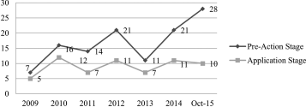
Patterns between Pre-Action & JR Application Stages?
Notes:
Consistent with other reports into traditional ‘public law’ areas of judicial review,⁹⁰ of the 492 legal challenges identified by our survey, 118 of them were issued stating that an application for judicial review would be made, equating to 24%, or approximately one in four legal challenges: with only 63 (53% of those 118) led to a full application being made to the High Court for judicial review (accounting for 13% of the original number of legal challenges)

Slide 7
Data Retention Concerns
19 LAs retained NO DATA on whether any legal challenges were made
A further 22 LAs only retained data on legal challenges made since new merged LA’s commenced
Major retrieval problem in NI where 26 Councils merged into 11..
Problems in England ...some Councils destroy most tender data within 12 mts
How would Wales fare had the Williams Report been implemented?

Slide 8
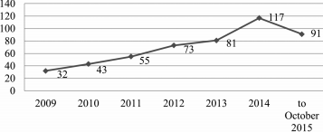
Rising Trend in Legal Challenges over reference period

Slide 9
Numbers of Legal Challenges by Region
Scotland - 89
London - 54
East Midlands - 52
By contrast, fewest legal challenges were in:
West Midlands - 22
North West of England - 23
Wales - 12
Notes:
¹ An economic operator is a business or other organization which supplies goods, works or services within the context of market operations. Within the context of public procurement, the term could be used interchangeably with ‘the seller’.
⁵² The would-be, or all things considered, ‘potential seller’.
⁵³ An individual or other organization which is not directly party to the procurement exercise, such as concerned citizens, pressure groups, non-governmental organizations, trade unions, charities and trade associations.
⁵⁴ Supra 18.

Slide 10
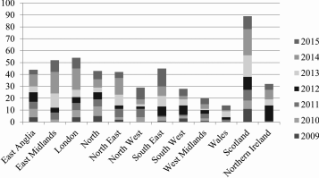
In some years there were NO challenges in Wales...

Slide 11
Ministry of Justice “fears” that JR would rise has NOT occurred
Contrary to the Ministry of Justice’s hypothesis and estimates, it is quantitatively confirmed from the above data that for a seven-year period, there were few challenges to local government procurement decisions, albeit numbers are growing (minimally) each year.
Across the 370 Local Councils who responded to the request, the average number of challenges per year, per region is six challenges, equating to 0.2 legal challenges per Local Council per year.
These findings contradict the views of the Ministry of Justice and highlight the need for greater evidence-informed approaches in proposing law reform.
Notes:
The exercise has confirmed, and now also numerically quantifies for the first time, an increasing trend over the seven-year reference period. The number of letters received by local governments giving notices of a legal challenge consistently grew year-on-year; while simultaneously nationally, the number of challenges that were actually lodged before the Courts, by means of an application for judicial review, have remained consistently low.

Slide 12
Ministry of Justice take note...
The highest number of legal challenges received within a single year was:
22 in Scotland in 2014
18 in Scotland in 2013
A similar figure in London & the East Midlands in 2014
By contrast some regions reported zero legal challenges within individual years:
the East Midlands in 2009
the North West in 2009
Wales in 2009 and 2010
Northern Ireland in 2010 & 2011

Slide 13
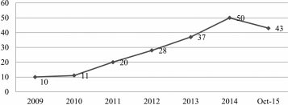
Annual Growth of Litigants in Person

Slide 14
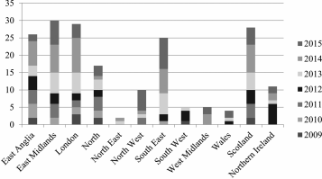
Litigants in Person - Regional Variations
Notes:
As illustrated within figure 4, over the sample period, across the UK, the East Midlands (thirty), London (twenty-nine), Scotland (twenty-eight), and East Anglia (twenty-six), had the highest number of aggrieved tenderers or prospective suppliers who sought to at least instigate a legal challenge without a lawyer.⁷⁵ By contrast, the North East (two) and Wales (four) had the fewest.

Slide 15
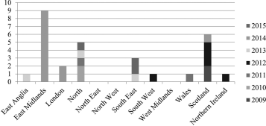
Regional Challenges by Third Parties
Notes:
..see above….3PTY challenges very low….and really low in Wales ….so this is why we need a new approach in Wales, and indeed the UK generally...

Slide 16
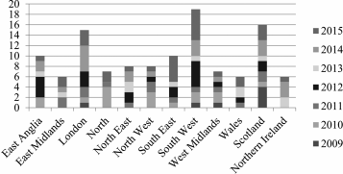
As seen below, the figures also illustrate significant regional differences in the prevalence of the pre-action threat, Wales has a low level of pre-action threat challenges ...

Slide 17
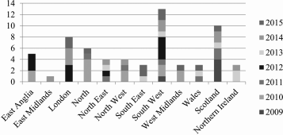
...and Wales has low level of JR in procurement cases

Slide 18
Conclusions on Study:
In conclusion, although the number of “legal challenges” in UK LA sector drastically increased post-2009, with growth of 366% by 2014, and high numbers reported up to October 2015, nonetheless the overall JR figures remain consistently low, with 47% of local governments claiming to have never been challenged over the seven-year reference period
Wales figures are particularly low on all metrics
Data retention concerns are a major problem

Slide 19
Which brings us to the question: Is it not about time Wales had a Procurement Ombudsman?
The JR data shows that the courts are not the place for Welsh procurement disputes to be solved
… too expensive
….does not (ie., cannot) direct sector-wide change of poor practices
….Welsh suppliers continue to be unhappy in procurement-related matters
….Now is the time for a properly designed Ombudsman to be considered

Slide 20
It’s not an entirely new idea...
Barriers To Procurement Opportunity Report 2009
…inter alia recommended Ombudsman as Welsh SMEs very unhappy
Welsh Govt accepted Barriers Report as Govt Policy in 2012
Govt established a dedicated Barriers Implementation Board (2012-2017)
All 16 Barriers Recommendations have been implemented...except 1… the Ombudsman...its time to revisit this European idea ….and the opportunity is presenting itself...

Slide 21
The Draft Social Partnership and Public Procurement (Wales) Bill presents a perfect opportunity to remedy this lacuna.…the Bill’s main aim is to get covered public bodies to make reasonable effort to include FG&WBA’s objectives, fair work and socially responsible procurement requirements into (some) public procurement in Wales ...HOWEVER...
There are no non-compliance penalties included in the Draft Bill, nor is provision made for an independent reviewer of public proc’ment decisions
The Minister may initiate investigation, but no teeth to impose change
Allowing the Minister to “mark the WG’s own procurement homework” is hardly a wise idea!!!
…note severe Wales National Audit Office Report 2017 criticisms...

Slide 22
Draft Social P’ship & Public Procurement (Wales) Bill 2021
...a Social Partnership Council will scrutinise annual reports by covered bodies on how they are observing the Act in their procurement practice
...Suppliers can contribute via a Supplier Feedback process
...but no teeth, no sanctions, just something nice to have
The new Bill presents an opportunity to introduce a (real) Ombudsman or Alternative dispute resolution decision maker into the Draft Bill ideally possessing both directive and investigative powers...like other countries have….

Slide 23
What possible models could Wales adopt…?
Canada Model - Ombudsman can:
adjudicate procurement disputes over 25,000 Dollars
open investigations into procurement practices of own motion or on foot of complaints
can direct change of poor practices, rather than make recommendations that are ignored

Slide 24
Canadian Procurement Ombudsman: main features
Can assess tender procedures for goods contracts under 25,000 dollars Can assess tender
Can assess tender procedures for service contracts under 100,000 dollars
Can intervene on contract performance issues on any size contract
Power to launch procurement reviews
Offers ADR for contract performance issues
Disseminates procurement best practices

Slide 25
...or the German Procurement Review Boards Model ?
An alternative to courts, the Procurement Review Boards in Germany could be a source of inspiration
Independent Administrative review bodies
Provide fast redress to aggrieved bidders for contracts above the EU thresholds.
Decisions are binding, but losing parties can appeal from the decision to court.

Slide 26
Complaints Board Model (Denmark)
Complaint procedure usually takes a few months to conclude - faster than a judicial decision.
Board can make Declaration of Illegality over the procurement award decision
Claimant can file for damages to be awarded by the Complaints Board
Cost of filing claim is low
Decisions taken by the Complaints Board are binding and enforceable
Losing party may appeal to court.

Slide 27
Danish Competition and Consumer Authority (CCA)...
CCA can bring court proceedings against contracting authorities via the Danish Complaints Board
CCA allows bidders to express their issues during the procurement procedure - its intervention frequently solves potential problems before contract is awarded.
After the contract is awarded, CAA can no longer intervene and the complaint must be filed with either the Complaints Board or the Courts.
The CCA also publishes guidelines on how procurement rules should be interpreted.

Slide 28
Competition Authority (Sweden)
Sweden’s National Competition Authority (NCA) monitors public procurement legal compliance
NCA can bring proceedings in court against contracting authorities awarding contracts in contravention of public procurement laws
NCA issues guidance on public procurement best practices and also produces reports on public procurement related activities

Slide 29
Conclusion
Wales is always praised by international bodies for having great procurement policies, but not so great on implementation and take-up.
The Draft SP&PP (Wales) Bill presents a perfect opportunity for Wales to introduce a non-judicial decision maker int Welsh procurement (£8bn spend per annum) to overcome limitations of current redress avenues, and that will be good for Welsh suppliers and drive good practices across public sector procurement.

