Slide 1
UK Green Paper on Transforming Public Procurement: Reflections on the Enforcement Provisions
www.bangor.ac.uk/law
Dr Ama Eyo
Bangor Law School,
Bangor University,
North Wales,
United Kingdom
a.eyo@bangor.ac.uk

Slide 2
Overview
Preliminary issues
Green Paper on Public Procurement: Perceptions
The Enforcement Provisions in the Green Paper
Premise for the proposed reform
Focus of the proposed reform
Some reflections on the Enforcement provisions
www.bangor.ac.uk/law

Slide 3
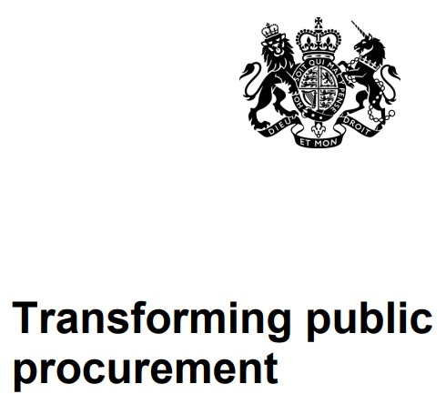
Green Paper: mixed perceptions
www.bangor.ac.uk/law

Slide 4
The Enforcement Provisions: Premise
Bureaucratic process due to fear amongst buyers of a decision being challenged in courts!
Ambiguity in the procurement regulations;
Current legal review processes are:
Excessive costs;
Time consuming;
Resource intensive!
www.bangor.ac.uk/law

Slide 5
The Enforcement Provisions: Approach
Para 11
Reform the challenge process
Speed up the review system
Make it more accessible.
Refocus the remedies
Introduce more pre-contractual redress measures so that fewer challenges proceed to court for post-contractual remedies!
Cap the damages level available to bidders
Reduce the attractiveness of speculative claims.
www.bangor.ac.uk/law

Slide 6
Proposals for Enforcement: The Measures (1)
New service unit & enforcement
Review powers
Intervention powers
Chapter 7
Court process
Tribunal
Redress for suppliers
Cap on Damages
Automatic suspension test
Changes to individual mandatory debrief letter
www.bangor.ac.uk/law

Slide 7
Proposals for Enforcement: The Measures (2)
Court processes
Reform court processes
Expedited process – speed + access (including cost)
Tribunal system
Investigate the possibility
Low value claims
Redress for suppliers
Primacy of pre-contractual measures
Wider use should the proposed Court reforms not deliver the require benefits!
Ongoing procurements
Tailored fast track system
New Civil Procedural Rules
Use of written pleadings
www.bangor.ac.uk/law

Slide 8
Proposals for Enforcement: The Measures (3)
Damages
Introduce cap to level of damages
Automatic suspension
Remove for some contracts
E.g., contracts let competitively in crisis or extreme urgency situations!
Individual debrief letter
Remove the requirement
www.bangor.ac.uk/law

Slide 9
Reflections on the Proposals
Court process reform
Tribunal ,
Any role for an Ombudsman?
Other adjudication system?
Suppliers’ redress: Primacy of pre-contract remedies -
Cap on level of Damages
Automatic suspension test
Removal of individual debrief letters
New Service unit – implication for Wales?
www.bangor.ac.uk/law

Slide 10
Reflections on the Proposals
www.bangor.ac.uk/law

Slide 11
References
Green Paper: Transforming Public Procurement, available at https://www.gov.uk/government/consultations/green-paper-transforming-public-procurement
L. Dobson, Remedies & The Green Paper” [2021] 3 P.P.L.R. 133-152
C. Murray and R. Bickerstaff, “Should an adjudication system be established for procurement disputes?” [2021] 3 P.P.L.R. 153-158
E. Lindahl, “Proposal to establish a public procurement ombudsman”, [1997] 6 P.P.LR. CS218-220
S. Arrowsmith, “Transforming public procurement law after Brexit: some reflections on the Government's Green Paper” [2021] 3 P.P.L.R. 103-123
A. Sanchez-Graells, “The UK’s Green Paper on Post-Brexit Public Procurement Reform: Transformation or Over complication?”, available at SSRN: https://ssrn.com/abstract=3787380
https://www.procurementlawyers.org.uk/wp-content/uploads/2021/03/PLA-Response-to-the-Transforming-Public-Procurement-Green-Paper.pdf
www.bangor.ac.uk/law

Slide 12
Thank you
www.bangor.ac.uk/law
Dr Ama Eyo
Lecturer and Public Procurement Specialist
Bangor Law School
Bangor University,
North Wales,
United Kingdom
a.eyo@bangor.ac.uk

