Slide 1
Access to Justice South West:
Introduction to the Equality Act 2010
Audrey Ludwig
Solicitor

Slide 2
A Whistlestop Tour of Equality Act

Slide 3
Equality Act 2010
Essentially it sets out what is prohibited, required & allowed in certain situations to avoid *unlawful* discrimination based on each of the protected characteristics.
The first part of the Act has general principles and most of the latter contains exceptions to those general rules
No hierarchy of rights. Conflict between protected classes is recognised and determined by courts.

Slide 4
Protected Characteristic
The Equality Act protects the following characteristics (s4):
Age (s5)
Disability (s6)
Gender reassignment (s7)
Marriage and civil partnership (s8)
Pregnancy and maternity (s4)
Race (s9)
Religion or belief (s10)
Sex (s11)
Sexual orientation (s12)

Slide 5
Notes about protected characteristics
Each one has to be considered separately. A policy or decision benefitting one protected class may amount to unlawful discrimination against another
Where there is conflict between two competing rights (Ladele v London Borough of Islington [2009] EWCA Civ 1357 (15 December 2009) or Lee v Ashers Bakery 2018, then court will determine issue

Slide 6
Context of discrimination is important
Equality Act only applies in context of work, some housing, education, some transport, provision of services to the public, some clubs and associations, trade unions, public functions, occupational pensions and insurance.
Doesn’t apply in other contexts. Also many, many exceptions in Act to make it workable
Primarily, breach dealt with by Civil Action taken in County Court, Employment Tribunal or First Tier Tribunal ( Special Educational Needs and Disability Tribunal) depending on issues (NB judicial review…see later)
Don’t confuse with hate crime

Slide 7
Direct Discrimination
13. Direct discrimination
(1)A person (A) discriminates against another (B) if, because of a protected characteristic, A treats B less favourably than A treats or would treat others.

Slide 8
Indirect discrimination
19. Indirect discrimination
(1)A person (A) discriminates against another (B) if A applies to B a provision, criterion or practice which is discriminatory in relation to a relevant protected characteristic of B's.
(2)For the purposes of subsection (1), a provision, criterion or practice is discriminatory in relation to a relevant protected characteristic of B's if—
(a)A applies, or would apply, it to persons with whom B does not share the characteristic,
(b)it puts, or would put, persons with whom B shares the characteristic at a particular disadvantage when compared with persons with whom B does not share it,
(c)it puts, or would put, B at that disadvantage, and
(d)A cannot show it to be a proportionate means of achieving a legitimate aim.

Slide 9
Harassment
26. Harassment
(1)A person (A) harasses another (B) if—
(a)A engages in unwanted conduct related to a relevant protected characteristic, and
(b)the conduct has the purpose or effect of—
(i)violating B's dignity, or
(ii)creating an intimidating, hostile, degrading, humiliating or offensive environment for B.
(2)A also harasses B if—
(a)A engages in unwanted conduct of a sexual nature, and
(b)the conduct has the purpose or effect referred to in subsection (1)(b).
(3)A also harasses B if—
(a)A or another person engages in unwanted conduct of a sexual nature or that is related to gender reassignment or sex,
(b)the conduct has the purpose or effect referred to in subsection (1)(b), and
(c)because of B's rejection of or submission to the conduct, A treats B less favourably than A would treat B if B had not rejected or submitted to the conduct.

Slide 10
Victimisation (hint: like whistleblowing protection)
27. Victimisation
(1)A person (A) victimises another person (B) if A subjects B to a detriment because—
(a)B does a protected act, or
(b)A believes that B has done, or may do, a protected act.
(2)Each of the following is a protected act—
(a)bringing proceedings under this Act;
(b)giving evidence or information in connection with proceedings under this Act;
(c)doing any other thing for the purposes of or in connection with this Act;
(d)making an allegation (whether or not express) that A or another person has contravened this Act.
(3)Giving false evidence or information, or making a false allegation, is not a protected act if the evidence or information is given, or the allegation is made, in bad faith.

Slide 11
Public Sector Equality Duty: breach is grounds for judicial review
149. Public sector equality duty
(1)A public authority must, in the exercise of its functions, have due regard to the need to—
(a)eliminate discrimination, harassment, victimisation and any other conduct that is prohibited by or under this Act;
(b)advance equality of opportunity between persons who share a relevant protected characteristic and persons who do not share it;
(c)foster good relations between persons who share a relevant protected characteristic and persons who do not share it.

Slide 12
A few examples of exceptions (100s of them)
Sched 9 part 1 s1 Occupational requirements
Schedule 9 part 1 s2 Religious requirements relating to sex, marriage etc., sexual orientation
Sched11 part1 s1 admission to single sex schools
Sched 3 part 27 single sex services (eg intimate waxing service)
Schedule 16 (1) single characteristic associations like an African Caribbean club
Sched 23 regarding acts authorised by statute or the executive

Slide 13
Making Policies Equality Act Compliant (or How to Spot Non Compliant Ones)

Slide 14
Making policy
How do public bodies (eg DWP, schools) private bodies (eg Tesco, British Airways), charities (Oxfam, RSPCA)) etc write policy whilst avoiding discriminating against someone?

Slide 15
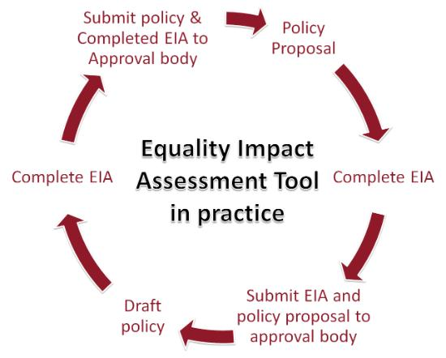
Equality Impact Assessment
Remember s149 Public Sector Equality Duty? Only applies to public bodies or those “exercising public functions”
To prevent breach of this and indirect discrimination, best to do one of these

Slide 16
Indirect Discrimination
s19 Equality Act defines indirect discrimination.
Applies to all bodies, so in making any policy, risk of indirect discrimination should always be considered

Slide 17
Indirect Discrimination cont
1. Essentially if there is a policy that applies/impacts in practice, generally or to more than one protected characteristic (p.c.), (even if only explicitly references one p.c. like a "disability policy" or a "trans policy")....
2. & it particularly disadvantages one p.c. (compered to people who don't share that p.c.) because of their p.c.
[We know from the case of Ewaida (British Airways cross necklace over uniform case) that it only needs to be some of that p.c. even just a few but just not one person... ] cont…

Slide 18
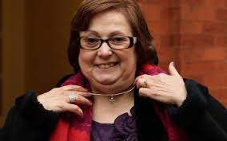
Indirect Discrimination cont
3. And the policy maker cannot objectively justify it by showing it is a proportionate means to achieve a legitimate aim.
4. This looks at how widely drawn the policy is and why it has been made?

Slide 19
Tips for Equality Act compliant policy making
1. Good equality monitoring of current service against each of the protected classes in the Equality Act (so note "sex" and “gender reassignment” not "gender" which isn’t one)
2. Check for any group that are disproportionately adversely affected by policy (or likely to be) so low uptake of service, or pattern of usage suggest certain needs.

Slide 20
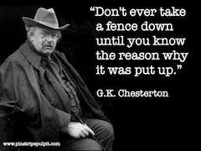
(slight detour) Chesterton’s Fence
If there is existing policy, why is as it is? What does current policy do and really get to grips with why?

Slide 21
Tips cont.
3. If you have the luxury do ask any specialist discrimination lawyer (not me!) to refer you to any law (both statutory and caselaw) that is relevant, guidance from Equality and Human Rights Commission etc. In their absence, google the issue to see if there are concerns expressed about the issue. Take care about written “guidance” as quality variable

Slide 22
Tips cont.
4. Consult widely; not just the lobbyists or spokespeople but people in community and users/potential users of service of all protected classes
5. Make draft policy explaining on what evidence you have made it and why?
6. Consult on draft policy;

Slide 23
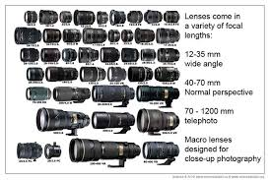
Seeing through different lenses
You need to see the issue as if through the lens of each of all of the P.Cs (list in s4 EA) and try to work out if and then how it will impact on them adversely or at all. Dont rush this or make assumptions

Slide 24
Think of yourself as a discrimination solicitor with long line of clients, each of them representing several different people from each protected class concerned about the policy. Why are they concerned? How does it impact them? Could the policy be rewritten, reduced etc? solicitor with long line of concerned clients representing several different people from each protected class concerned about the policy. Why are they concerned? How does it impact them? Could the policy be rewritten, reduced etc?

Slide 25
Tips cont.
7. Questions to think about:
Is the policy too widely drawn or could it be narrowed down?
Does a policy favour one P.C. at the expense of another? (Even extends to does it impact different groups of disabled people differently)
Can it be rewritten to balance it more?
Has anyone suggested how it could be done another way?

Slide 26
8. Pay particular attention to any statutory exceptions to normal rules in the Equality Act. These are numerous in the Act including positive discrimination, religious exemptions in certain employment, occupational requirements to allow employment only of ... particular p.c. (or p.c.s like an "BAME man") or single sex exemptions for facilities.
9. Why are they important? Parliament recognised it was important that, where objectively appropriate, that these particular exceptions to general rules against discrimination, are available. Whether you make a policy to use or not to use them, you will need to explain, by reference to good evidence why that is? It is not sufficient to just say we don’t have to; so need to consult & document evidence carefully why or why not used

Slide 27
Tips cont.
10. Make policy. Think about the actual wording of all policies. Some findings of indirect discrimination don’t relate to an intentional decision but really thoughtless drafting.
11. After implementing policy, get feed back and equality monitoring and review etc

Slide 28
Litigation is Expensive

Slide 29
Don’t be Dogmatic!!
12. Be pragmatic & careful. Litigation about discrimination is expensive financially & reputationally. So be prepared to compromise, think outside the box & don’t be dogmatic. Train staff to make policies carefully and in accordance with the law, not to appease lobbyists.
13. Above all document evidence to support why you made policy. You may need it

Slide 30
Case Study 1 : Housing Gateway Policy Bidding for properties
Disabled Client with top priority unable to successfully bid for property for 5 years. Why?
Rule allows local authority to disqualify bid if “property not adapted or unadaptable”. Individually could be good reason as prevent long voids whilst adaptation taking place, but means disabled people wait longer
When client came to us, unsuccessful in over 100 bids
Used FOIs to show his wait much longer than comparable non disabled person
Letter before Action resulted in an offer of a house. Now following R v Nuri and Abdullah ex parte Birmingham 2020 applying for legal aid to pursue substantive discrimination claim for failure to do reasonable adjustment to housing policy

Slide 31
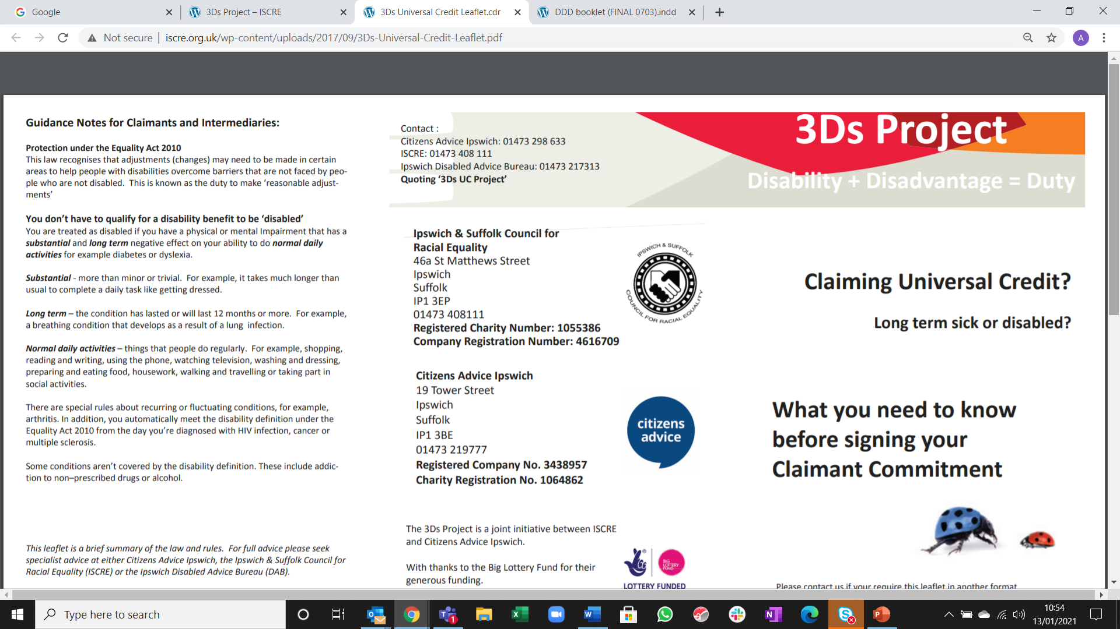
Case Study 2

Slide 32
Thanks for Listening!
@audreysuffolk

