Slide 1
The Means Test Review
Kate Pasfield
Director of Legal Aid Policy &
Members Services
Legal Aid Practitioners Group

Slide 2
LAPG’S ROLE IN POLICY WORK
We work to improve the delivery and administration of the legal aid scheme by engaging with the LAA on operational issues and the MoJ on the development and implementation of legal aid policy
We are a statutory consultee body for the LAA
We participation in the Civil and Crime Contract Consultative Groups, the Process Efficiency Team, the Quarterly Digital & Technology Meetings and numerous other informal and ad-hoc meetings and processes.
We seek to work constructively with the LAA and the MoJ as we have found that this is the most effective way of achieving meaningful change on behalf of legal aid providers.

Slide 3
Legal Aid Means Test Review
“We will conduct a review into the thresholds for legal aid entitlement, and their interaction with the wider criteria. This review will assess the effectiveness with which the means-testing arrangements appropriately protect access to justice, particularly with respect to those who are vulnerable. The review will include looking at the capital thresholds for victims of domestic violence and evidence gathered during the review of legal aid for inquests.” (Legal Support Action Plan, February 2019)
Government action: We will complete a comprehensive review of the legal aid eligibility regime by Summer 2020.
(Planned publication date due to Covid-19 delay, with accompanying consultation: Spring 2021 and likely to come into force in early 2022)

Slide 4
Eligibility for legal aid
Financial thresholds for entitlement to legal aid have not been uprated for inflation for many years.
Originally, when legal aid was first introduced in 1949, 80% of the population qualified for legal aid.
That proportion declined as means testing became progressively tougher. Data suggests that now, as few as 20% of people would be entitled to legal aid based on the current means test.

Slide 5
Legal Aid Means Test Review – Scope
In Scope | Out of Scope
All criminal and civil legal aid schemes and Exceptional Case Funding (ECF) | Which issues should be in scope of LASPO
The income and capital thresholds including disregards | The merits tests governing civil (including ECF) legal aid
The calculation of Civil and Criminal Legal Aid contributions including exemptions | The interests of justice (merits) tests governing criminal legal aid
Evidential requirements | Operational implementation (this will be delivered by LAA, HMPPS and any other operational bodies*)
Passporting arrangements, including in relation to Universal Credit (UC) recipients
Discretionary powers of the Director of Legal Aid Casework (DLAC) at the Legal Aid Agency
The rationale for determining why certain areas of legal aid provision should be means tested or non-means tested

Slide 6
MTR Work Streams
Civil legal aid income thresholds
capital thresholds
Criminal legal aid income thresholds at the Crown Court and Magistrates Court
Contributions income and capital contributions for both criminal and civil legal aid
Passporting which means-tested benefits recipients should be “passported” through the income test; whether to reinstate capital passporting
Non-means tested some areas of legal aid are non-means tested due to potential seriousness; look at rationale and potential changes
Disregards some types of income and capital are disregarded for legal aid purposes; re updating and refining the list

Slide 7
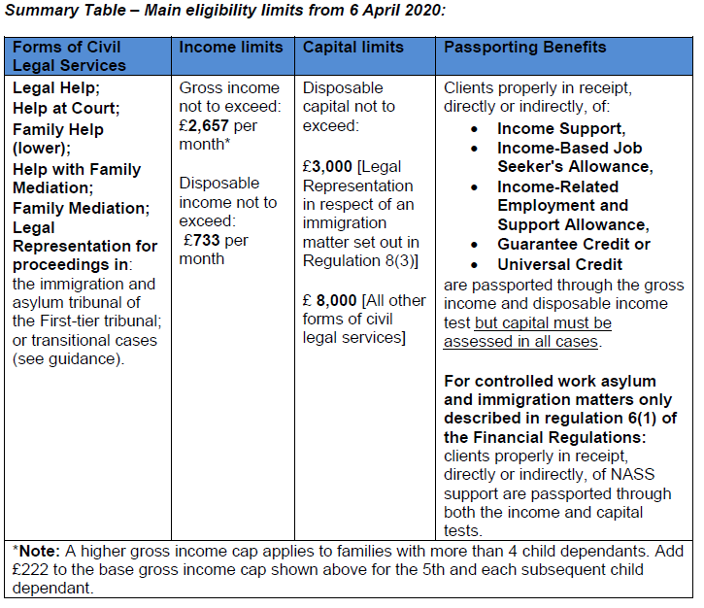

Slide 8
R (oao GR) v Director Of Legal Aid Casework [2020] EWHC 3140 (Admin).
The Director of Legal Aid Casework has a discretion to value capital other than money on an equitable basis. Although GR concerned a domestic abuse survivor, the discretion applies in all civil areas of law.
This means that it is possible for ‘trapped’ capital to be excluded by affording it a ‘nil’ value and this should be considered in all cases where the client would pass the means assessment but for the existence of the ‘trapped’ capital.

Slide 9
Mortgage cap removal
The LAA has legislated to remove the existing cap on the amount of mortgage debt that can be deducted from a property’s value, so that all mortgage debt will be deducted. The current limit is £100,000.
This means that more individuals will pass the financial eligibility criteria for civil legal aid.
This change will come into effect from 28 January 2021.

Slide 10
LAA stats on provider numbers
Number of Providers :
Category of Law | Dec-10 | Apr-11 | Apr-12 | Apr-13 | Apr-14 | Apr-15 | Apr-16 | Apr-17 | Apr-18 | Start of current contract, 01/09/2018 | % change Dec 2010 to Sep 2018 | Apr-19 | Apr-20 | Sep-20 | Oct-20 | Nov-20 | Dec-20 | Jan-21* | % change Sep 2018 to Jan 2021
Claims against Public Authorities | 66 | 65 | 63 | 58 | 54 | 53 | 65 | 65 | 64 | 82 | 24% | 80 | 74 | 74 | 72 | 72 | 72 | 72 | -12%
Community care | 88 | 87 | 85 | 83 | 71 | 91 | 87 | 81 | 76 | 92 | 5% | 94 | 88 | 86 | 86 | 84 | 84 | 84 | -9%
Discrimination | 0 | 0 | 0 | 0 | 0 | 0 | 0 | 0 | 0 | 0 |  | 0 | 17 | 17 | 16 | 16 | 16 | 16
Education | 25 | 25 | 24 | 0 | 0 | 0 | 0 | 0 | 0 | 0 |  | 0 | 8 | 8 | 8 | 8 | 8 | 8
Housing & Debt | 368 | 367 | 346 | 368 | 345 | 323 | 305 | 286 | 254 | 286 | -22% | 295 | 265 | 260 | 254 | 252 | 252 | 252 | -12%
Immigration & Asylum | 194 | 199 | 197 | 239 | 226 | 199 | 182 | 166 | 141 | 198 | 2% | 203 | 189 | 186 | 184 | 183 | 182 | 182 | -8%
Family | 1781 | 1721 | 1557 | 1352 | 1269 | 1211 | 1160 | 1090 | 1003 | 1017 | -43% | 1029 | 992 | 986 | 977 | 974 | 972 | 971 | -5%
Clinical Negligence | 175 | 172 | 169 | 166 | 156 | 142 | 107 | 106 | 100 | 99 | -43% | 100 | 99 | 99 | 97 | 97 | 96 | 96 | -3%
Mental Health | 188 | 184 | 172 | 168 | 160 | 176 | 169 | 158 | 147 | 156 | -17% | 156 | 148 | 148 | 144 | 141 | 140 | 139 | -11%
Public Law | 90 | 90 | 87 | 83 | 79 | 74 | 92 | 89 | 84 | 111 | 23% | 110 | 100 | 100 | 99 | 99 | 99 | 99 | -11%
Welfare Benefits | 288 | 288 | 286 | 0 | 14 | 15 | 15 | 16 | 14 | 51 | -82% | 52 | 41 | 41 | 41 | 41 | 40 | 40 | -22%
 |  |  |  |  |  |  |  |  |  |  |  |  |  |  |  |  |  | * figures to 13 January

Slide 11
How to feed into the means test review?
Contact:
Phoebe Clapham Head of Legal Aid Means Test Review – MoJ
Phoebe.Clapham@justice.gov.uk
kate.pasfield@lapg.co.uk

