Slide 1

Access Social Care
March 2020

Slide 2
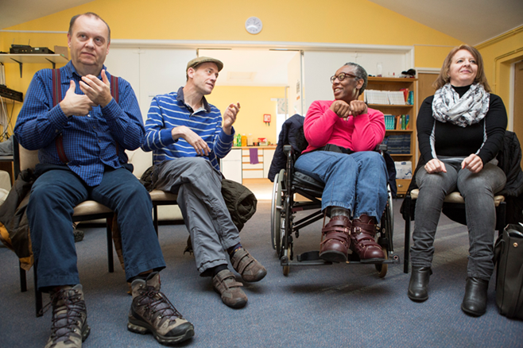
LEGAL NETWORK
Social care can change lives

Slide 3

There has been a staggering 92% drop in the number of legal aid cases taken on since 2010
Without access to justice, the right to social care might as well not exist

Slide 4

Our Legal Aid Research
Written a hypothesis – why legal aid lawyers are not taking on cases
Research to test hypothesis
Look for solutions to maximise the use of legal help

Slide 5
How we work – connecting our expertise to other organisations
Access Legal network
Member org.
Member org.
Member org.
Member org.
Subscriptions based model

Slide 6
Our legal network has 3 workstreams:
Empower
Enforce
Challenge
Providing legal education so people know when to use the law
Providing early legal help to hold public bodies to account
Using data and strategic approaches to drive system level change
Training videos
Case studies and bite sized updates
Ongoing training through the advice line
Resources – info packs, precedent letters
Caseworker advice and casework
Pro-bono clinics
Pro-bono Barristers’ panel
Chatbot
Monthly reports to spot trends
Collaborating with others to influence change locally and nationally
Strategic casework

Slide 7

We have a 98% full or partial success rate with our cases
We have a 98% full or partial success rate with our cases
So we need to make sure that we can help more people

Slide 8
Growth in the South West – partnering with Barnwood
Gloucestershire and SW hub
Community org.
Community org.
Community org.
Community org.
Community org.
Community org.
Local organisations apply to Barnwood to fund their membership fee
Co-produced service model
Local advice co-ordinator works with our cloud based legal team
Technology will help us

Slide 9

Knowing when to refer to a legal aid firm
(a) Asylum and immigration ​
(b) Community care​
(c) Criminal cases​
(d) Debt - partial​
(e) Discrimination ​
(f) Education - partial​
(g) Family - partial​
(h) Housing - partial​
(i ) Mental health and mental capacity ​
(j) Welfare benefits appeals beyond first tier tribunal ​
(k) Other cases / exceptional case funding
Choose the area you most need help with - Check if you can get legal aid - GOV.UK (checklegalaid.service.gov.uk)

Slide 10
Knowing when to refer 2
Availability of legal aid will depend on:
the type of case
the person’s means​

Slide 11
Knowing when to refer 3
Two levels (as apply to community care):​
(a) early legal help – pre-action and some tribunal work ​
(b) full legal representation – legal proceedings requiring application to Legal Aid Agency

Slide 12
Knowing when to refer 4
Are there any urgent issues?​
​
Do you need to gather more information, factual or financial?​
​
Think about possible legal deadlines: e.g. maximum 3 months from date of decision if looking at potential judicial review

Slide 13
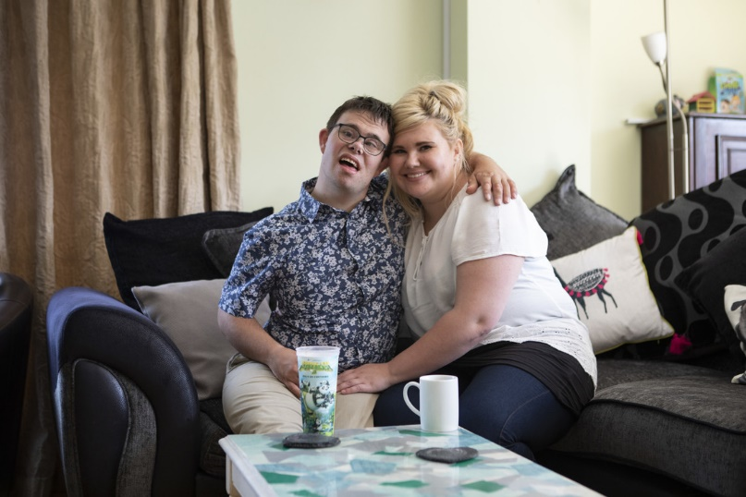
Who makes the referral
No rules on who can refer​
​
Individual affected,
family member,
deputy or power of attorney if this is relevant,
or advice sector organisation (with consent) amongst others​
​
The most important thing is that the referral contains the relevant information needed to proceed to next steps

Slide 14
Information needed to refer - 1
Set out information to assist on legal aid eligibility. ​
Means of live-in partner are aggregated​
Is the person on means tested benefits?
Savings under £3,000 (not taken into account for the purposes of legal aid)​
Savings between £3,001 and £8,000 (they will qualify for legal help but may be asked to contribute to full legal representation) ​
Savings over £8,000 (this would mean the person is unlikely to qualify for legal aid at all unless pensioner disregards apply)​
How old are they?

Slide 15
Information needed to refer - 2
Give effective background information ​
Does the decision relate to a public body? If so, which one?​
Does the decision relate to a care provider specifically? Or in housing, for example, who is the housing provider?​
If you are challenging a specific decision, what was the date of that decision?​
What steps have already been taken?​
What is the ongoing impact on the individual / group of individuals if the situation remains unresolved?​
Why is it urgent and / or what is the point of law in issue?

Slide 16
THE LEGAL NETWORK
Our referral process:
Gather information on
the individual
case
Option 1
Support indiv. to self refer to nearest firms
Option 3
We refer directly to firms with who, we have relationship
Option 2
We refer to nearest firms
​
At each stage we record reasons for referrals not being successful. ​
Many cases skip 1 and 2 due to urgency or strategic issues arising.

Slide 17

Thank
you

Slide 18
Contact details
enquiries@accesscharity.org.uk
www.accesschariy.org.uk

